Slide 1
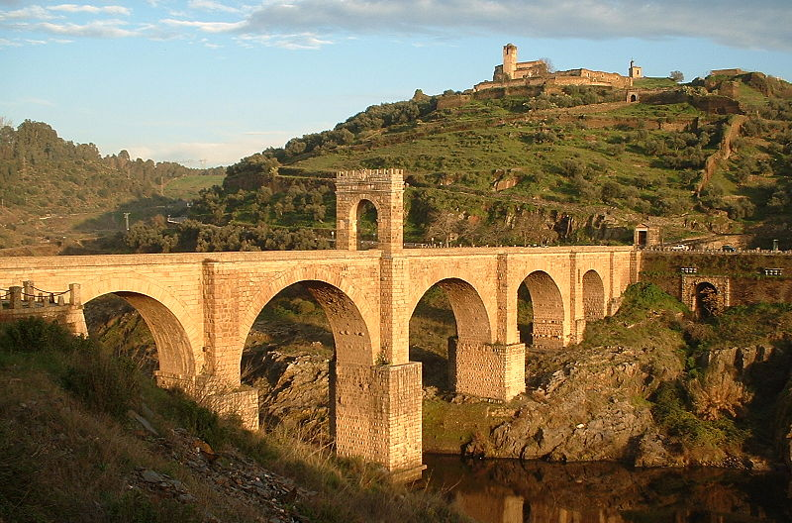

CONSIDERING UNCERTAINTY IN
PLANNING AND DESIGNING
INFRASTRUCTURE
INTEGRATION
Claudio Martani
Alcántara Bridge. Alcántara, Spain between 104 and 106 AD
Notes:
Good morning. Today I’d like talk about flexibility in engineering design. What you see here Alcántara Bridge, Spain. The impressive thing about this Roman bridge is that, despite the fact it has been built 2000 years ago for horses and coaches to pass over, it is (like many others of its kind) still used in modern times, sometimes for cars to drive over. This tells us that the infrastructures are long-lasting structures that lives beyond what we imagine is possible or probable.

Slide 2

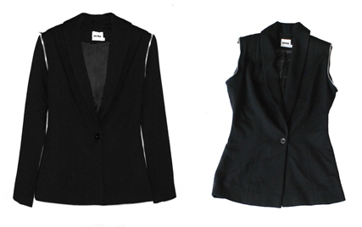

What is flexibility and why consider it as a design approach?
Flexible solutions
May cost
more than
But cost
less than
And the summer will come …
Notes:
As infrastructures live for a long period of time, decisions taken in the early stages of design are critical. Flexibility in this sense can be largely beneficial because, despite requiring an initial investment, it potentially allows big savings in the running costs. All those that is approaching an investment should always consider which is the most cost effective solution in the long run and not just as initial investment.

Slide 3
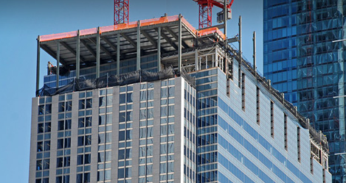
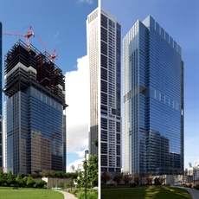
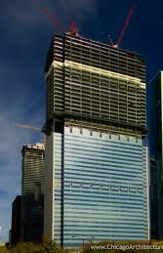
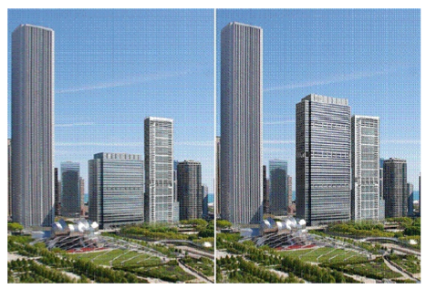
Flexibility in engineering design saves future costs
Vertical expansion of Health Care Service Corporation building in Chicago.
Source: Goettsch Partners release to Wittels and Pearson, 2008)
Notes:
Flexibility has been applied also to engineering design. The Health Care Service Corporation building in Chicago has been built with bigger foundation than needed for possible expansion in stores. Vertical Expansion Project completed in 2010 expanded the building from 33 to 57 stories. This was a big saving for the owner that expanded the capacity just when needed avoiding both to pay interests for unnecessary years and avoiding also the risk of a large initial investment for future needs that might never materialize. The Health Care Service Corporation here did an, effective, cost efficient and low-risk investment.

Slide 4
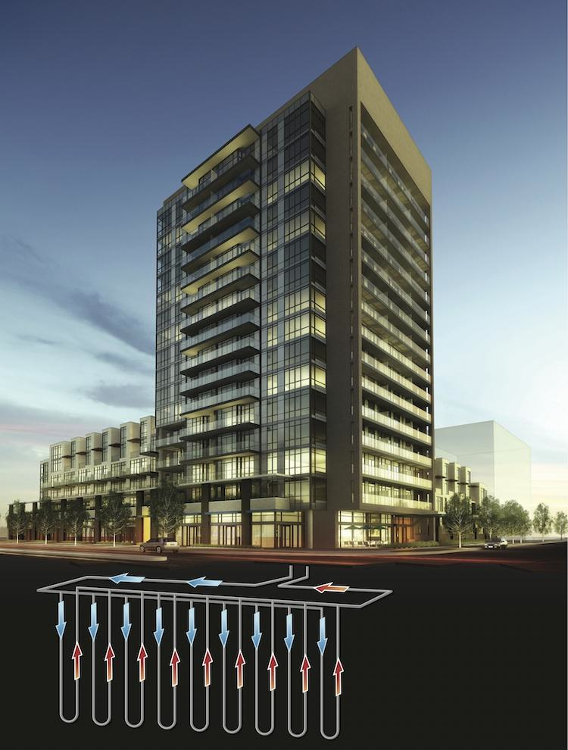
Geo-Thermal Heating Pump (GSHP)
It is an energy storage technology that uses the stable temperature of the soil to enter, or extract heating according to seasonal needs.
GSHP systems require quite significant initial investments to be installed.
Notes:
Verical expansion is not the only possibility for applying flexible design to deal with uncertainty over future. With the current keen emphasis on renewable energy sources, the integration of a geo thermal heat pump system into a new office building, certainly represents a relevant example of infrastructure integration. In GSHP a flexible approach can be very beneficial, as a system of this type, in most cases (and depending on the building shape on the land) requires to drill some of the bars under the building. For this reason the initial investment on it is crucial.

Slide 5
Flexibility in integration a GSHP system into a new building
Notes:
A method has been developed at CSIC - in line with the vision of reducing management costs through whole life approach – to evaluate the best initial investment strategy for infrastructure integration and a test has been run on the integration of a GSHP system into a new building. The total costs of three design scenarios were compared over 50 years: All initial with all the system installed in cinstruction, a second with no GSHP system installed and a third with a flexible investment (some bars at the beginning, under the building, and the possibility to integrate it in future if required). Which is the best solution? It depends…

Slide 6

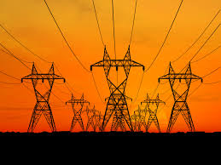
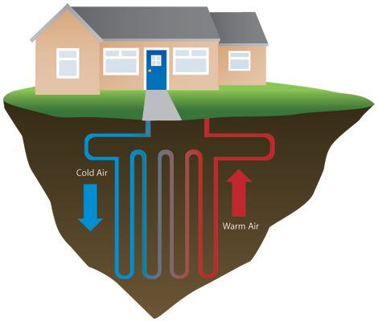

Considering a number of key and tricky variables
1. Price of
gas
2. Price of
electricity
3. Coefficient
of performance
of the GSHP
4. Energy
demand (for
heating and
cooling)
Notes:
It depends on many variables: from the energy prices and demand as well as from the performances of the system in the context of where it is installed. All these conditions are variable and a the method proposed by the CSIC aims to suggest which design solution is trusted to be most successful under uncertain conditions, through simulations based on randomness modeling of variables.

Slide 7

Modelling the uncertainty over variables
1. Price of gas
2. Price of electricity
3. Coefficient of performance of the GSHP
4. Energy demand (form heating and cooling)
Notes:
The first step of our method is the randomness modelling. Predictions of all variables are taken from various sources: price of gas and electricity were assigned according to predictions of the National Grid (2011), the demand both for heating and cooling according to estimations from GIEnergy and from the ASHRAE, the COP was given according to the characteristics of the soil in London (2.95 on average). All the prevision were taken as mean value and a degree of uncertainty was modeled around these.

Slide 8
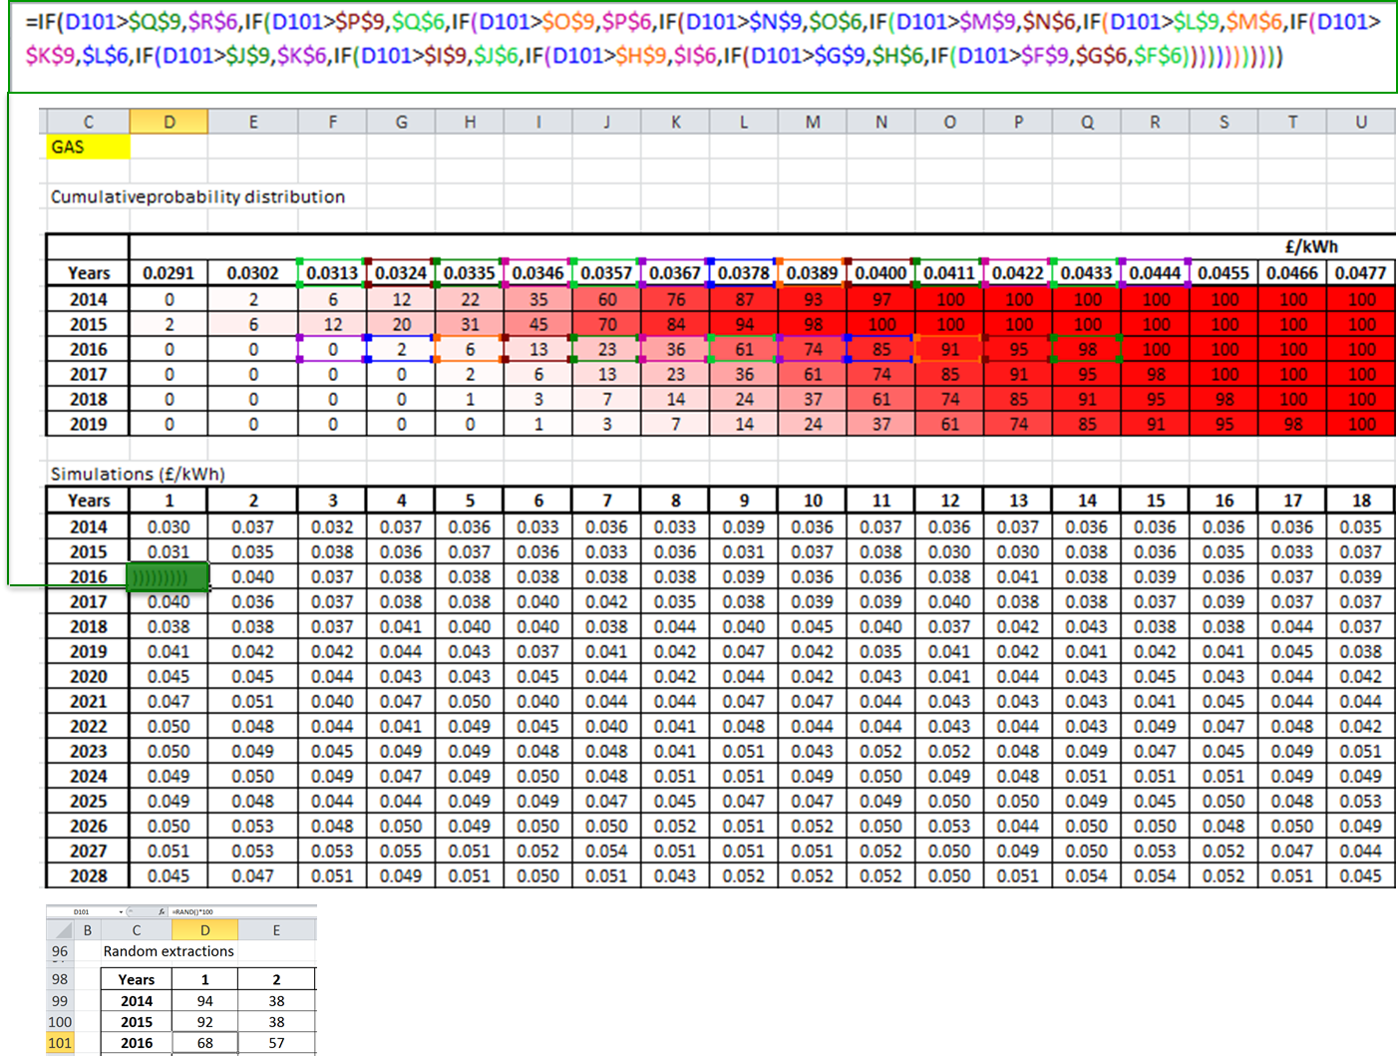
Random simulation of variables with Monte Carlo method
1. Price of gas
2. Price of electricity
3. Coefficient of performance of the GSHP
4. Energy demand (form heating and cooling)
Notes:
Uncertainty modeled were than simulated 1000 times using the Monte Carlo method – a stochastic operation to estimate deterministic values out of probability distribution - to convert the probability distributions in deterministic values and simulate 50 years of performance of the plants.

Slide 9
… to compute costs over 50 years
Trigger investments
RHI (Incentives)
Notes:
After having defined the trigger conditions for investors, the annual running cost and the opportunity for eventual investments were computed for 50 years - based on the assumption for investments as well as on: energy demand and costs and on the COP - leading to a simulated total cost for the time period, by applying the Monte Carlo Method. The results of each simulation is a the total cost of the investment over 50 years under the defined conditions.

Slide 10
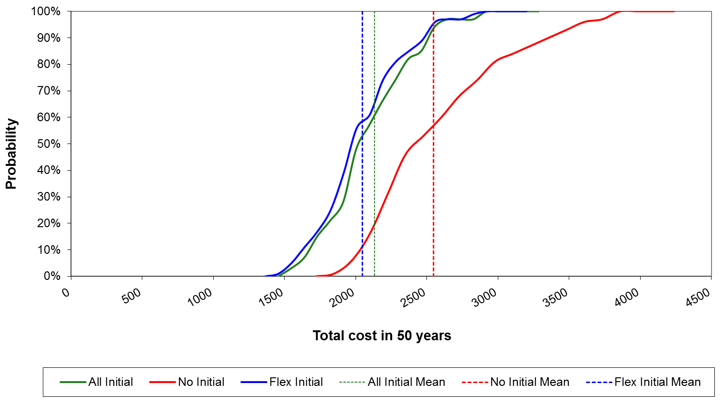
Most likely total cost for design approach
Decisions on investment taken rationally on the average prices of energy from projections (with incentives). Discount rate: 6% | Average COP: 2.9/3
Notes:
1000 simulation for each design approach allows to build probability distributions of costs. The most probable total cost in 50 years of the combined cost for building construction, heating and cooling is estimated to be £2,136,830 in net present value (NPV) against the £2,192,870 of the All Initial investment approach and the 2,254,820 of the No Initial investment one. This result is due to the possibility offered by the flexible approach to operate the investment when it is needed and not before, making substantial savings in the use of capital.

Slide 11
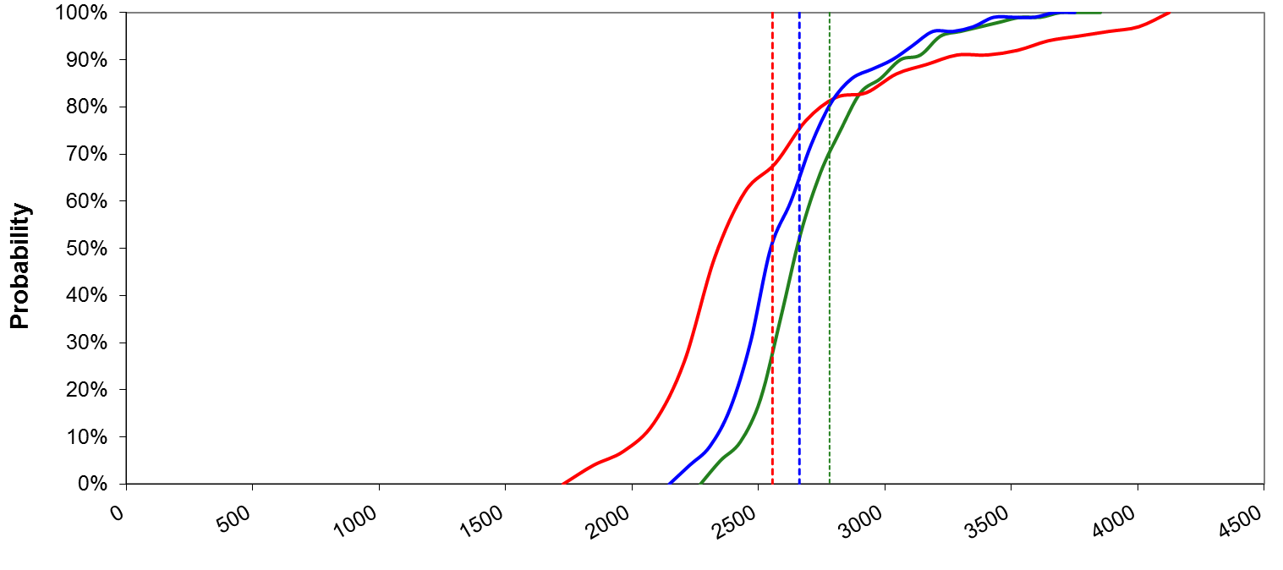
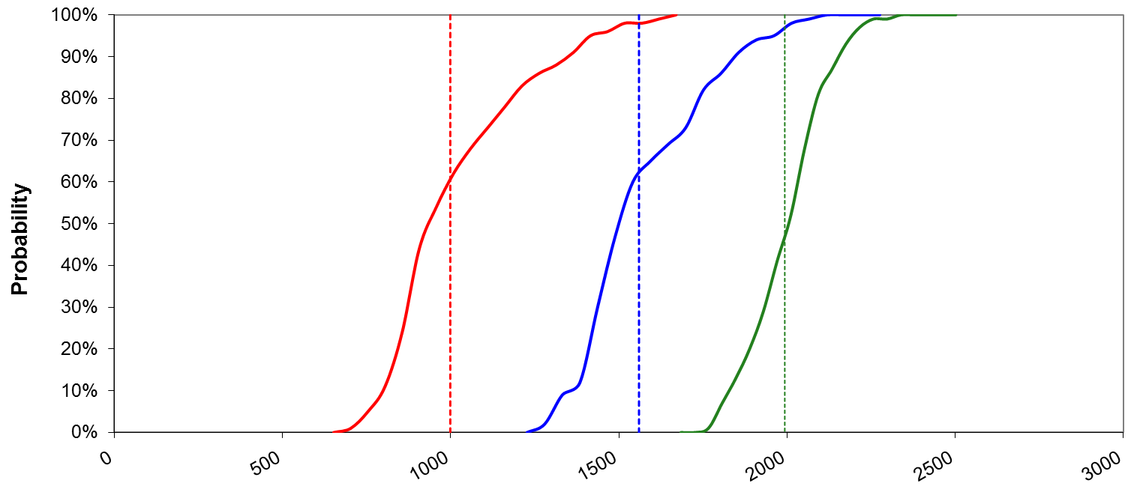
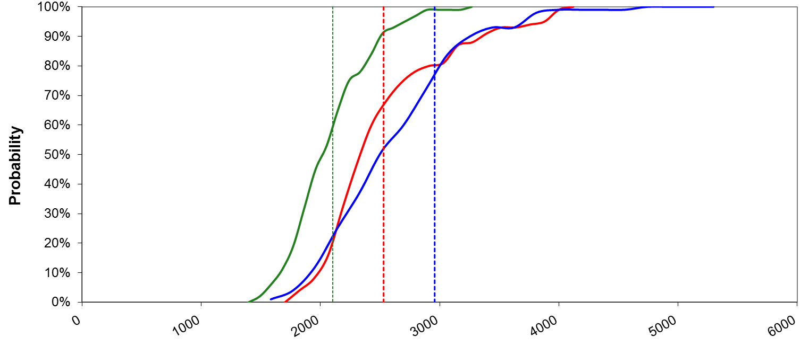
Sensitivity
Average COP: 2.2
No RHI (Incentives)
Considering common management behaviours
Notes:
Is that always the case? No. After having analysed the results, five sensitivity analyses were also conducted to test the system response under a wider range of conditions. Some of the most interesting results of the analysis show that the Flexible approach is not always the best one. Indeed, either by reducing the performance of the system, or by eliminating the incentives from the prevision, or by inserting some behavioural randomness of investors, that is no longer the case.

Slide 12
The value of flexibility depends upon contextual conditions
1. Price of gas
2. Price of electricity
3. Coefficient of performance of the GSHP
4. Energy demand (form heating and cooling)
Notes:
As for the Roman Bridge in Alcantara, also GSHP system and other type of infrastructure last for a long time in which they are subject to uncertainty. In most cases a flexible design is a good strategy for operating initial investment that allow to deal with unknown and unpredictable future, but not always.
The variability of the output depending on conditions seems to suggest the need that suggest the best initial strategy approach considering uncertainty through all the life cycle. As our knowledge on the set of conditions in which we operate changes from case by case there is a clear need for evaluating each case through a solid method that simulates the the most likely future condition in the long term and allows comparison between alternatives.
Design approach evaluation in light of an uncertain future conditions is what the new CSIC method proposes.

Slide 13
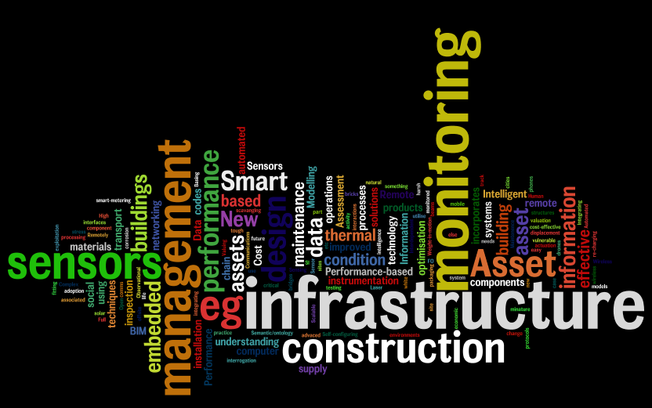
www.centreforsmartinfrastructure.com
Claudio Martani
cm743@cam.ac.uk
Notes:
Thank you!

