Slide 1
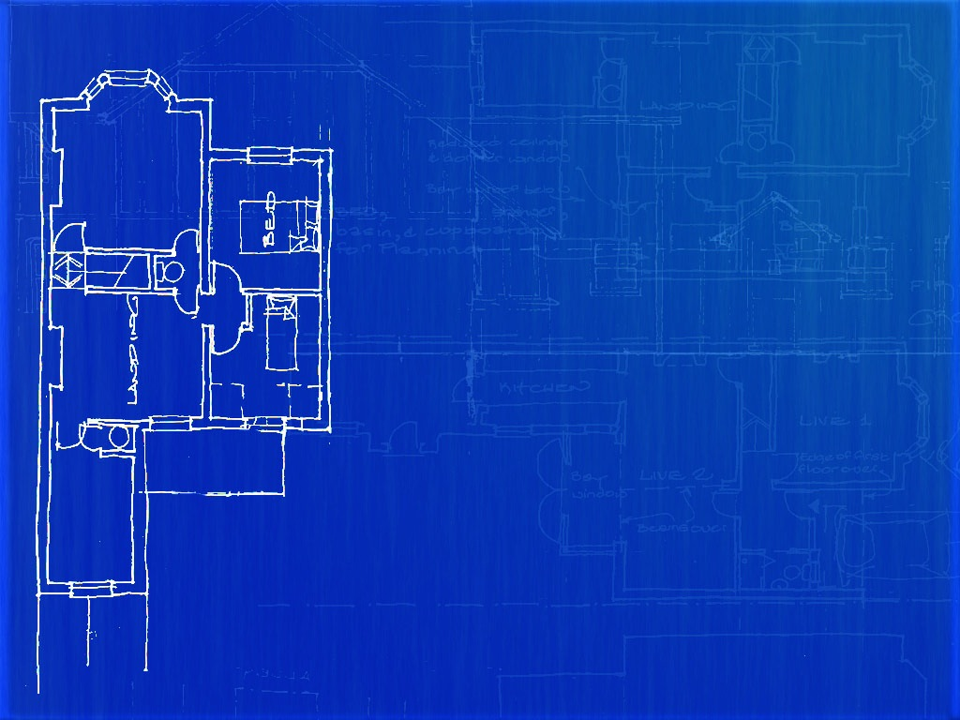

Smart wireless sensing: Shaping the future of civil infrastructure
David Rodenas Herráiz

Slide 2


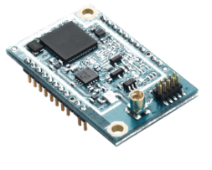

A major goal of the CSIC WSN team is...
To develop robust, reliable, low-power, low-cost and interoperable Wireless Sensor Networks (WSNs) for infrastructure monitoring
APPLICATION
TRANSPORT
NETWORK
Internet Engineering Task Force
Software
DATA LINK
PHYSICAL
Hardware

Slide 3
Taking a look at the WSN operation…
WSN traffic
Data
Control
Such as…
Temperature
Relative humidity
Displacement
Acceleration
To…
form the network
maintain network connectivity

Slide 4
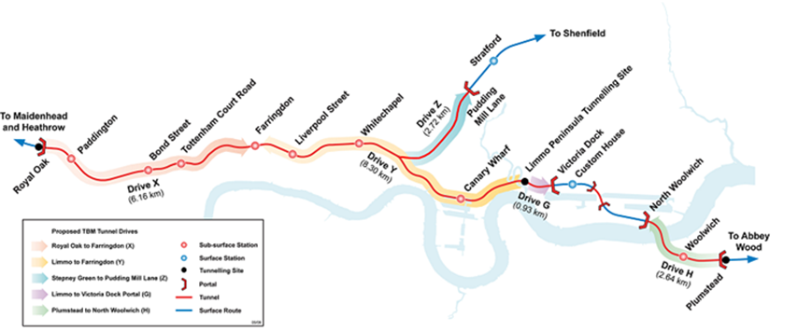
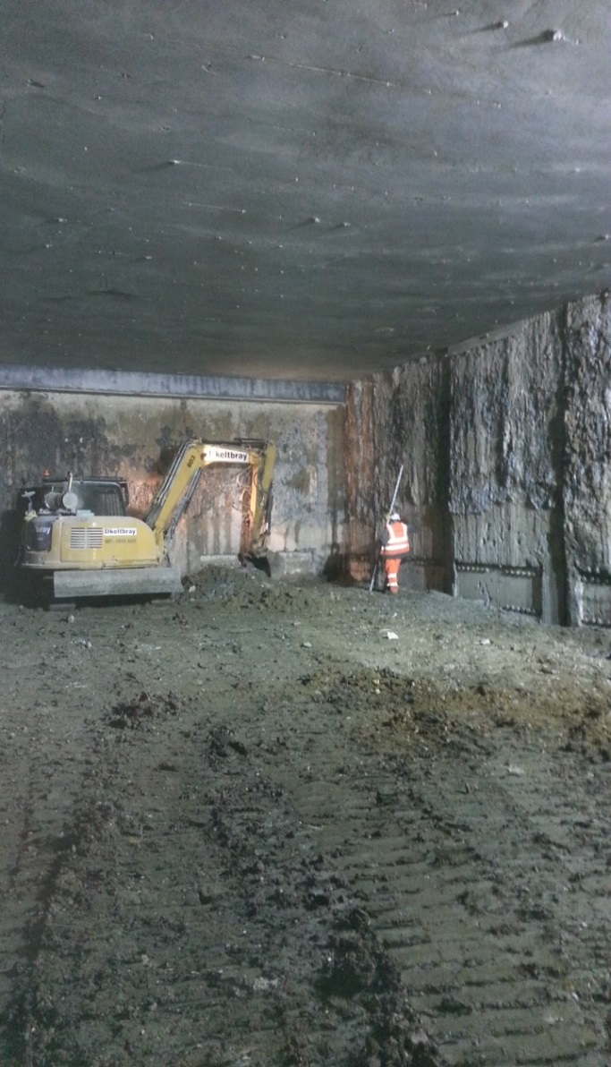
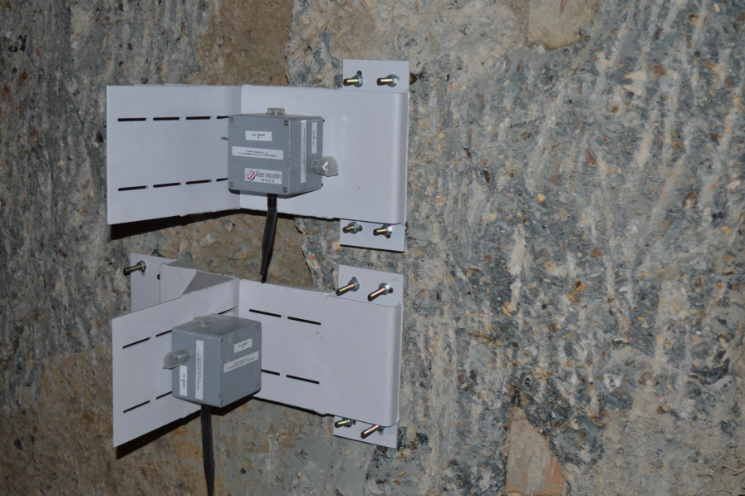
What happens under extremely low data rates?
Example application: Crossrail - Paddington Station

Slide 5
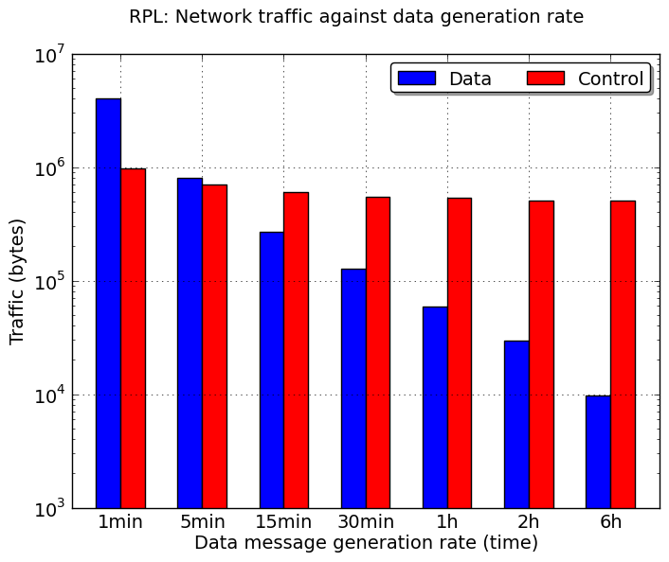
What happens under extremely low data rates?
First set of experiments: Simulation
Data
WSN traffic
Control

Slide 6
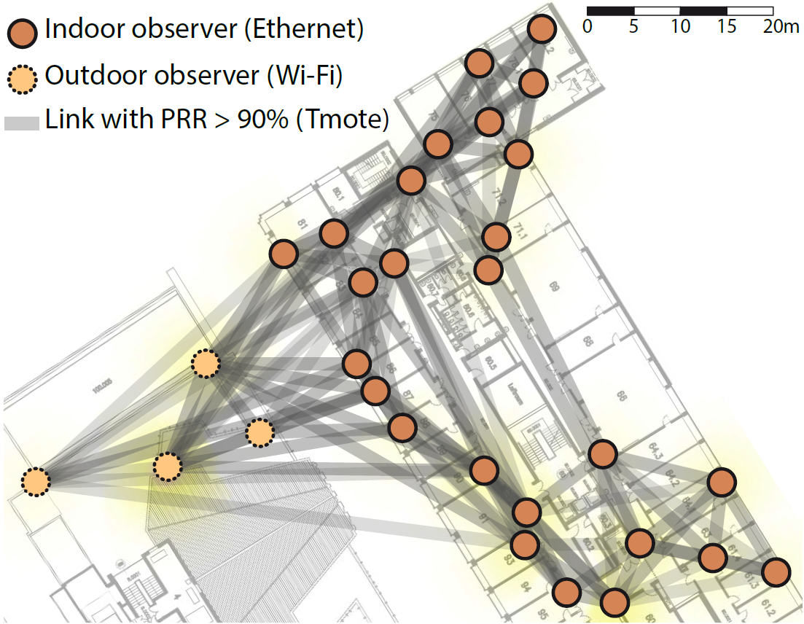
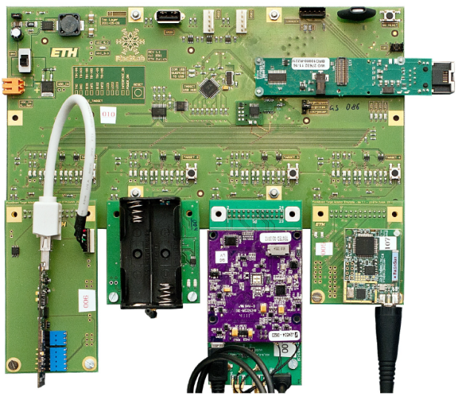
What happens under extremely low data rates?
Second set of experiments: Real world
FlockLab test bed

Slide 7
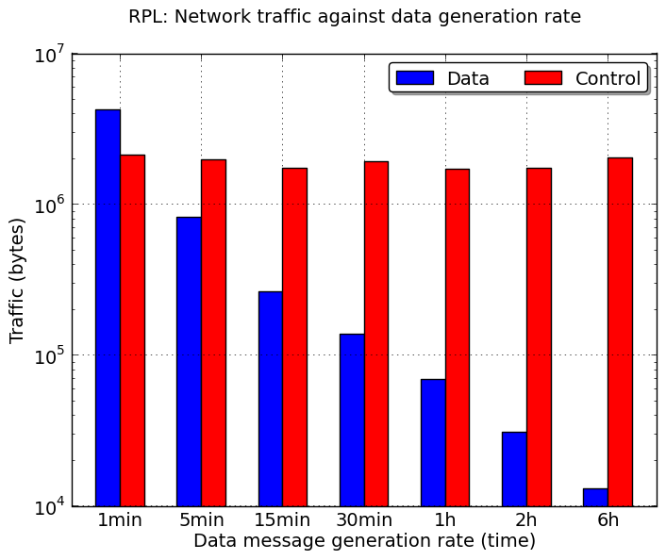
What happens under extremely low data rates?
Second set of experiments: Real world
~80%
~92%
~96%
~97%
~98%
~99%
Data
WSN traffic
Control

Slide 8




So.. what is the problem?
Data
Control

Slide 9



If you say so… but then what?
Replace the standard IETF data routing protocol
for …

Slide 10

So, our goal is to…
Design a new data routing algorithm suitable for infrastructure monitoring applications
Data
Data
WSN traffic
Data
WSN traffic
Control
Control
Current standard IETF solution
Our solution

Slide 11


Which leads us to contribute to our initial objective…
To develop robust, reliable, low-power, low-cost and interoperable Wireless Sensor Networks (WSNs) for infrastructure monitoring
And… why not?

Slide 12

Industry Breakthrough

Slide 13



www.centreforsmartinfrastructure.com
dr424@cam.ac.uk

