Slide 1


Axial shortening in high rise buildings
Cambridge CSIC
John Parker
09.09.14

Slide 2
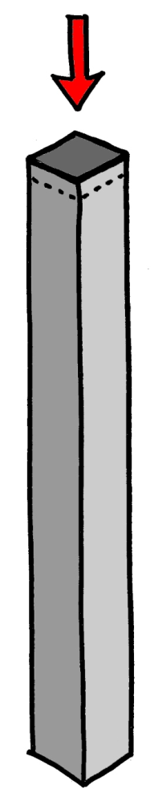
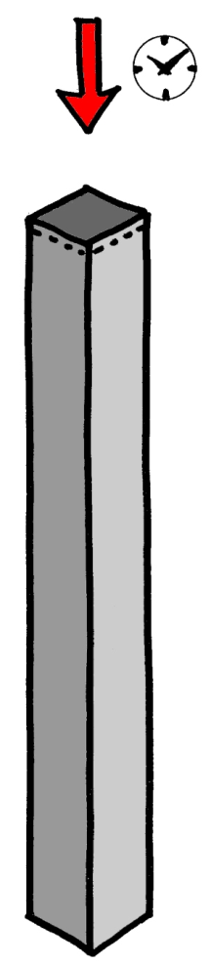

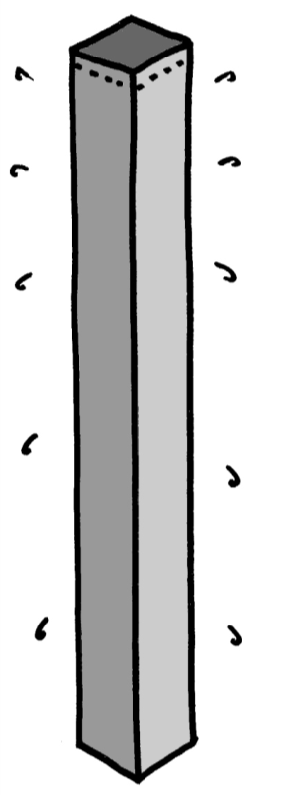
Axial shortening
Elastic
Creep
Shrinkage

Slide 3


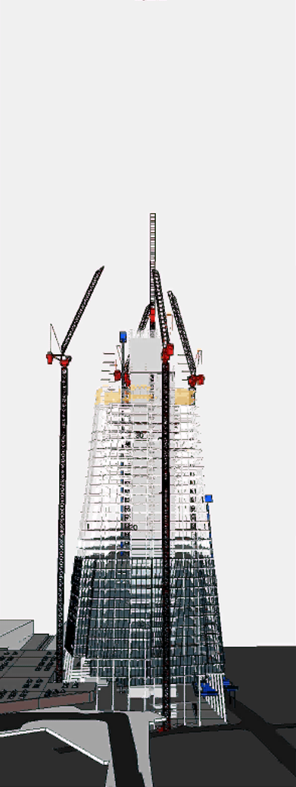
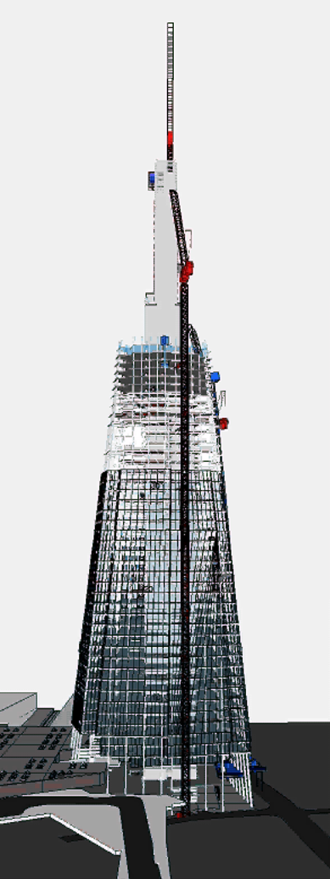
Axial shortening
Construction sequence

Slide 4
Fintel, Ghosh, Iyengar (1986) : parameters
Elastic shortening
  Stress
  Reinforcement
  Young’s modulus of concrete
  Concrete density
  Concrete strength
  Time
Shrinkage
  Drying / residual shrinkage
  Water content of concrete
  Member volume to surface area ratio
  Relative humidity
  Time
Creep
  True / drying / residual creep
  Stress
  Age of concrete at loading
  Member volume to surface area ratio
  Relative humidity
  Specific creep
  Concrete strength
  Time

Slide 5
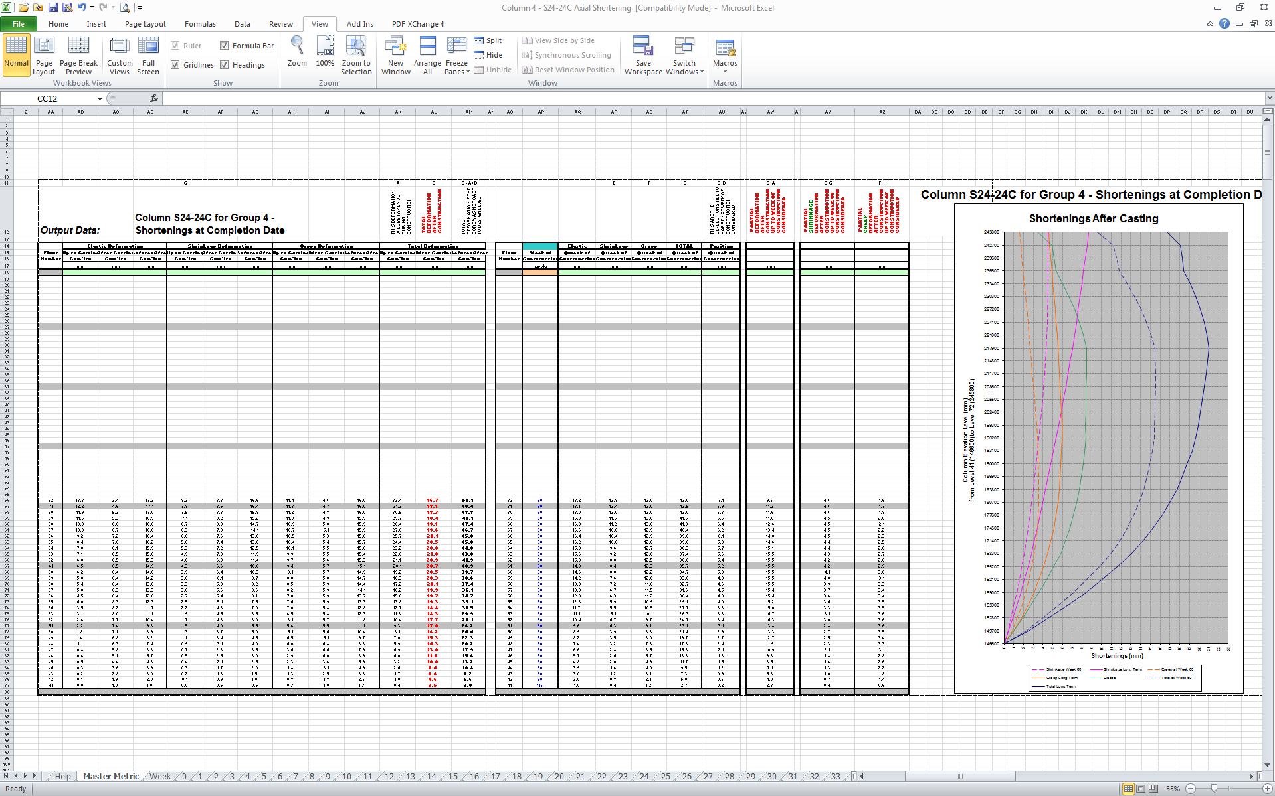

Slide 6
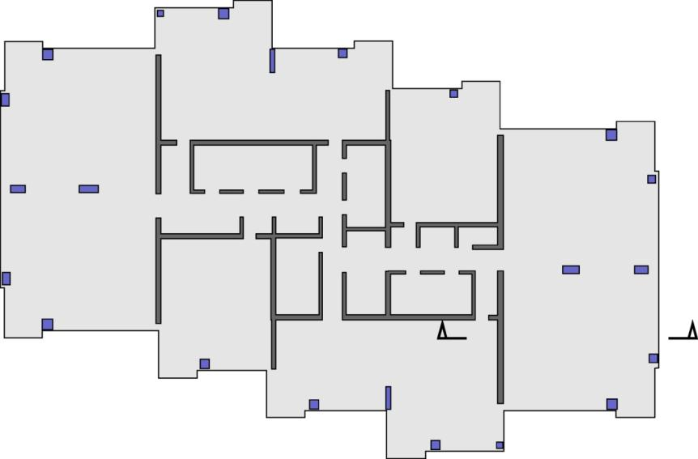

Why does it matter?
Partitions
Building services
Tolerances
Floor to ceiling heights
Overall building height

Slide 7

Shard : structure
Steel
Concrete
Steel
Concrete

Slide 8

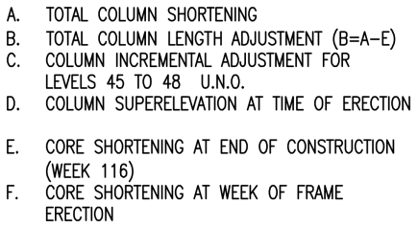
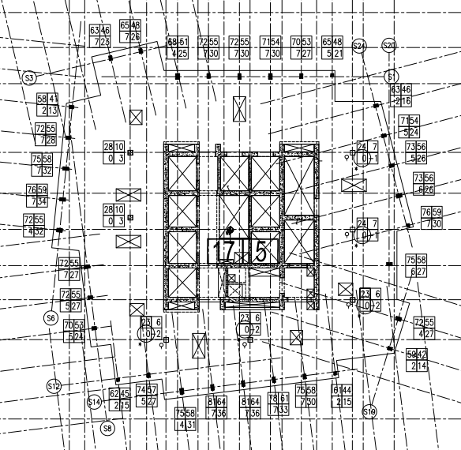

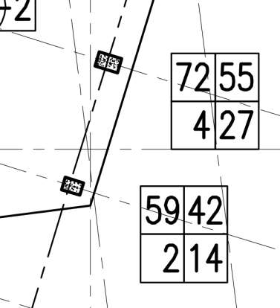
Shard : column presets

Slide 9
Shard : axial shortening records

Slide 10
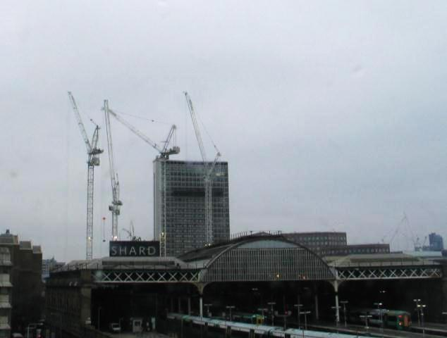
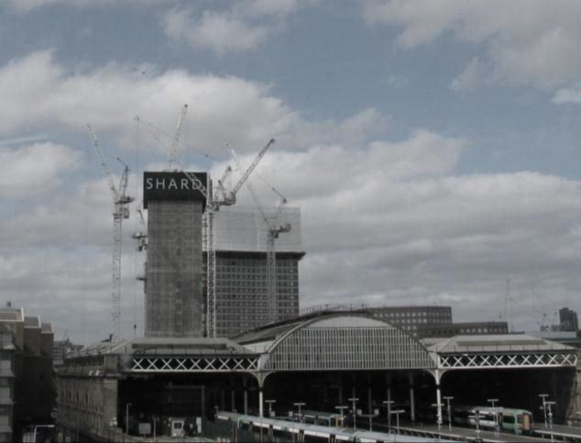
Shard : axial shortening records
Level | Date cast | Monitoring start | Delay
0 | 22/01/10 | 04/03/10 | 6 weeks
10 | 12/02/10 | 25/03/10 | 6 weeks
30 | 30/05/10 | 31/08/10 | 13 weeks
50 | 28/09/10 | 03/11/10 | 5 weeks
08/02/10
22/03/10

Slide 11
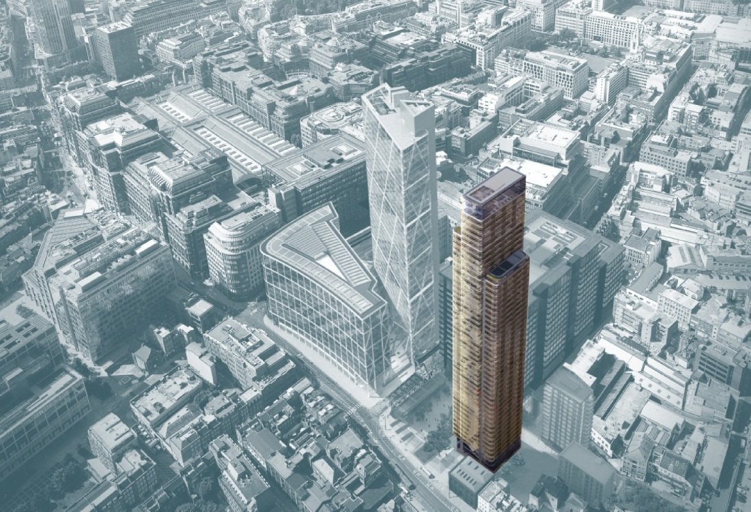
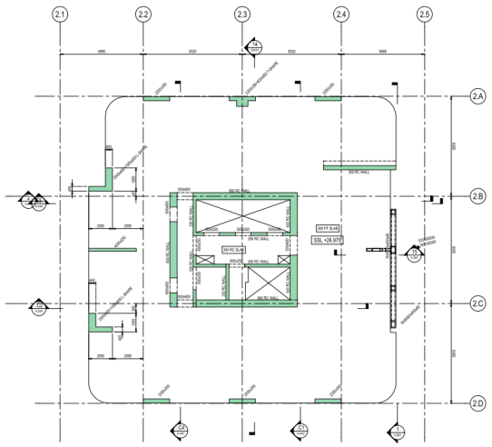
Principal Place

Slide 12
Axial shortening in high rise buildings
Cambridge CSIC
John Parker
09.09.14

