Slide 1

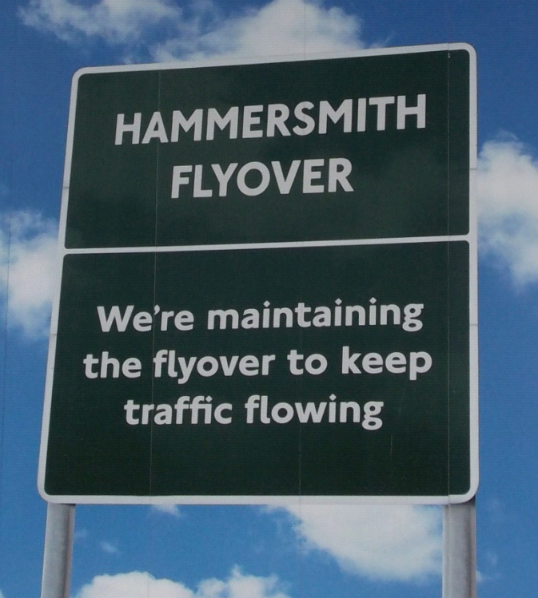
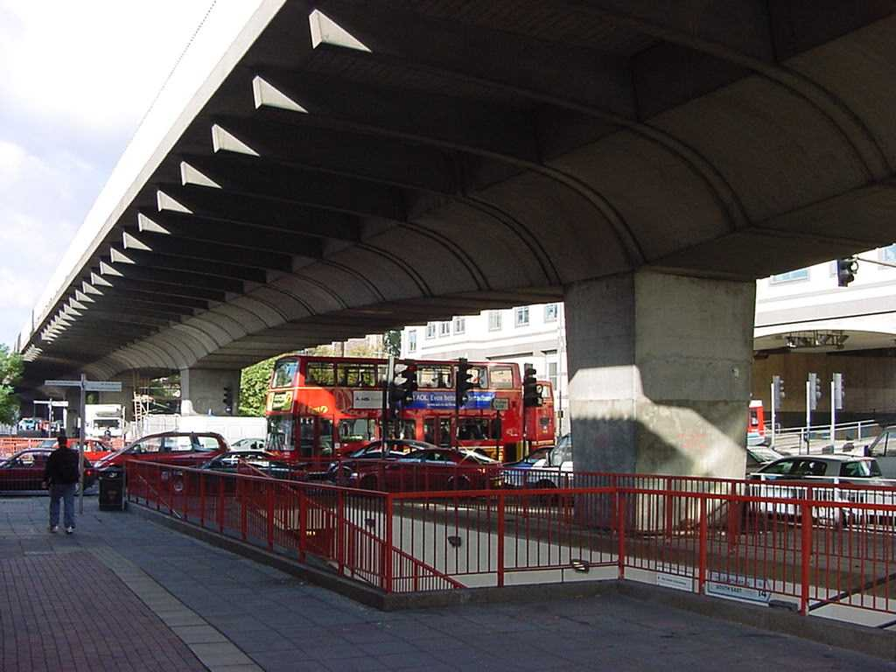
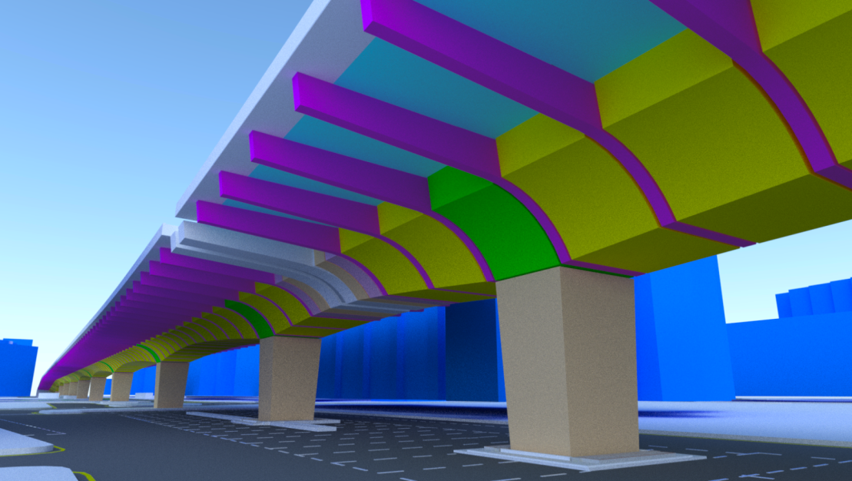


Hammersmith Flyover
Phase II Strengthening

Slide 2
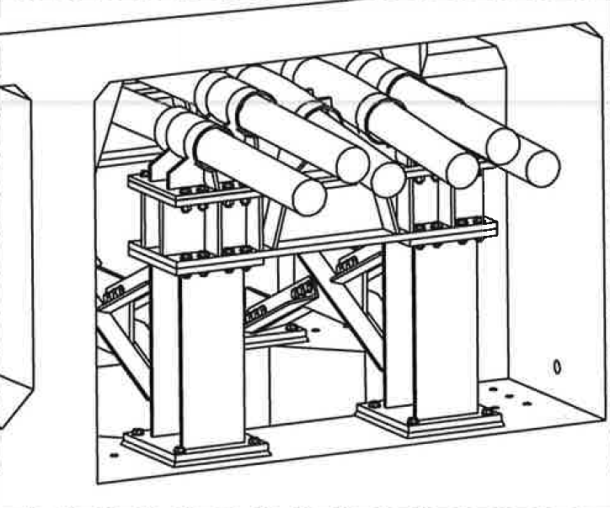
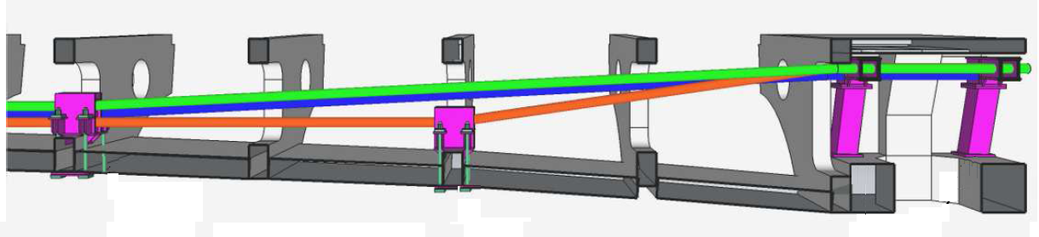
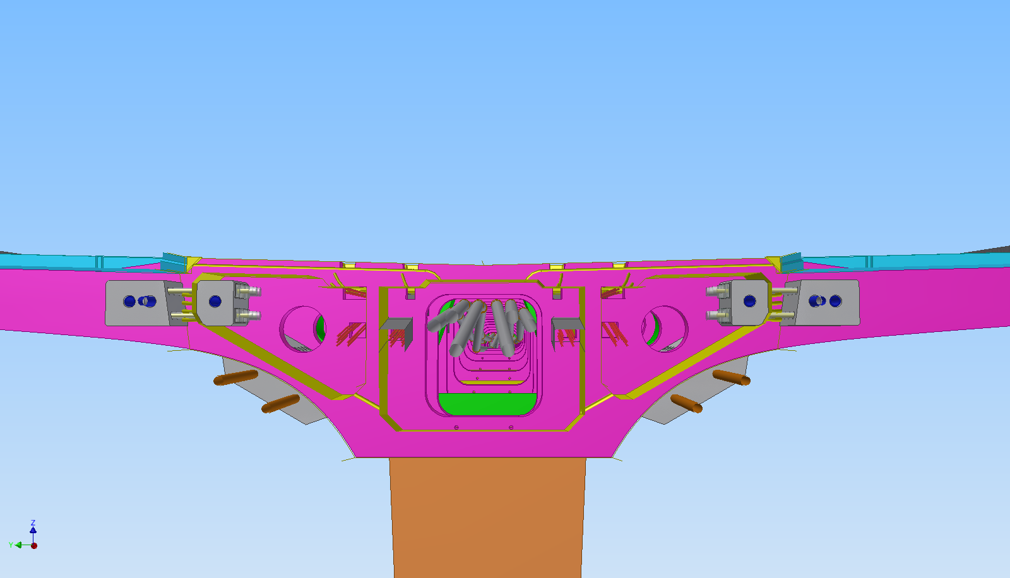
Tendons 2 & 3
Mid-span deviators
Tendon 1
Pier deviators
Main (Internal) ‘Long’ Tendon Arrangement
Isometric of Pier Deviators
Main ‘Long’ Tendons
‘Short’ Pier Capping Tendon Anchors
‘Short’ Mid-span Tendons
Arrangement of new Post-Tensioning

Slide 3
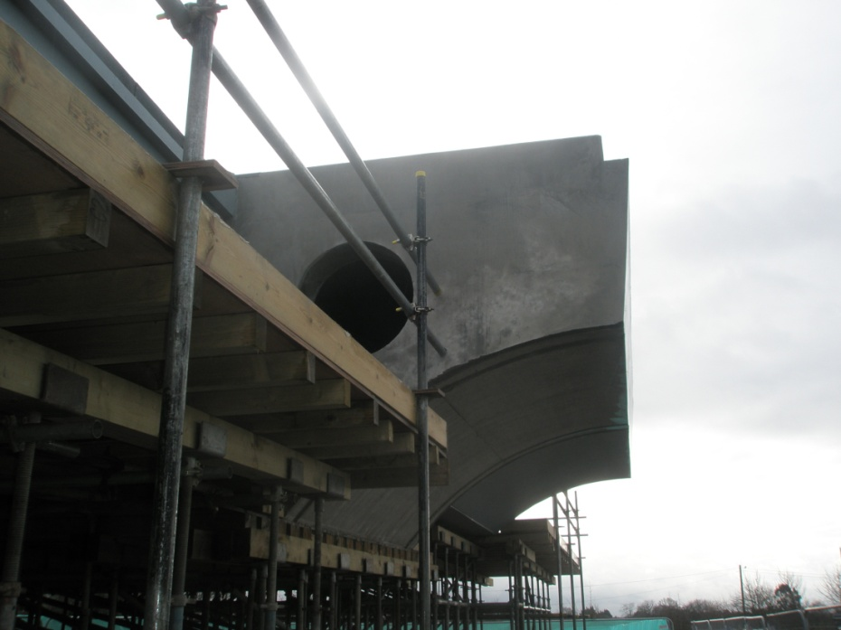
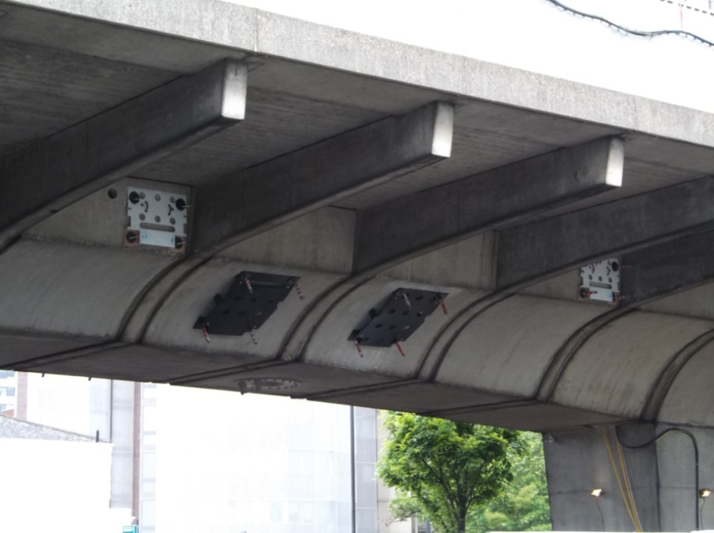
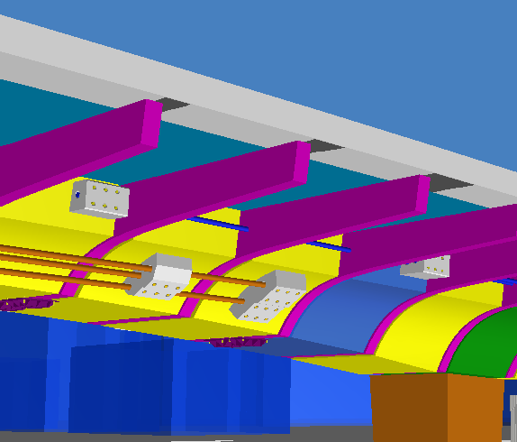
Templates for Positioning Anchor (Blister) Fixing Bolt Installation
‘Short’ Pier Capping Tendon Anchors
‘Mock-up’ used for Training Purposes and Trial Installation of Blisters
Installation of External Tendons
‘Short’ Mid-span Tendons

Slide 4
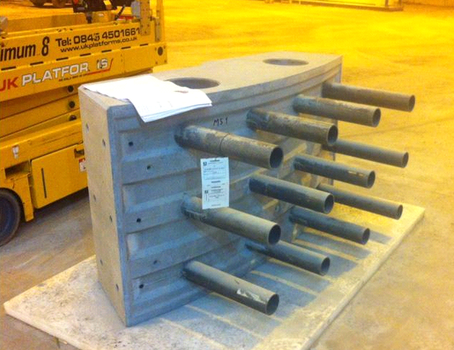
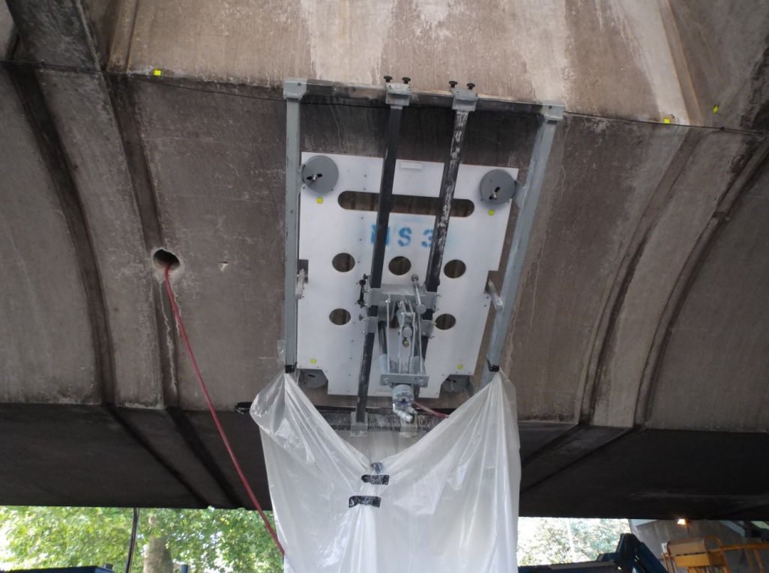
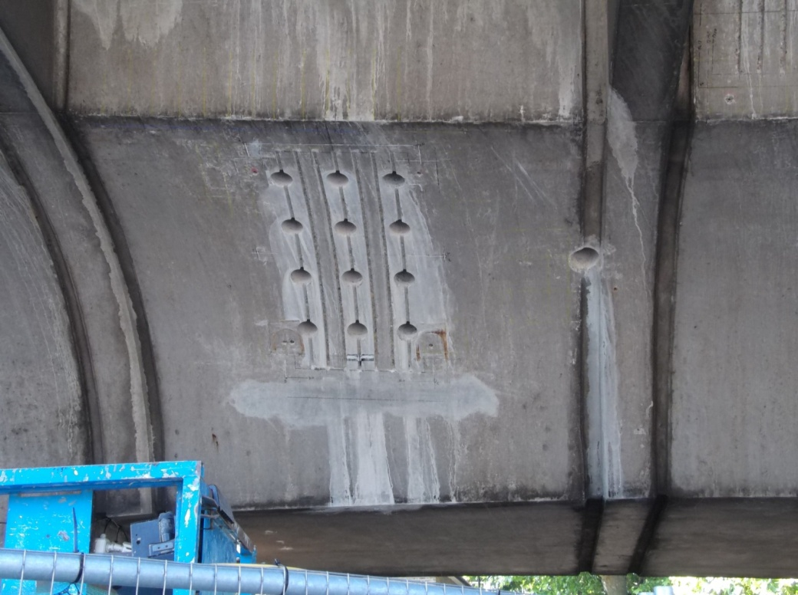
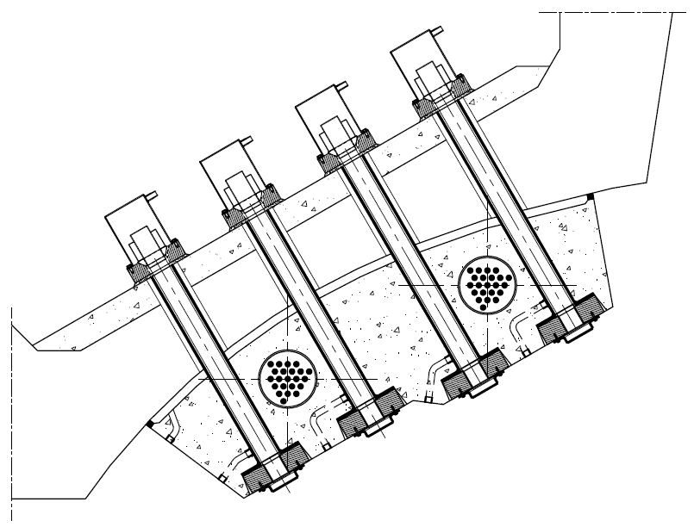
Blister Anchor Hole Drilling Template
Pre-cast Blister
Strengthening
Backing Slab
Cross-Section Through Midspan Tendon Blister
Blister Installation

Slide 5
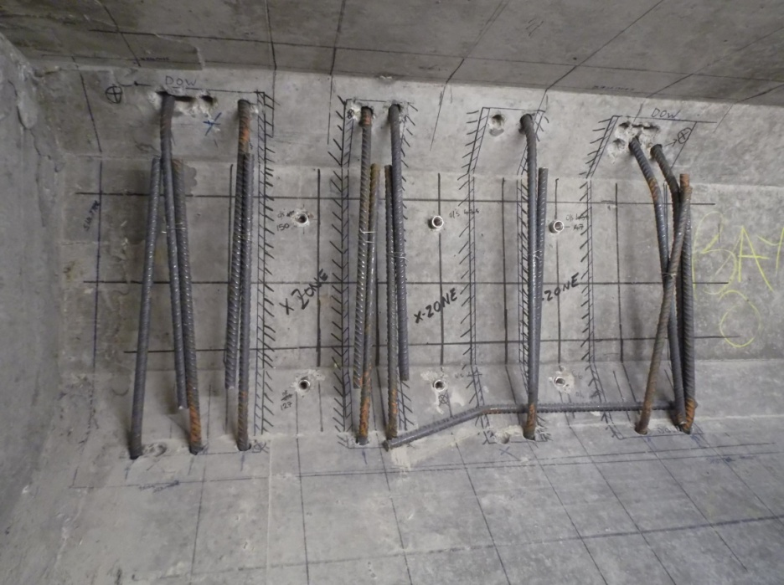
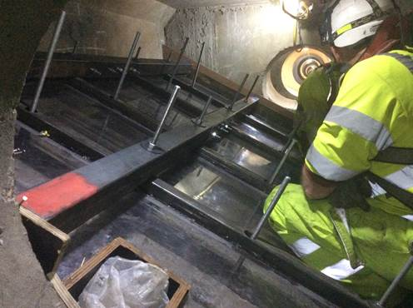
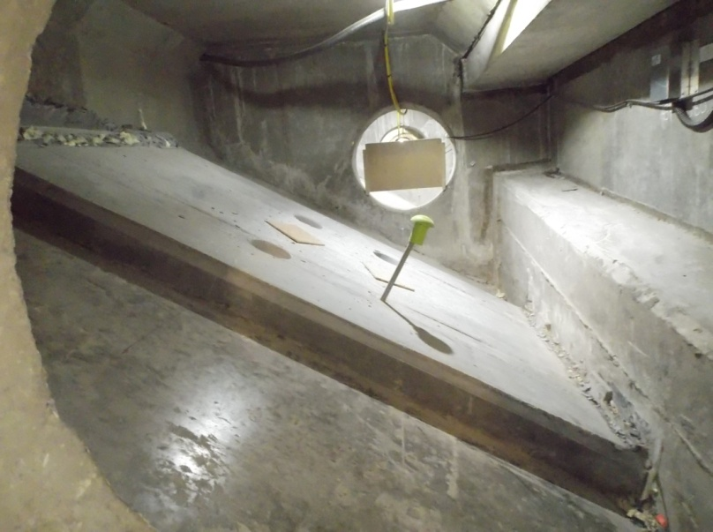
Grouted-in Reinforcement (to replace that cut for the anchor bolt holes and bond strengthening slab to web)
Perspex Formwork (to ensure adequate filling of backing slab)
Backing Strengthening Slab Construction
Completed Strengthening Slab

Slide 6
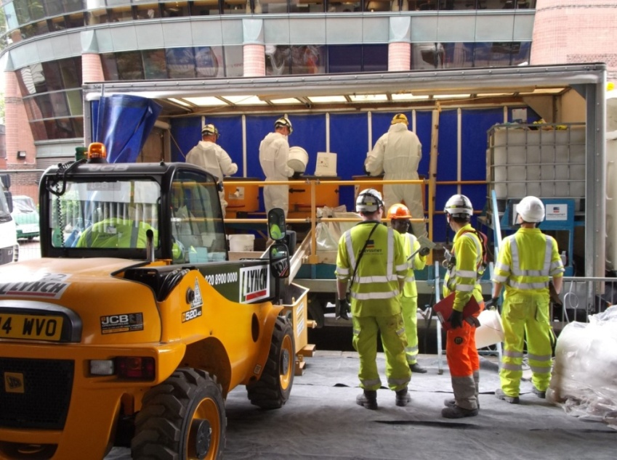
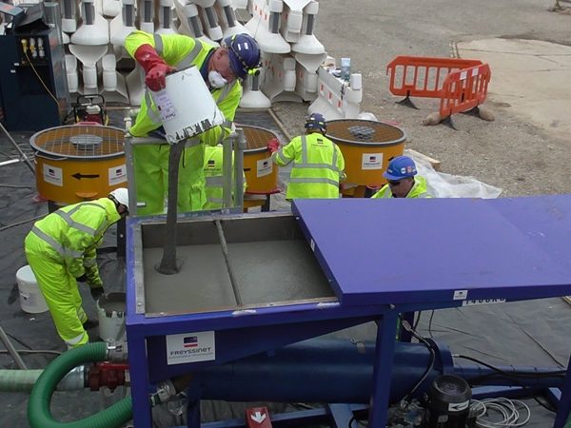
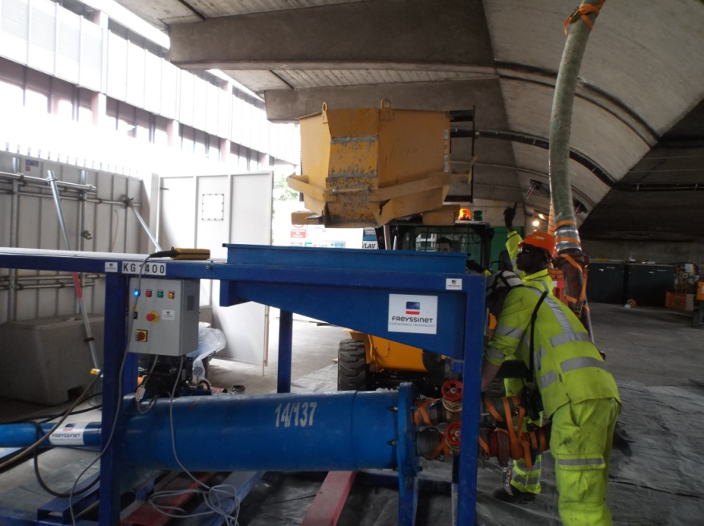
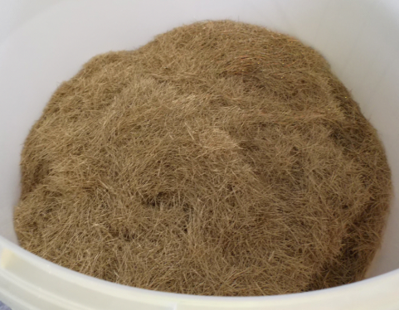
Loading ‘Syringe’ Injector with (UHSFRC)
Mixing Ultra High Strength Fibre Reinforced Concrete (UHSFRC)
Syringe Injector
Steel Fibre Reinforcement
Mixing and Placing UHSFRC

Slide 7
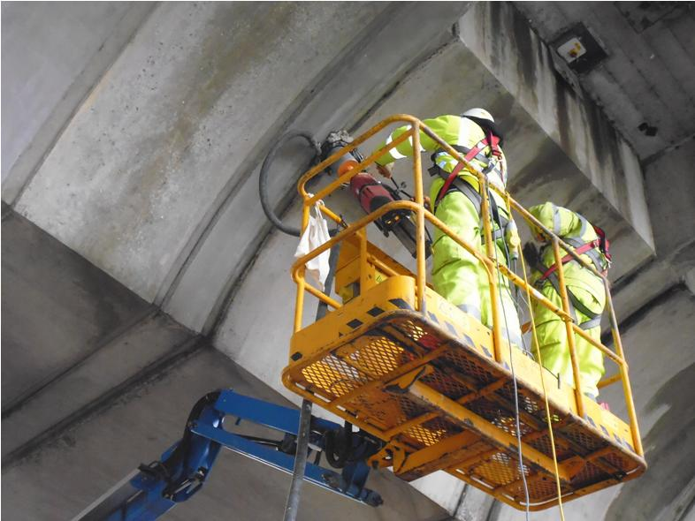
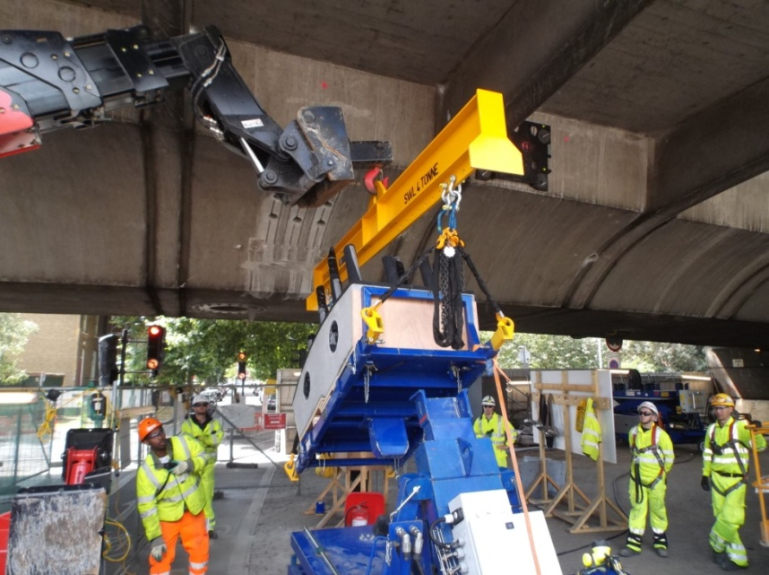
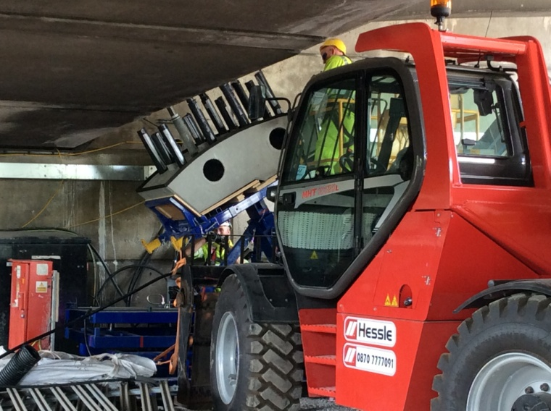
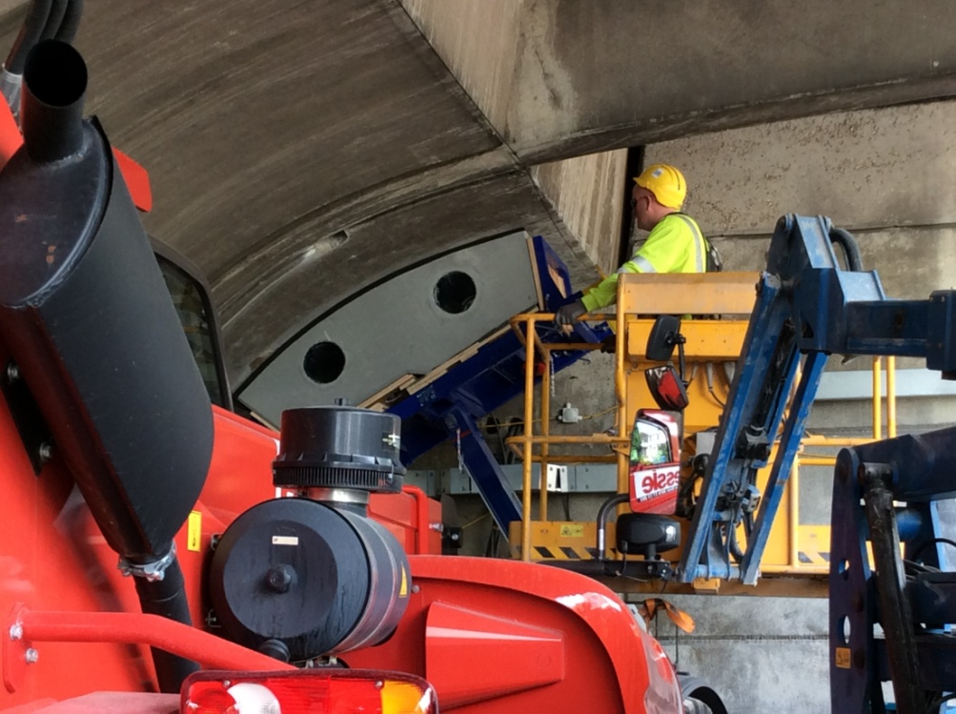
Preparation and Installation of Mid-Span Blisters

Slide 8
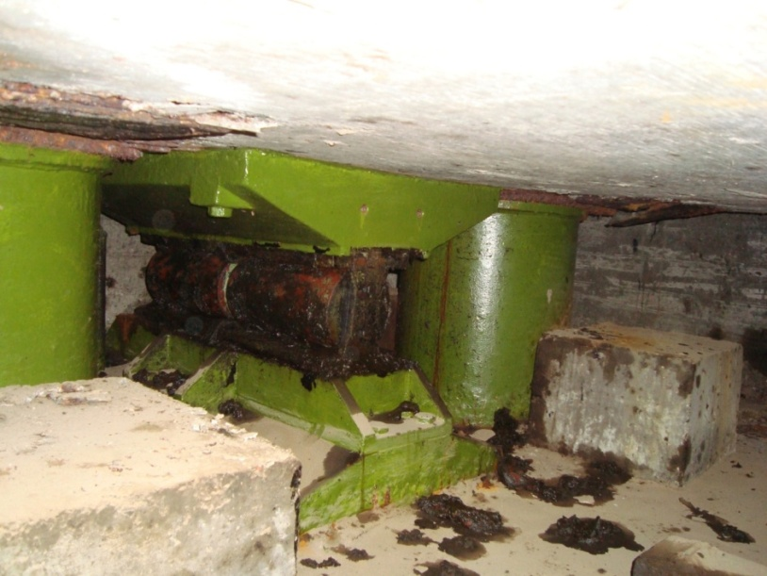
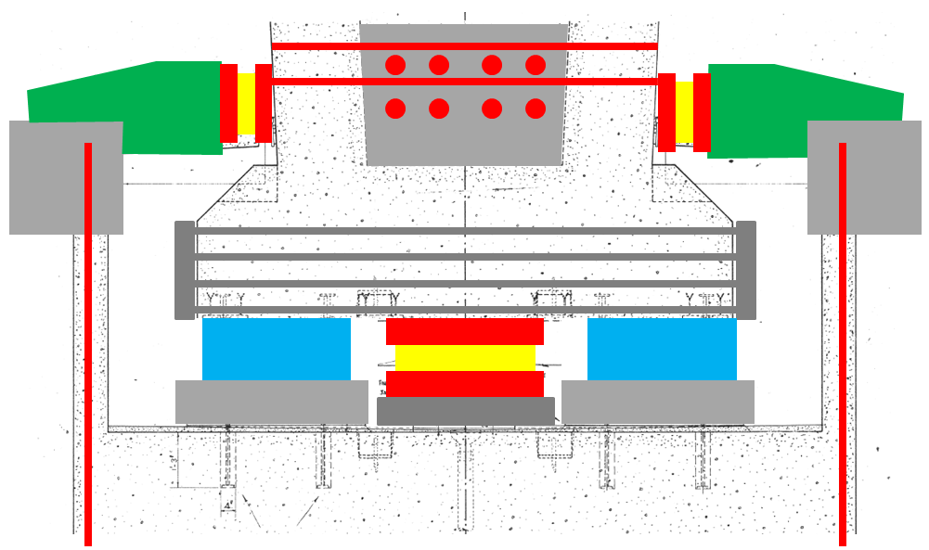
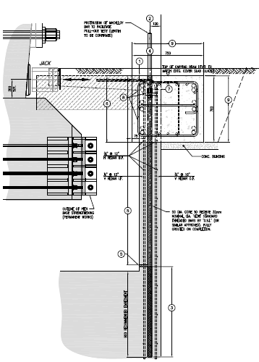
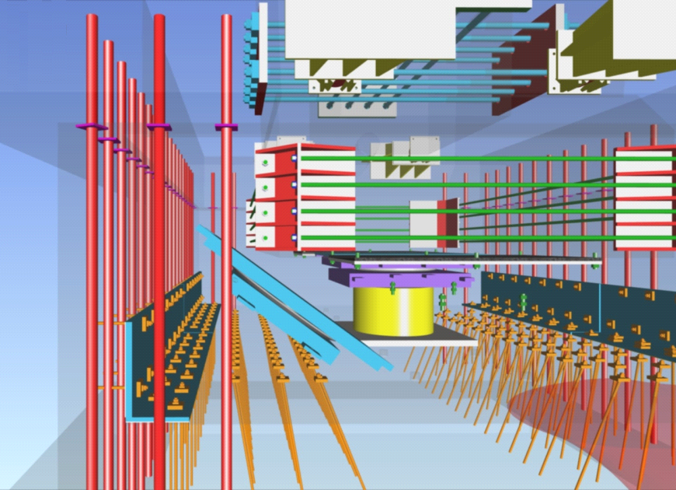
Lateral Stabilising Jacks
New Jacking Ring Beam
Existing Roller Bearings
Bearing Replacement and Foundation Strengthening
Bearing Pit and Pier Foundation Strengthening
New Lateral Jacking Ring Beam

Slide 9
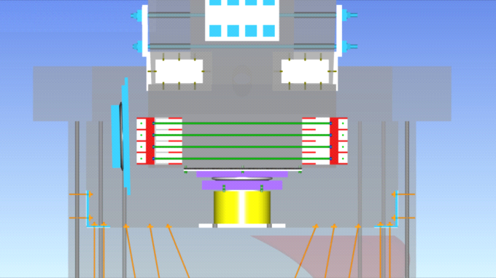
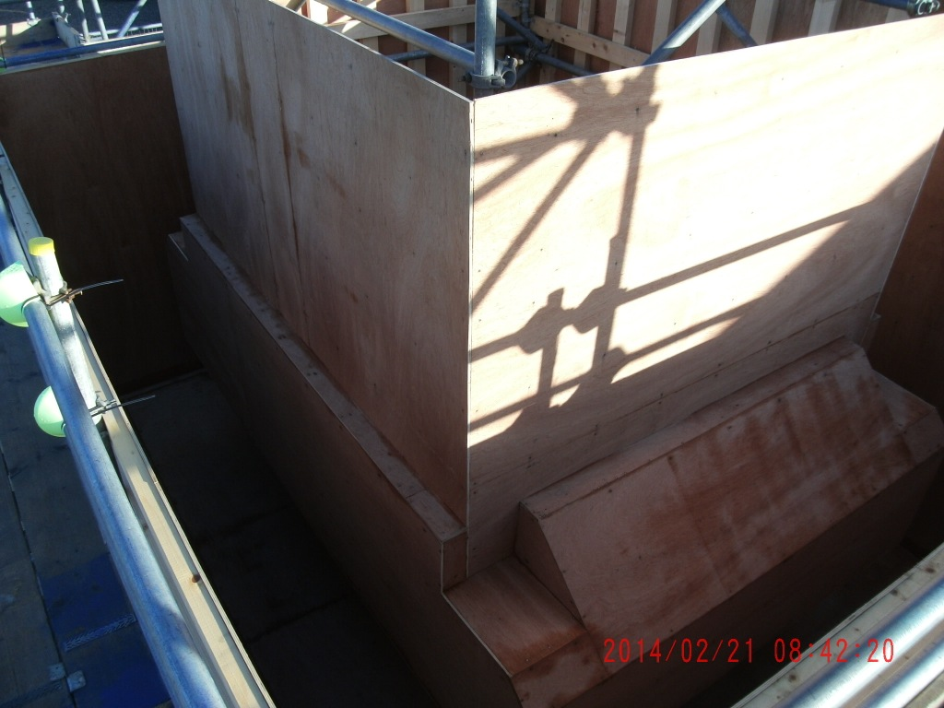
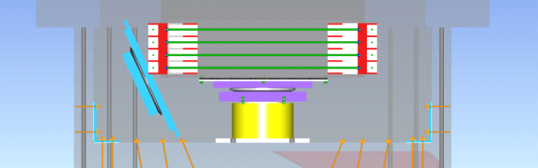
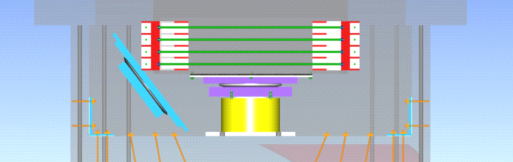
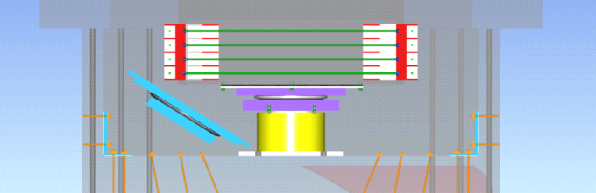
Mock-up of Pier and Bearing Pit to rehearse Bearing Installation Methodology
Modelling Bearing Replacement Installation Methodology
Bearing Installation Methodology modelled in BIM

Slide 10
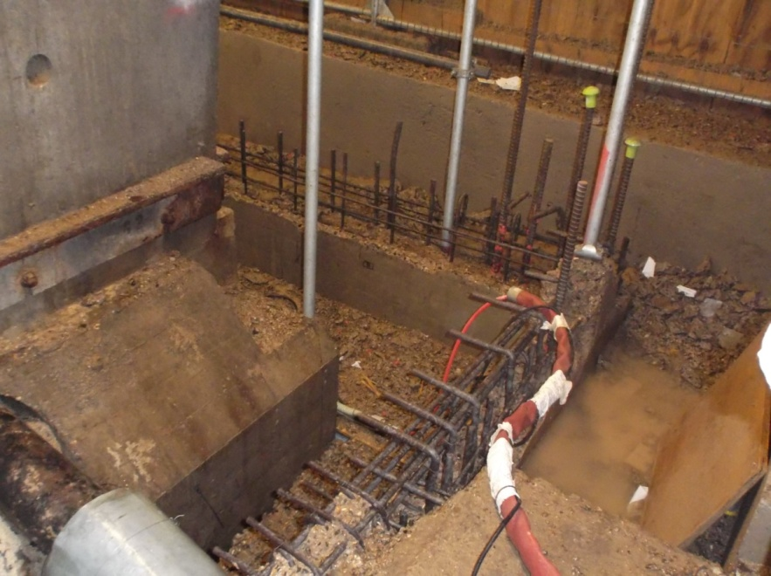
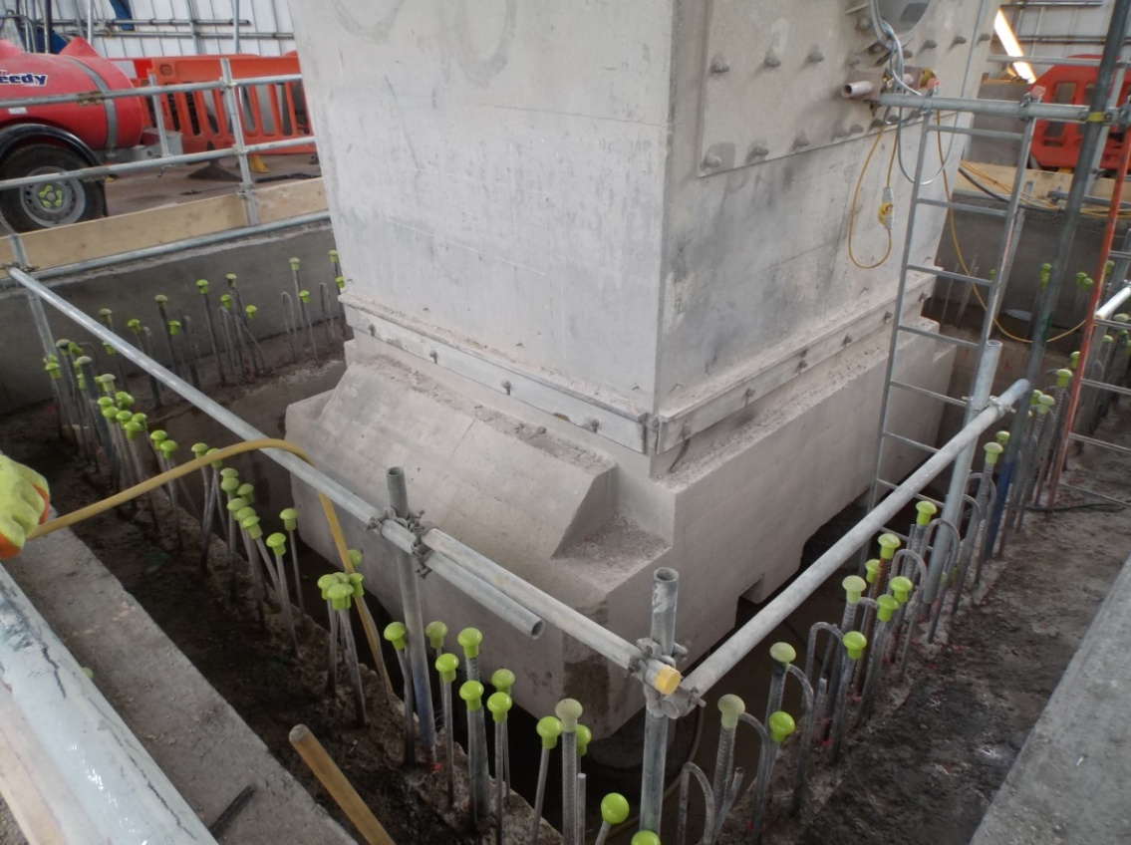
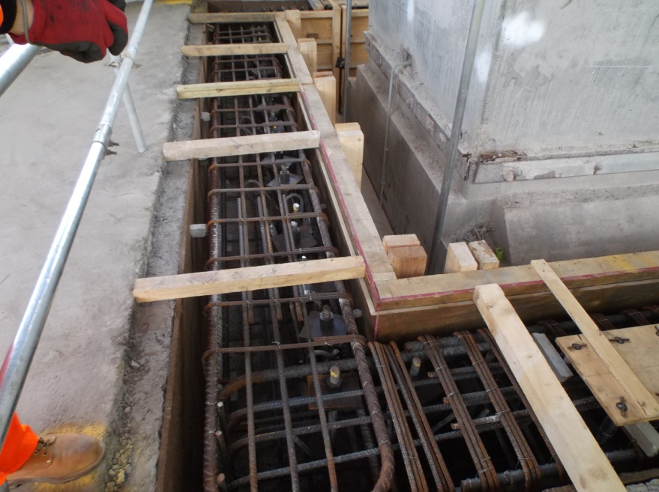
Bearing Pit and Pier Foundation Strengthening

Slide 11
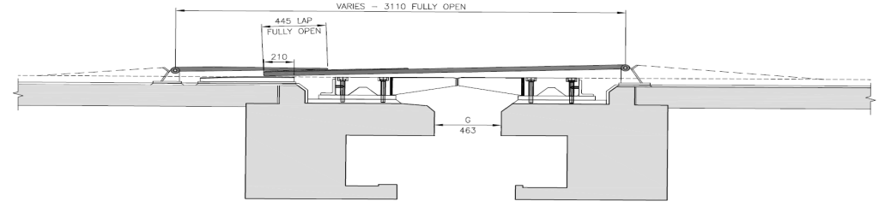
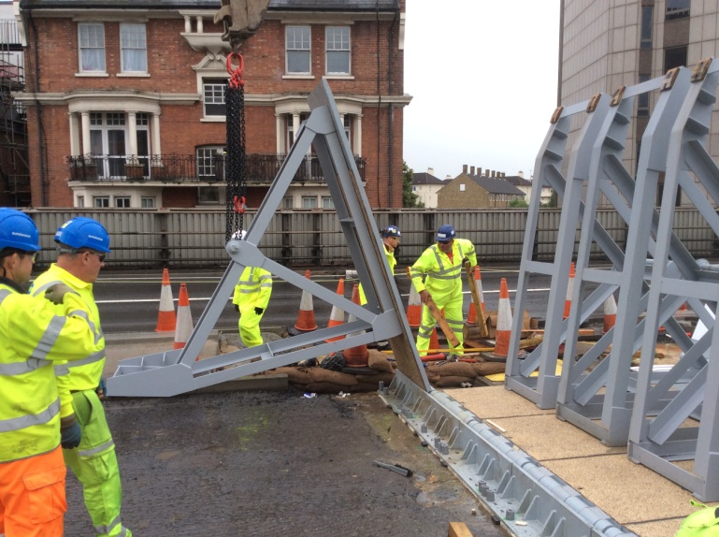
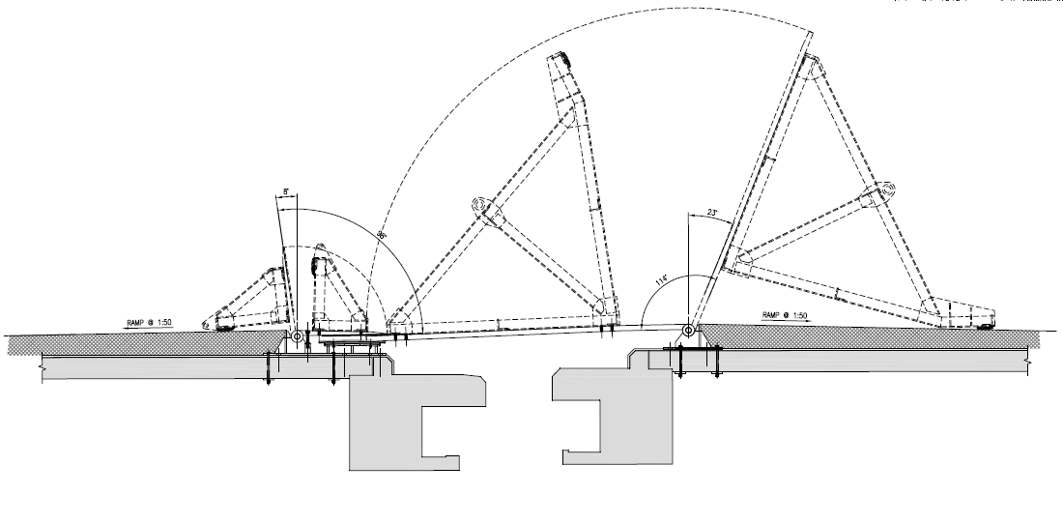
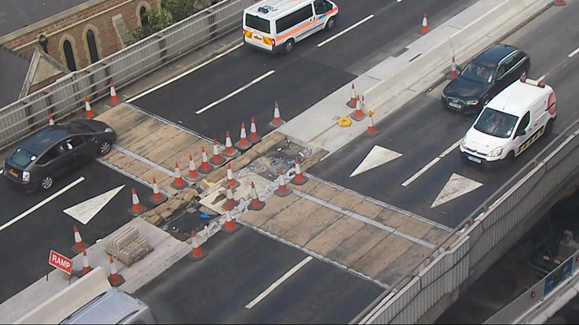
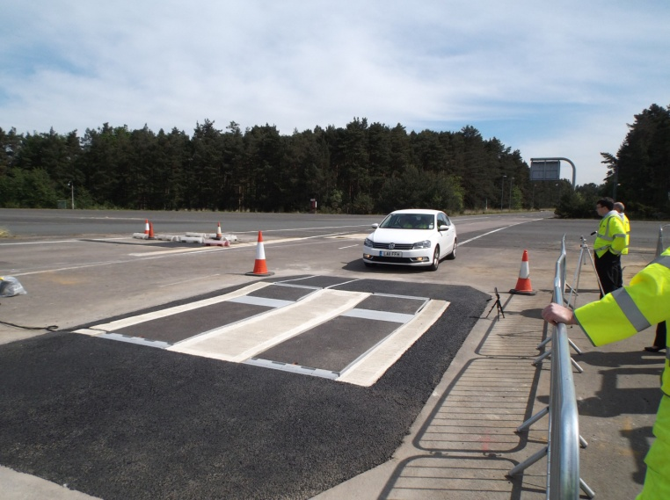
Lifting Frames
Designed to open to enable modifications to concrete cantilevers and the installation of the New Joint
Temporary Expansion Joint
Temporary Joint in service
Testing Temporary Joint Panels at TRL Test Site

Slide 12
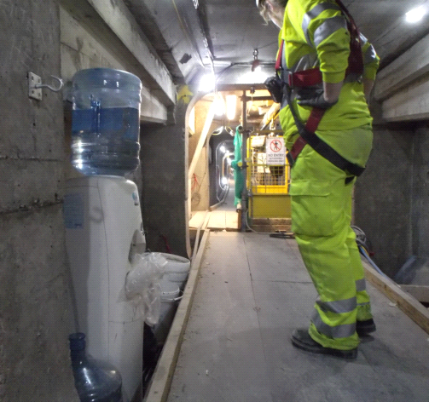

Health and Safety and Staff Welfare have been of prime consideration and importance throughout the planning and execution of the Works
Chilled Water Station inside Main Box Spine Beam
Hammersmith Flyover
Phase II Strengthening
Designed to extend the life of the Flyover for decades to come

