Slide 1


INSTRUMENTATION
For
GEOTECHNICAL, CIVIL, & STRUCTURAL MONITORING

Slide 2

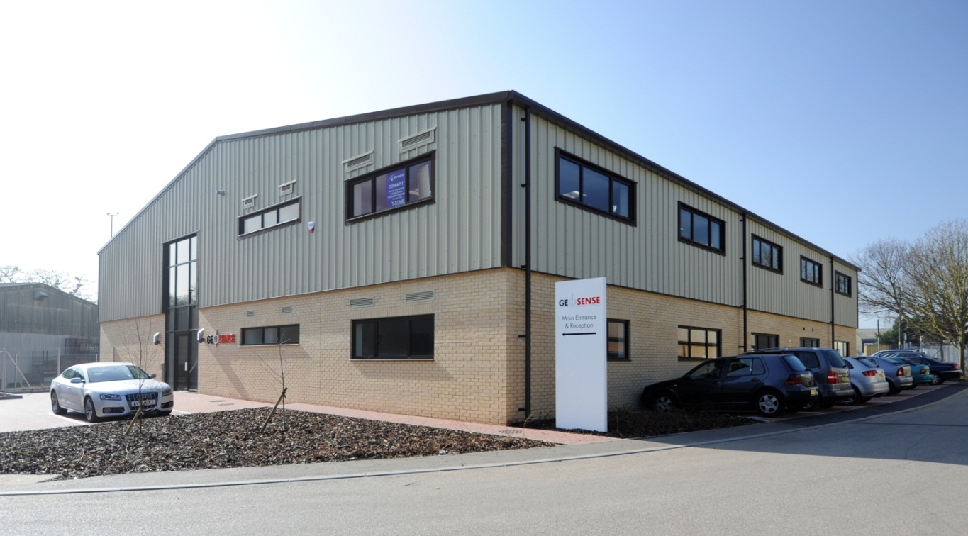

Company Profile
Geosense established in 1990 is a major European manufacturer and supplier of instrumentation to the geotechnical, civil engineering, mining and environmental industries worldwide
Geosense operates out of its purpose built headquarters in Bury St Edmunds, Suffolk, England
This 1,000 m² premises houses a range of modern equipment which allows for the highest quality of production, calibration and testing

Slide 3
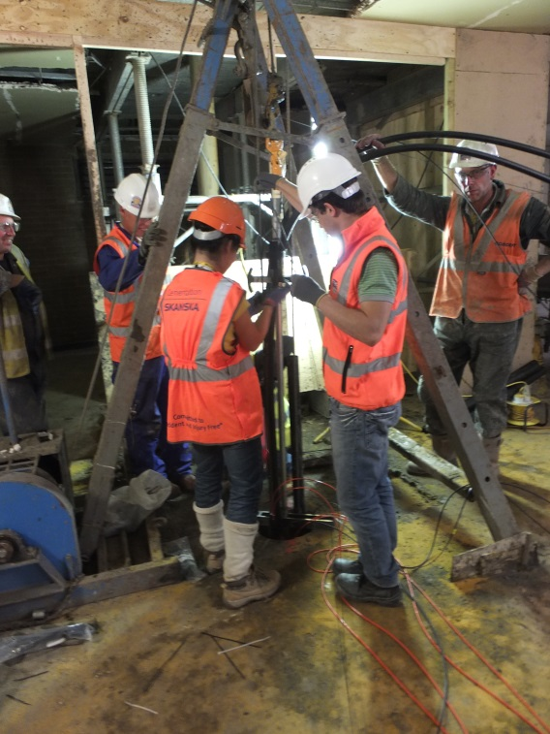
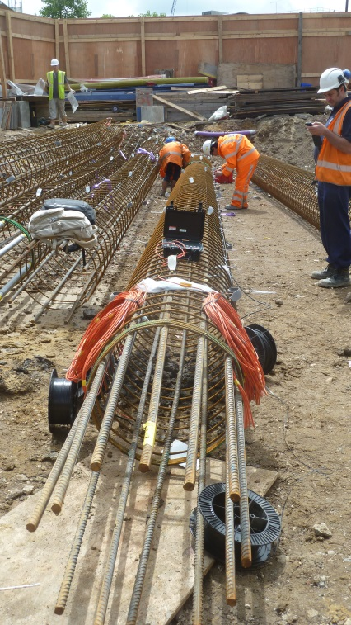
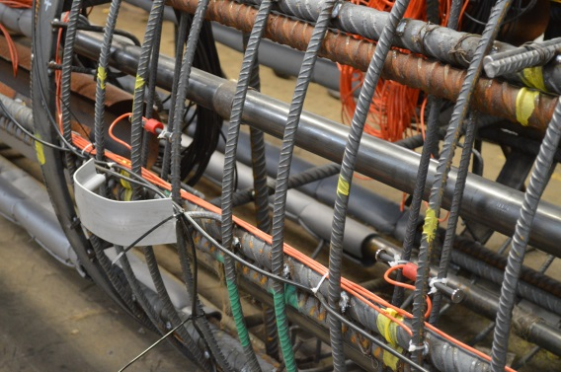
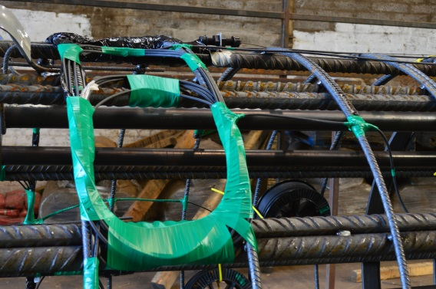
CSIC Industry Partner
Geosense is proud to have worked together with Cambridge University on several projects measuring strain
Shell Centre Geothermal pile testing
259 City Road pile testing
New London Embassy pile testing

Slide 4
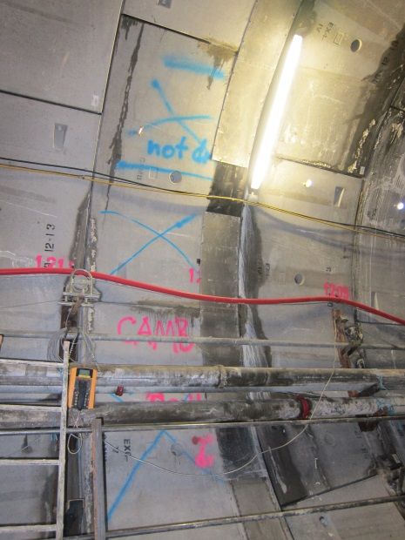
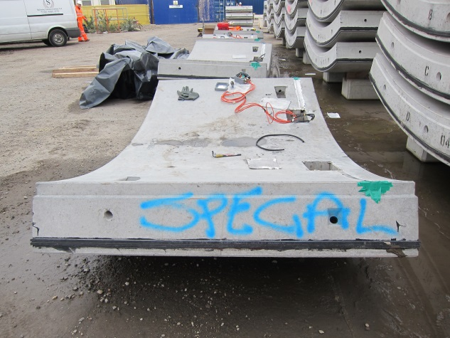
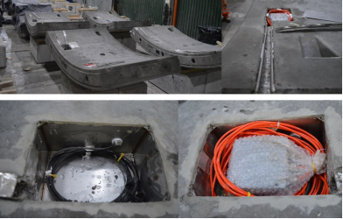
CSIC Industry Partner
Geosense VW strain gauges are used as the bench mark for fibre optic comparisons
Crossrail C301 Thames Tunnel

Slide 5


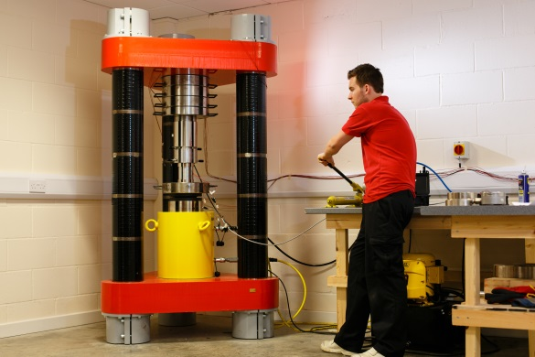

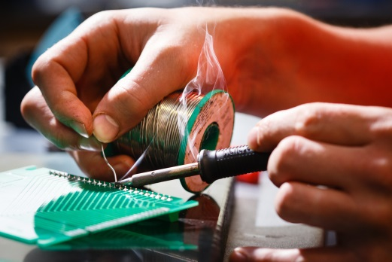
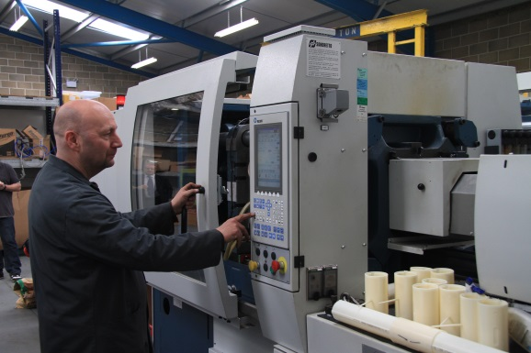
UK manufacture
All Geosense products are manufactured in the UK
(Also a technology partner with RST Instruments - Canada)

Slide 6
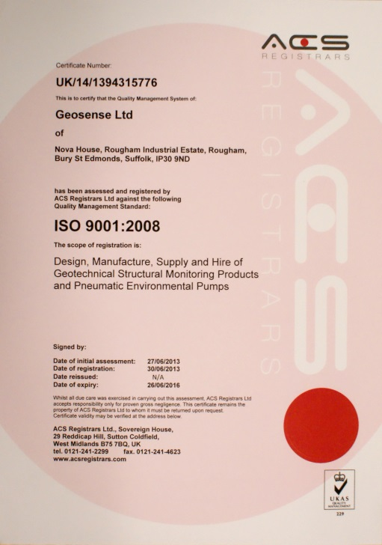
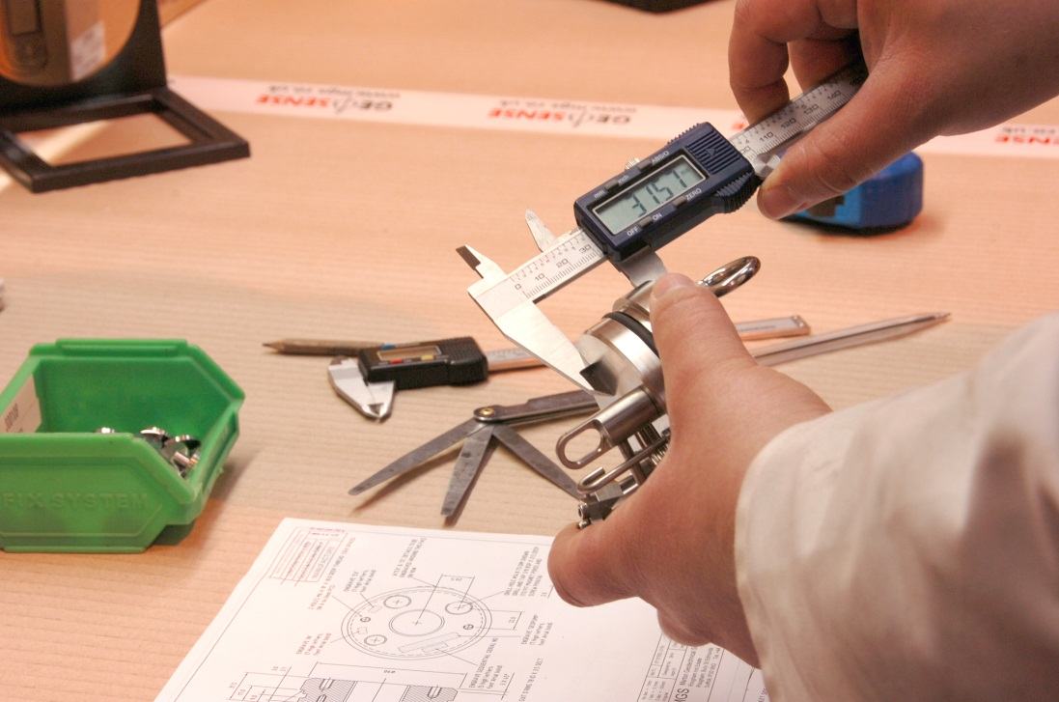
Quality ISO 9001:2008
Geosense is UKAS accredited to ISO 9001:2008 guaranteeing customers quality products together with a quality management system

Slide 7
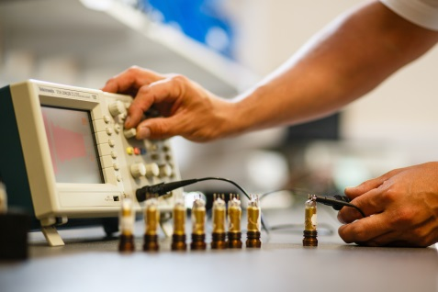
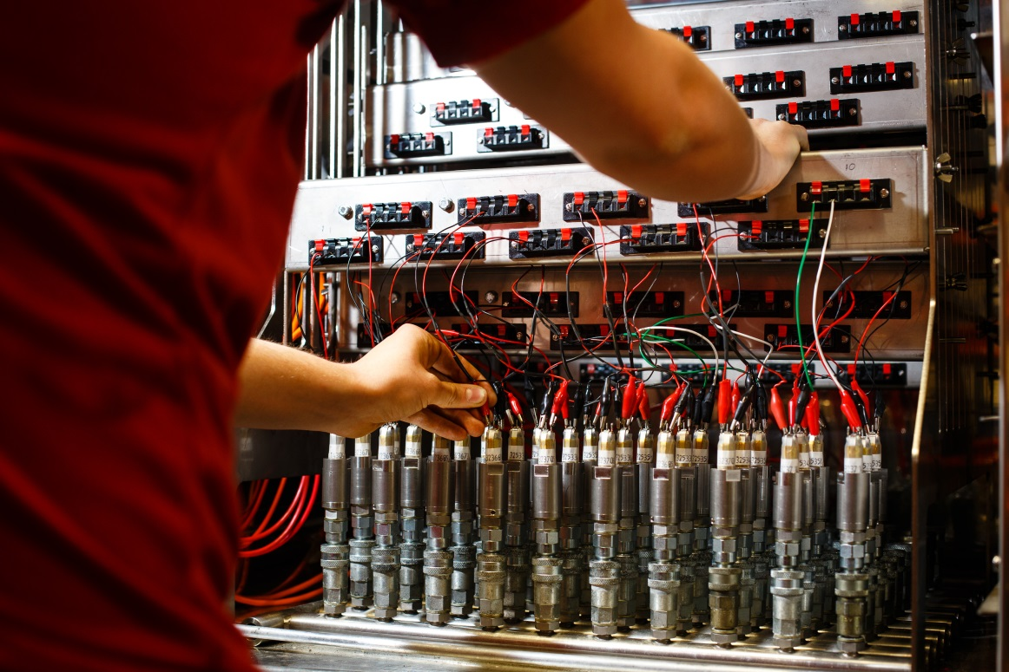
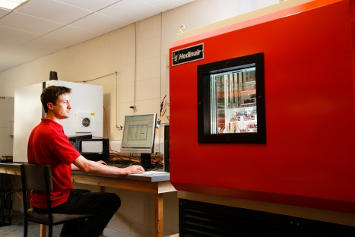
Skilled Technicians
Highly skilled and trained technicians work in purpose built facilities to produce quality instruments

Slide 8
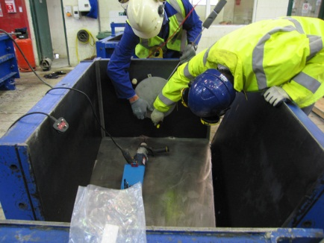
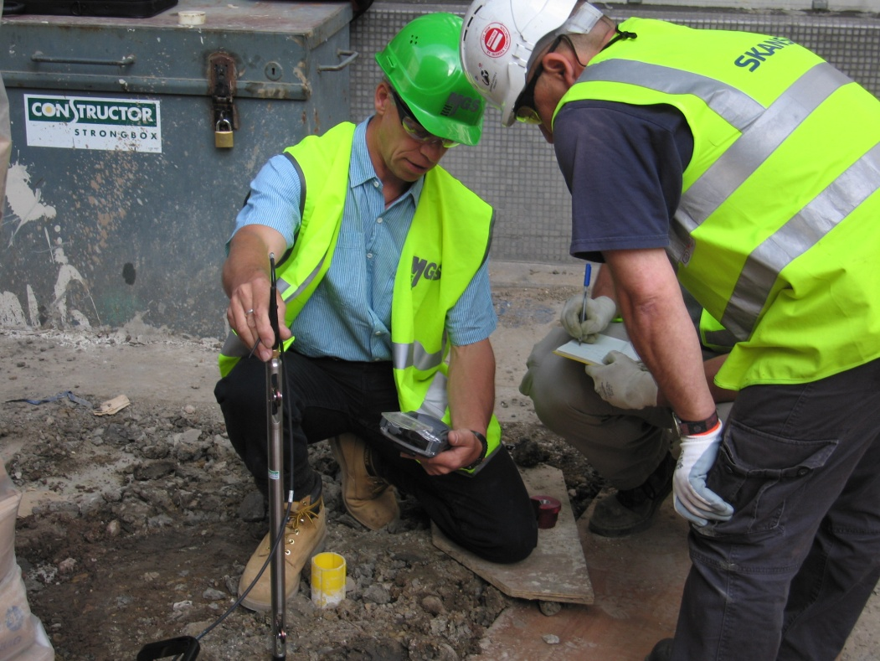
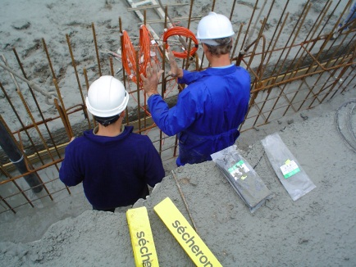
Technical support
Full technical support on and off site is provided to all our partners & customers

Slide 9
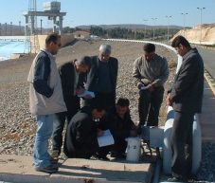
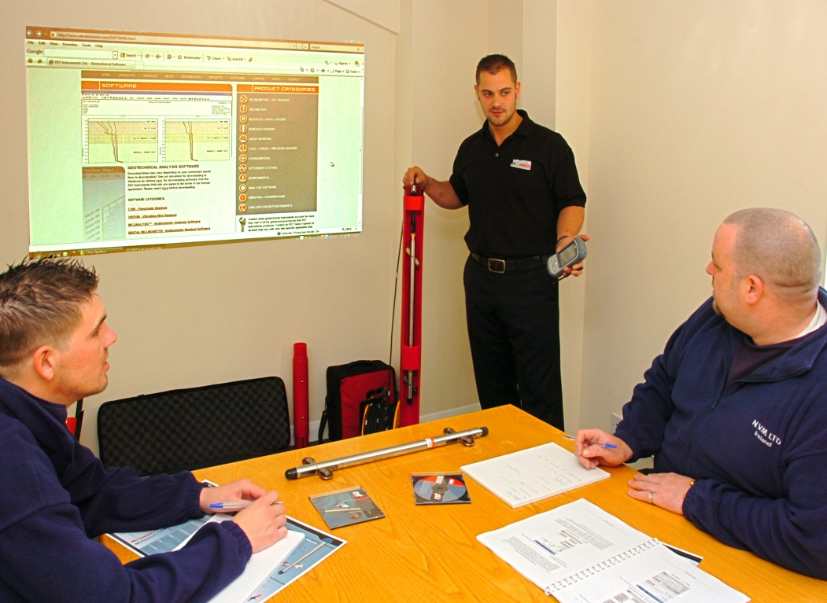
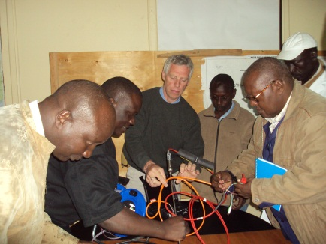
Training
Training is a key part of our technical support and includes product, application and data interpretation

Slide 10
Rotation and Lateral movement
Our instruments are used to monitor
Strain
Settlement & convergence
Vertical Movements
Displacement
Load
Pressure

Slide 11
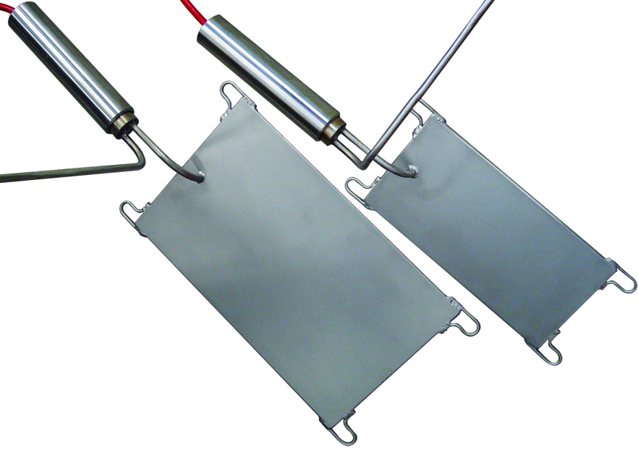
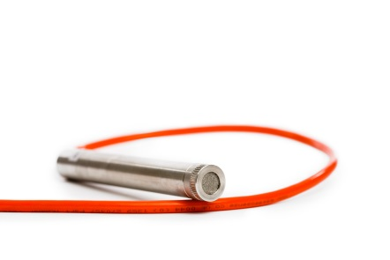
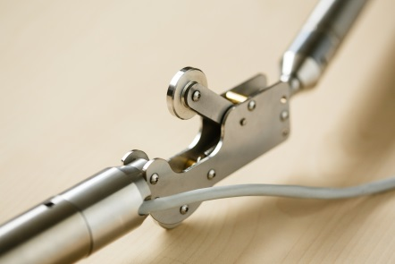
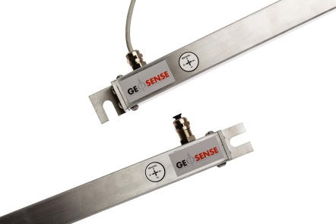
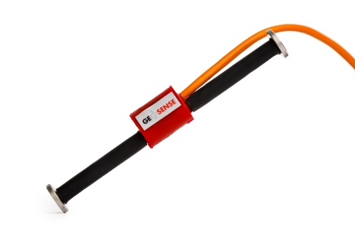
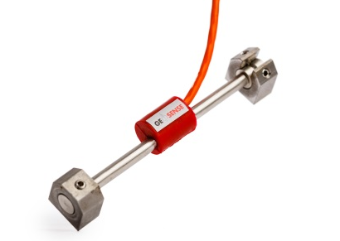
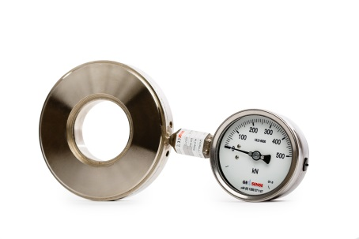
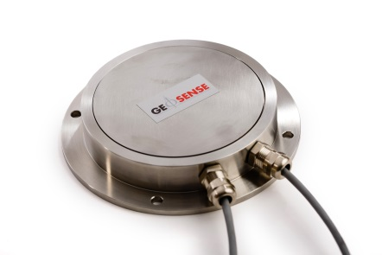
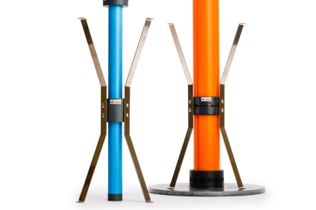
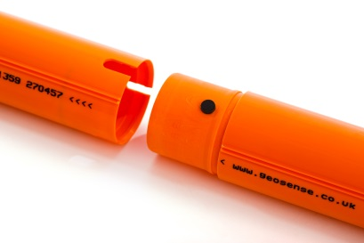
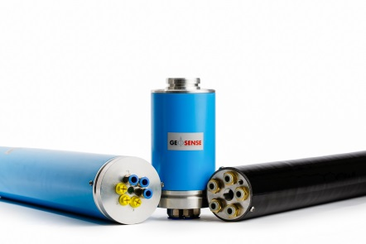
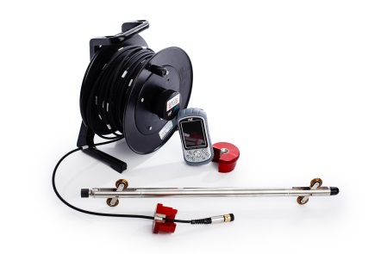
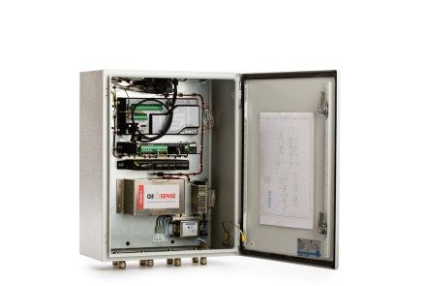
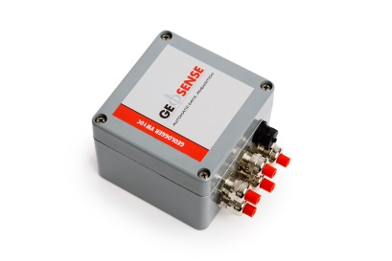
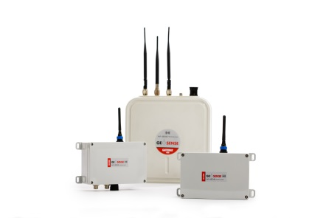
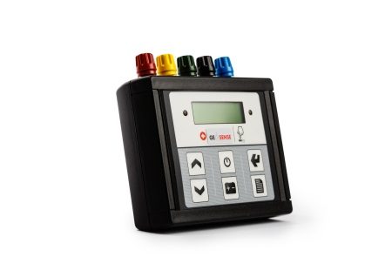
Typical instruments

Slide 12

THE END
Thank you, Danke, Dank u, Merci, Gracias, Grazie,
Dziękuję, σας ευχαριστώ, Takk ,Tack, Tak, Kiitos,
شكرا, благодаря, Hvala, Děkuji, Aitäh, გმადლობთ,
Köszönöm, þakka þér, Paldies, Ačiū, Obrigado,
Mulţumesc, спасибо, хвала, ďakujem,
Hvala, Teşekkür ederim, Спасибі, آپ کا شکریہ, शुक्रिया

