Slide 1

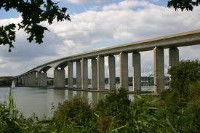
Managing the Highways Agency’s Infrastructure Asset
The Engineering Challenges
Pecha Kucha presentation to CSIC
9th September 2014 Trinity Hall, Cambridge
Neil Loudon

Slide 2
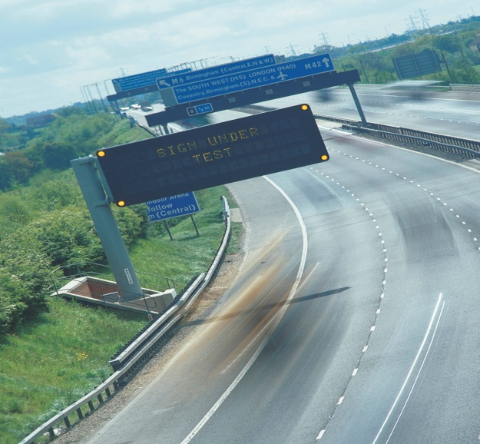
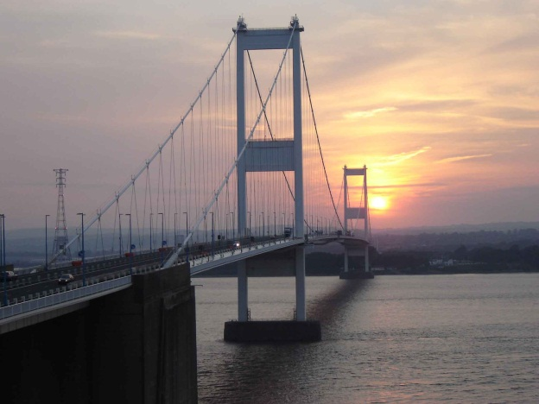
The Strategic Road Network
Approximately 7,200km of road network in England, ranging from motorways to single carriageway trunk roads.
Approx value £100billion
Comprises carriageways, fencing, drainage, lighting, signage, kerbs, footways, road markings, road studs, bridges, tunnels, underpasses, culverts, retaining walls, gantries, communications equipment, earthworks, freehold land

Slide 3
What do we want from our assets?
Construction
Cost effective
  – materials, construction technique
  Aesthetic considerations
Maintenance
Minimal maintenance
Future proof - availability of spares
Easily inspected
S A F E
Replacement
Sustainability considerations recycling of materials/components
Operation
Comfort (ride quality of pavements
Fit for purpose - fulfils purpose for which it was built
eg noise, spray, flooding

Slide 4
Asset management roadmap (research to support)
Outputs Outcomes
Reliable Budgets
Proactive
Maintenance
Whole Life Costing / Risk Management Tools
Deterioration Models
Condition
Asset Knowledge
Inventory
Rapid Data Acquisition
Data Management System
Standards
Time

Slide 5
Properties of assets
Engineering assets must have functionally balanced requirements:-
Safe
Durable – minimal maintenance required, service life concepts
Fit for purpose
Resilient
Robust
Comfort – ride quality of pavements
Operational - minimal disruption, noise, spray, pollution, flooding
Cost effective – new and repair/replacement situations
Buildable
Inspectable
Maintainable and replaceable
Sustainable
Recyclable materials
Future proof – technology, replacement parts available
‘Quality’ cuts across all requirements
Crucial to anticipate and identify risks and manage/mitigate them
Understand likelihood and consequence
Understand impact on network operation is essential, interaction with other assets

Slide 6
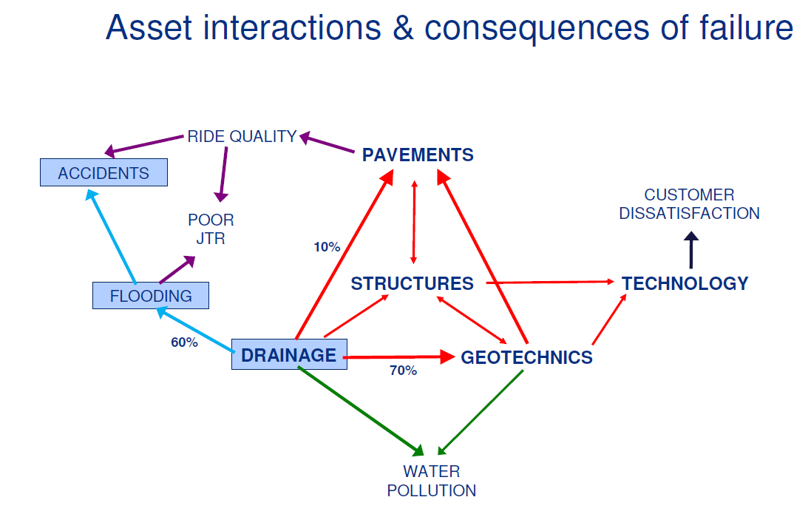
Asset interactions and consequences of failure
(How this interfaces with operation of the network and asset management – safety and loss of service must not be compromised.
This example focussed on drainage assets)

Slide 7
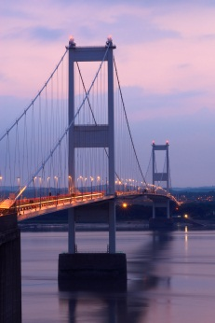
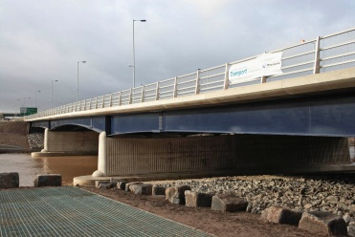
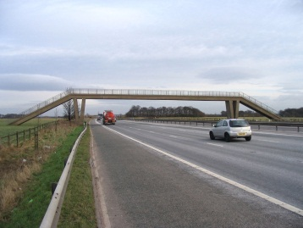
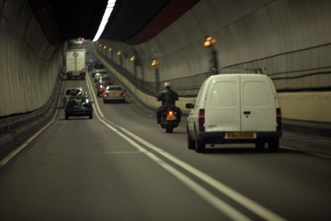
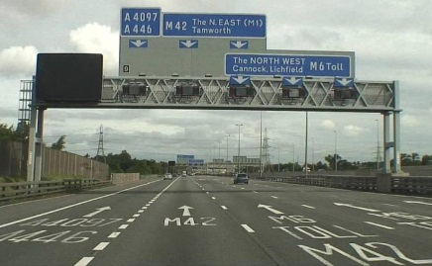
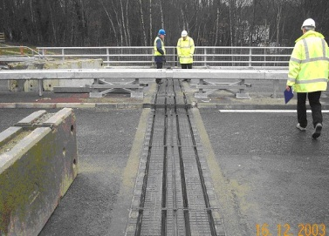
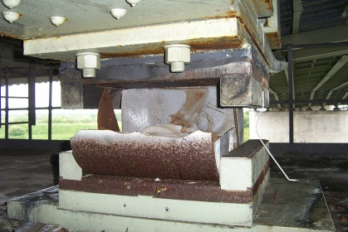
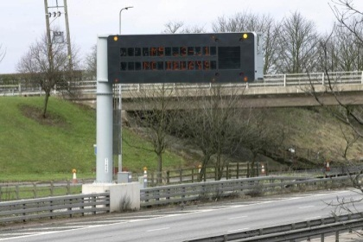
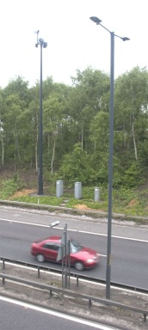
18000 Structures
Bridges, footbridges, tunnels, gantries, etc .
Bridge Components and Minor Structures
Expansion joints
Bridge Bearings
Minor Structures

Slide 8
Bridges by Construction
Year

Slide 9
Bridges by Material
Concrete (reinforced, mass, prestressed), Steel (reinforcement, girders)
Iron (cast, wrought), Other metals such as aluminium, Masonry (stonework, brickwork, blockwork),Timber, Plastics, Paints and coatings, Specialised materials

Slide 10
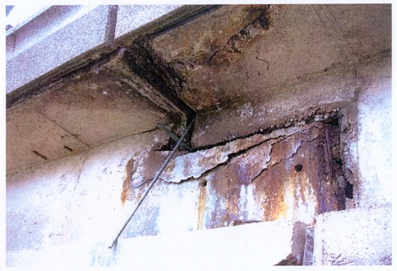
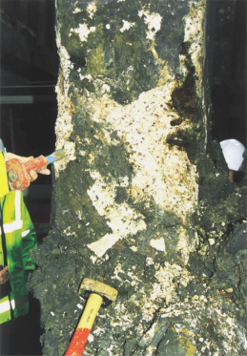
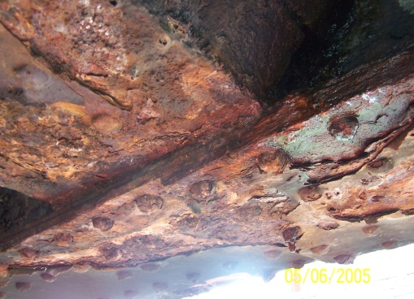
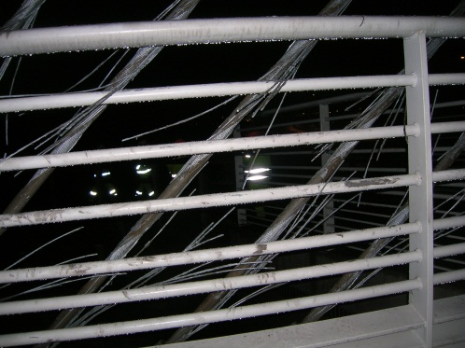
Structural condition
Materials inspected
Range of materials – Concrete, steel, fibre reinforced polymer (plastic) aluminium, composites (steel/concrete) etc
Components – expansion joints, bearings, parapets
Methods of fixing – welding, bolts, glue
Protection – paints and high specification coatings
Concrete - defects
Corrosion
Vandal damage
Examples of defects

Slide 11
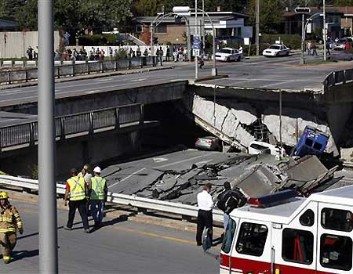
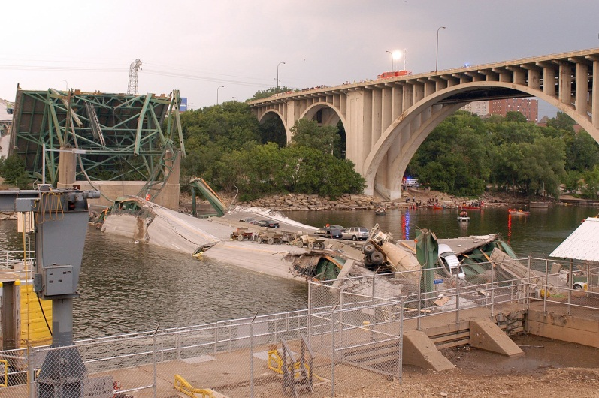

Learning lessons and Prioritised Action Plans
Montreal Bridge 2006
Minneapolis 2007
M1 Deansbrook Viaduct fire 2011
Cumbria flooding 2009
Notes:
11

Slide 12
Discussion
Thanks for your patience
But this is the short story!!
There is a lot to understanding and managing the Agency’s engineering assets
The Agency is an intelligent asset manager, but this is an ongoing role
It anticipates and identifies risks, proactively and reactively and continues to develop and implement processes to mitigate them, and provide reliable operation of the network.
Risk cannot be eliminated, and some failures may occur – the Agency needs to be responsive in these circumstances and have the skills to learn lessons
Key areas to review – quality of construction, and ‘feedback loops’ on asset performance
Areas to reflect on:-
the ‘3P’s’ (People, Product and Process) and a 4th ‘P’ (Procurement)
maintaining the Agency’s asset management and engineering skills
Happy for further discussion/questions

