Slide 1

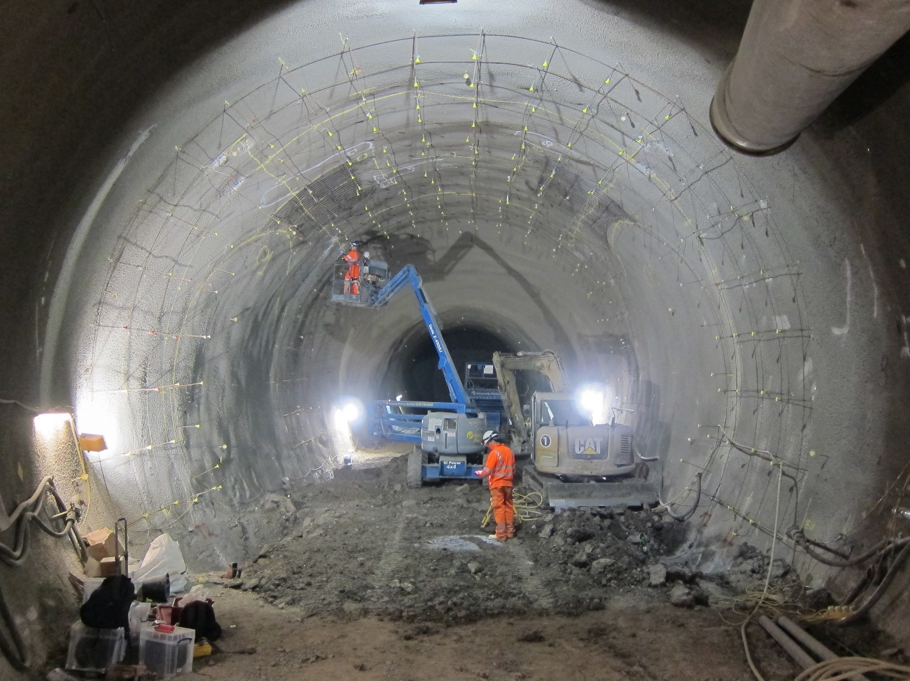
Monitoring of sprayed concrete lining in tunnels
using distributed fibre optic sensors
running tunnel
concourse tunnel
running tunnel
Crossrail Liverpool Street Station
Notes:
CSIC Template 2013

Slide 2
Monitoring of sprayed concrete lining in tunnels
using distributed fibre optic sensors
running tunnel
concourse tunnel
running tunnel
Crossrail Liverpool Street Station

Slide 3
Monitoring of sprayed concrete lining in tunnels
using distributed fibre optic sensors
Liverpool Street station
12 cross passages
~7700 m³ thickening concrete
Crossrail Liverpool Street Station

Slide 4


Monitoring of sprayed concrete lining in tunnels
using distributed fibre optic sensors
Additional stresses in the SCL due to cross passages
Real data
Cost savings
in SCL tunnels
Crossrail Liverpool Street Station

Slide 5
Monitoring solution
Distributed fibre optics
Liverpool Street station
~800 m
embedded & exposed
fibre optic cables
Distributed
strain and temperature measurement
CP1
CH5
CP2

Slide 6

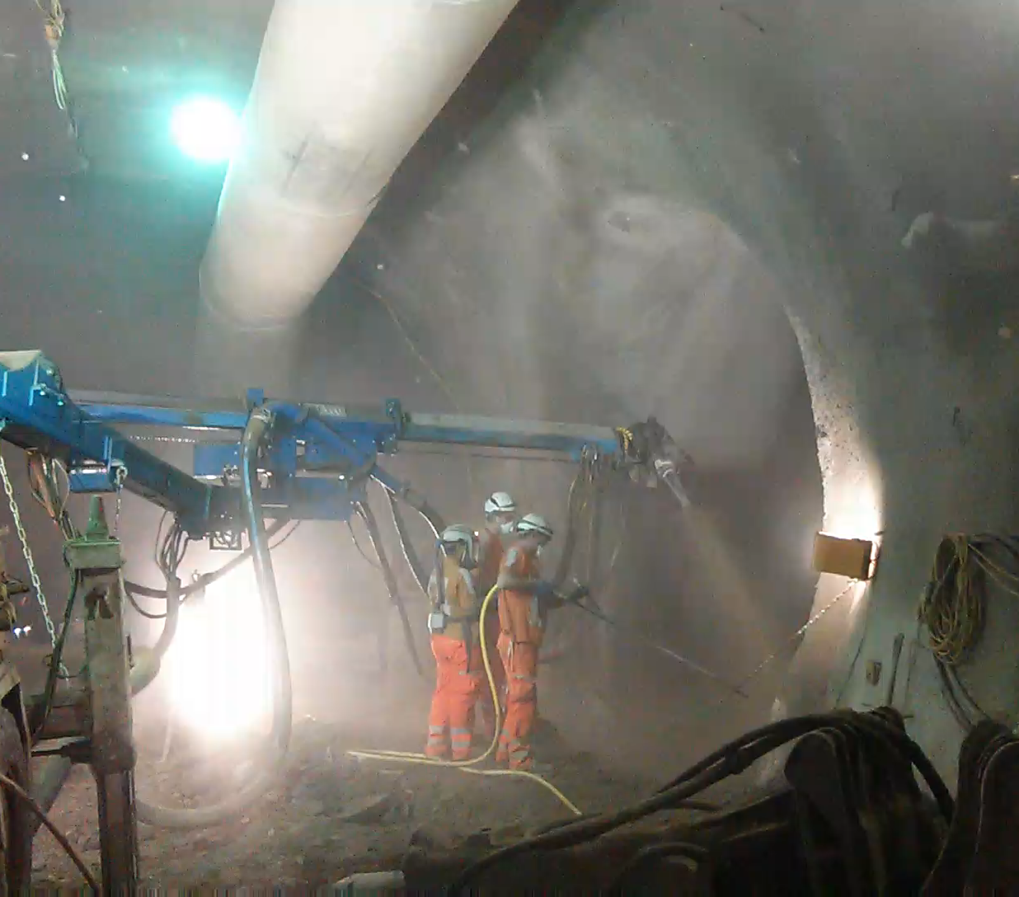
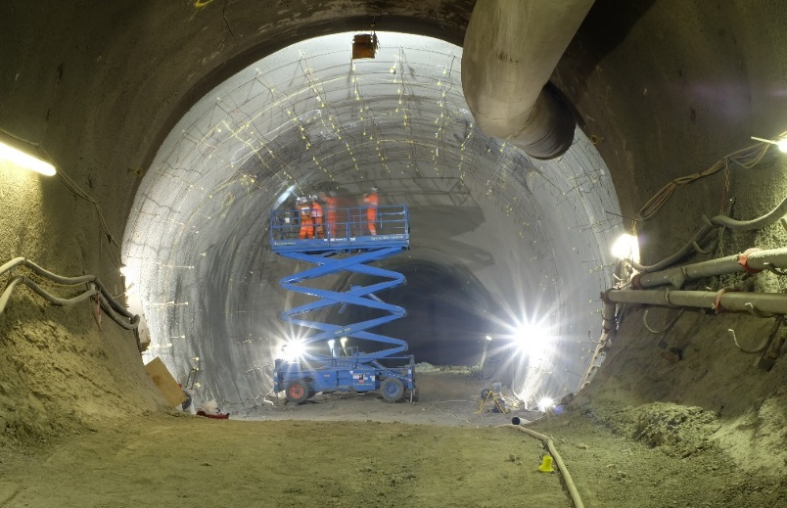
Monitoring solution
Distributed fibre optics
First of its kind!

Slide 7
Some results to date
Evolution of longitudinal strain
June
July
CP1 breakout and pilot tunnel
CP2 breakout and pilot tunnel
CP1 enlargement
compression
tension

Slide 8
Some results to date
Evolution of hoop strain
June
July
CP1 breakout and pilot tunnel
CP2 breakout and pilot tunnel
CP1 enlargement
compression
tension

Slide 9
Some results to date
Engineering insights
compression
tension

Slide 10
Some results to date
Engineering insights
compression
tension

Slide 11
Some results to date
Engineering insights
Plan view of typical enlargement chamber
compression
tension

Slide 12

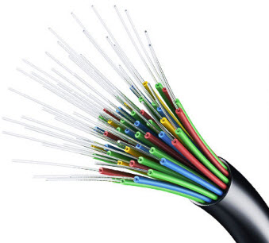
Conclusion
SC tunnel linings
→ potentially large savings
Distributed fibre optics
→ complete strain (& temperature) profile

Slide 13

www.centreforsmartinfrastructure.com
Nicky de Battista
n.debattista @ eng.cam.ac.uk

