Slide 1

PechaKucha Session
Dr Phil Catton
Notes:
CSIC Template 2013

Slide 2
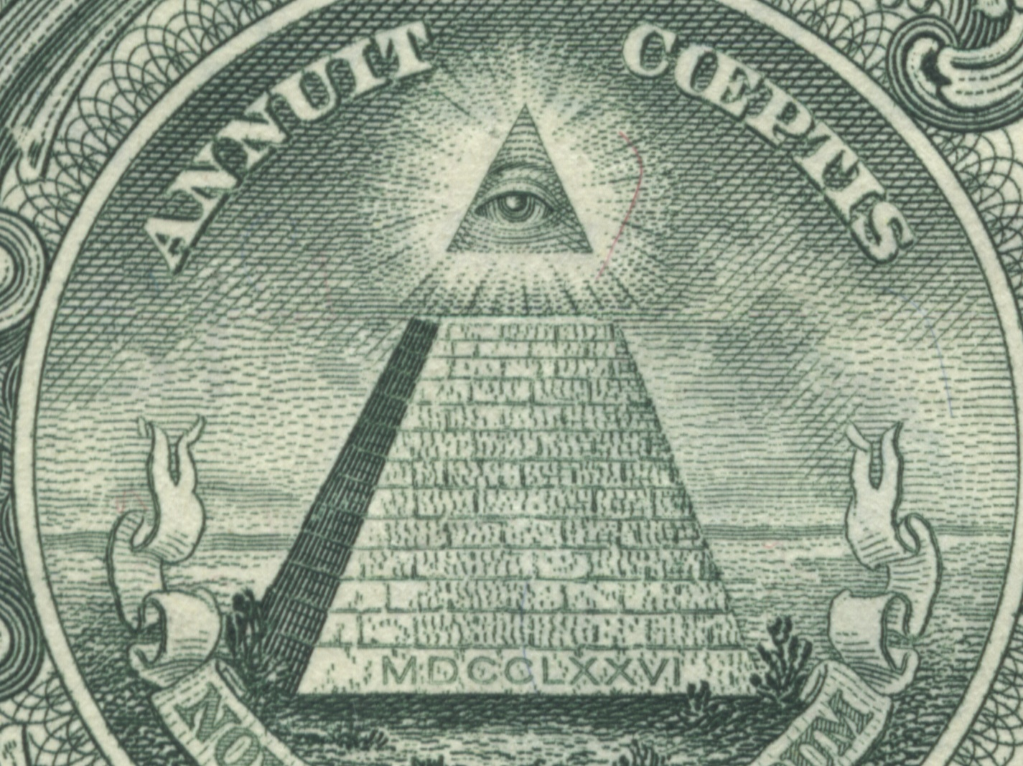
Notes:
Hi, my names Phil and I’m going to talk about pyramids
Might seem a little obtuse, and not especially ‘smart’
…but we still build plenty of pyramids today

Slide 3
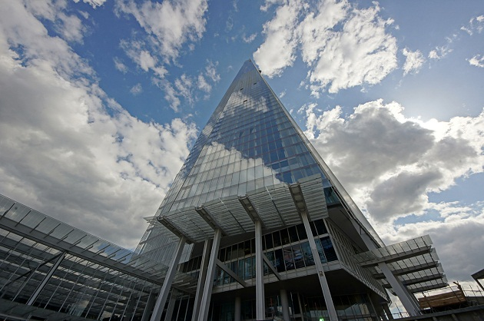
Notes:
They are just a little bigger, and more complicated.
But I’m not a civil engineer. I’m more interested in getting the most output from a situation for the smallest input
So I talk about a different kind of pyramid

Slide 4
Knowledge
Decisions
Information
Data
Notes:
This pyramid provides a starting point for everything that we do in CSIC.
Every aspect of our work fits neatly into one of the four tiers

Slide 5
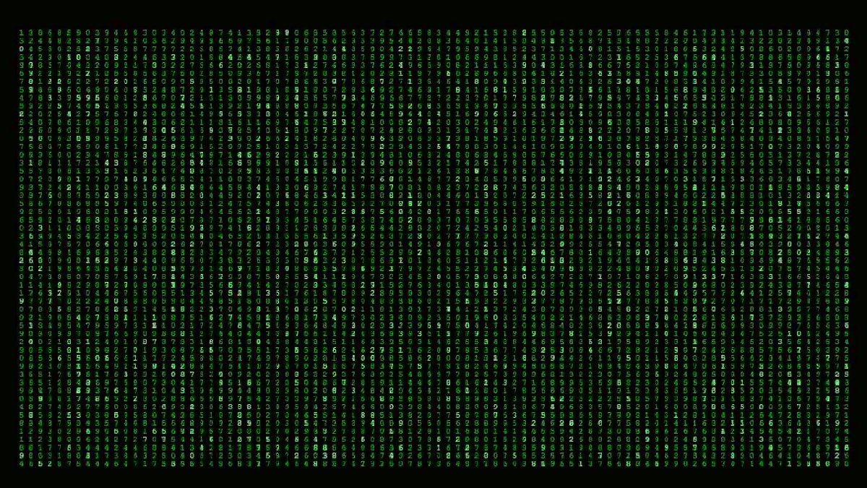
D | D | D | D | D | D | D | D | D |  |  |  |  |  |  |  |  |  | A | A | A | A |  |  |  |  |  |  | T | T | T | T | T | T | T | T | T | T | T | T |  |  |  |  |  |  | A | A | A | A
D | D | D | D | D | D | D | D | D | D | D |  |  |  |  |  | A | A | A | A | A | A | A | A |  |  |  |  | T | T | T | T | T | T | T | T | T | T | T | T |  |  |  |  | A | A | A | A | A | A | A | A
D | D | D | D | D | D | D | D | D | D | D |  |  |  |  | A | A | A | A | A | A | A | A | A | A |  |  |  | T | T | T | T | T | T | T | T | T | T | T | T |  |  |  | A | A | A | A | A | A | A | A | A | A
D | D | D | D | D | D | D | D | D | D | D | D |  |  |  | A | A | A | A | A | A | A | A | A | A |  |  |  | T | T | T | T | T | T | T | T | T | T | T | T |  |  |  | A | A | A | A | A | A | A | A | A | A
D | D | D | D |  |  |  | D | D | D | D | D |  |  | A | A | A | A | A | A | A | A | A | A | A | A |  |  |  |  |  |  | T | T | T | T |  |  |  |  |  |  | A | A | A | A | A | A | A | A | A | A | A | A
D | D | D | D |  |  |  |  | D | D | D | D |  |  | A | A | A | A | A | A | A | A | A | A | A | A |  |  |  |  |  |  | T | T | T | T |  |  |  |  |  |  | A | A | A | A | A | A | A | A | A | A | A | A
D | D | D | D |  |  |  |  | D | D | D | D |  |  | A | A | A | A | A |  |  | A | A | A | A | A |  |  |  |  |  |  | T | T | T | T |  |  |  |  |  |  | A | A | A | A | A |  |  | A | A | A | A | A
D | D | D | D |  |  |  |  | D | D | D | D |  |  | A | A | A | A |  |  |  |  | A | A | A | A |  |  |  |  |  |  | T | T | T | T |  |  |  |  |  |  | A | A | A | A |  |  |  |  | A | A | A | A
D | D | D | D |  |  |  |  | D | D | D | D |  |  | A | A | A | A |  |  |  |  | A | A | A | A |  |  |  |  |  |  | T | T | T | T |  |  |  |  |  |  | A | A | A | A |  |  |  |  | A | A | A | A
D | D | D | D |  |  |  |  | D | D | D | D |  |  | A | A | A | A |  |  |  |  | A | A | A | A |  |  |  |  |  |  | T | T | T | T |  |  |  |  |  |  | A | A | A | A |  |  |  |  | A | A | A | A
D | D | D | D |  |  |  |  | D | D | D | D |  |  | A | A | A | A |  |  |  |  | A | A | A | A |  |  |  |  |  |  | T | T | T | T |  |  |  |  |  |  | A | A | A | A |  |  |  |  | A | A | A | A
D | D | D | D |  |  |  |  | D | D | D | D |  |  | A | A | A | A |  |  |  |  | A | A | A | A |  |  |  |  |  |  | T | T | T | T |  |  |  |  |  |  | A | A | A | A |  |  |  |  | A | A | A | A
D | D | D | D |  |  |  |  | D | D | D | D |  |  | A | A | A | A | A | A | A | A | A | A | A | A |  |  |  |  |  |  | T | T | T | T |  |  |  |  |  |  | A | A | A | A | A | A | A | A | A | A | A | A
D | D | D | D |  |  |  |  | D | D | D | D |  |  | A | A | A | A | A | A | A | A | A | A | A | A |  |  |  |  |  |  | T | T | T | T |  |  |  |  |  |  | A | A | A | A | A | A | A | A | A | A | A | A
D | D | D | D |  |  |  |  | D | D | D | D |  |  | A | A | A | A | A | A | A | A | A | A | A | A |  |  |  |  |  |  | T | T | T | T |  |  |  |  |  |  | A | A | A | A | A | A | A | A | A | A | A | A
D | D | D | D |  |  |  | D | D | D | D | D |  |  | A | A | A | A | A | A | A | A | A | A | A | A |  |  |  |  |  |  | T | T | T | T |  |  |  |  |  |  | A | A | A | A | A | A | A | A | A | A | A | A
D | D | D | D | D | D | D | D | D | D | D | D |  |  | A | A | A | A |  |  |  |  | A | A | A | A |  |  |  |  |  |  | T | T | T | T |  |  |  |  |  |  | A | A | A | A |  |  |  |  | A | A | A | A
D | D | D | D | D | D | D | D | D | D | D |  |  |  | A | A | A | A |  |  |  |  | A | A | A | A |  |  |  |  |  |  | T | T | T | T |  |  |  |  |  |  | A | A | A | A |  |  |  |  | A | A | A | A
D | D | D | D | D | D | D | D | D | D | D |  |  |  | A | A | A | A |  |  |  |  | A | A | A | A |  |  |  |  |  |  | T | T | T | T |  |  |  |  |  |  | A | A | A | A |  |  |  |  | A | A | A | A
D | D | D | D | D | D | D | D | D |  |  |  |  |  | A | A | A | A |  |  |  |  | A | A | A | A |  |  |  |  |  |  | T | T | T | T |  |  |  |  |  |  | A | A | A | A |  |  |  |  | A | A | A | A
Notes:
At the foundation of our pyramid, we have data. This might include measured values from monitoring or inspection systems, like temperature, displacement, tilt and so on.
But on its own, data is pretty useless…

Slide 6

Information
Notes:
Before any value can be gleaned, it has to be distilled into meaningful and relevant information. This could be in the form of graphs, dashboards, traffic lights, or simply ‘yes’ or ‘no’.
But even then, information in its on right does not present any value

Slide 7
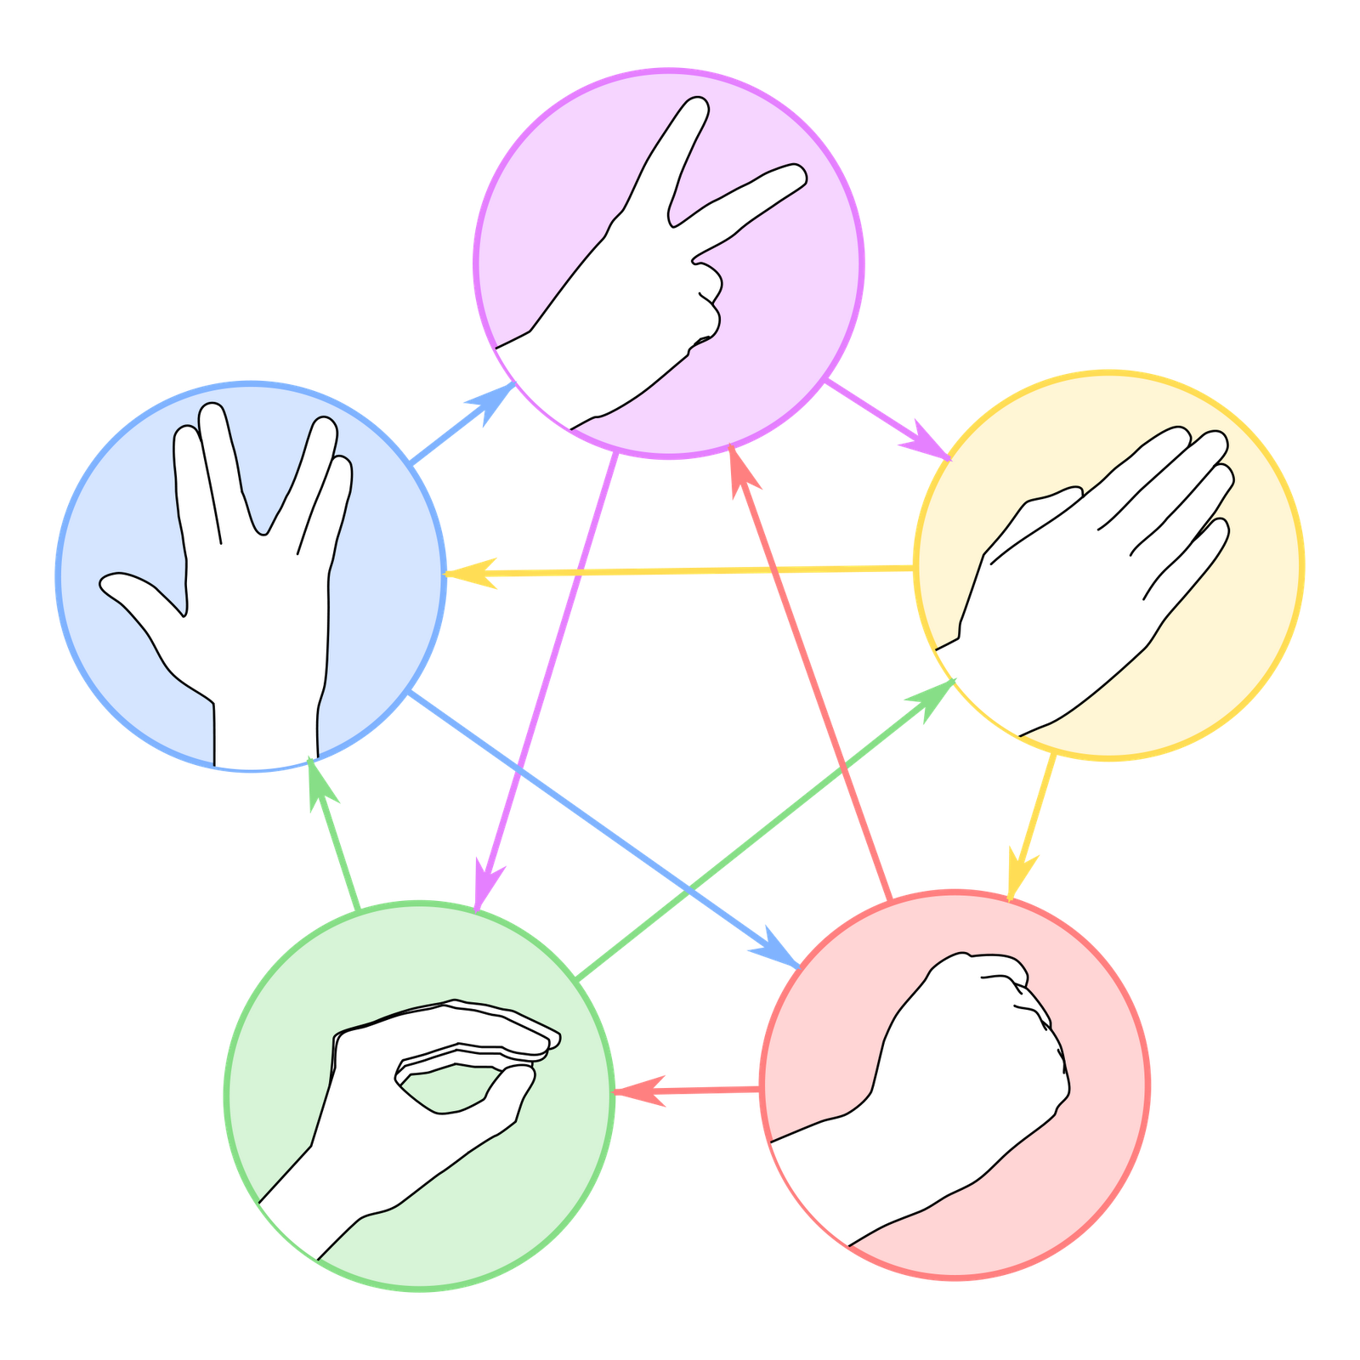
?
Decisions
Notes:
– it is only when it informs decisions that any benefit from the information (and therefore the data behind it) is seen. Questions like ‘is this bridge safe for another 5 years?’ ‘can i reuse these foundations?’, ‘Can I delay maintenance until the next period?’ all have bottom line impacts, either

Slide 8
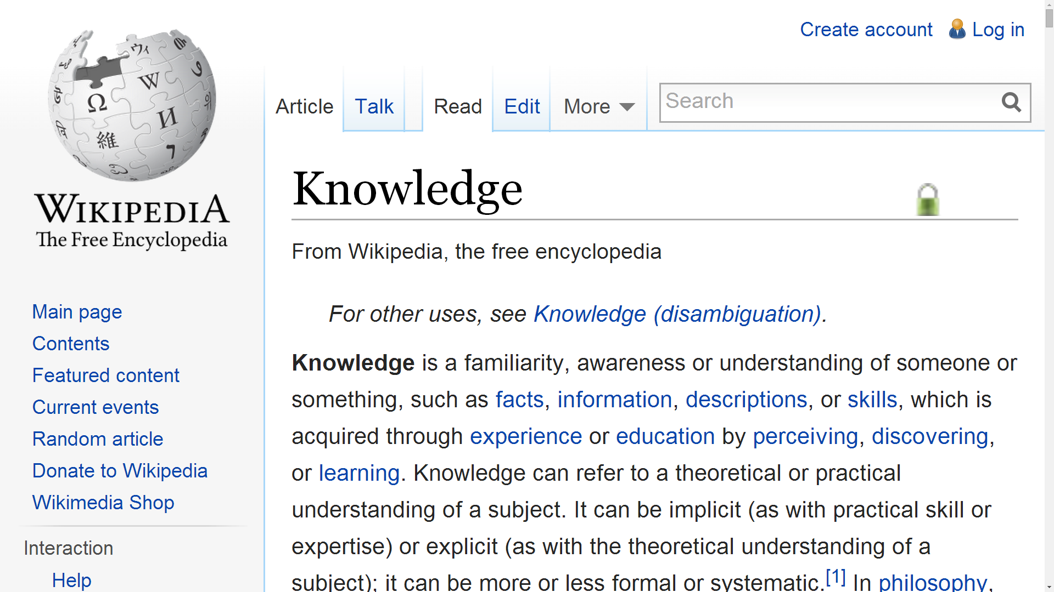
Notes:
But there was a fourth tier to the pyramid. Where real gains can be made is abstracting individual decisions to the bigger picture. What can one situation teach us about others? How can one part of an organisation benefit from the good work of another part?

Slide 9
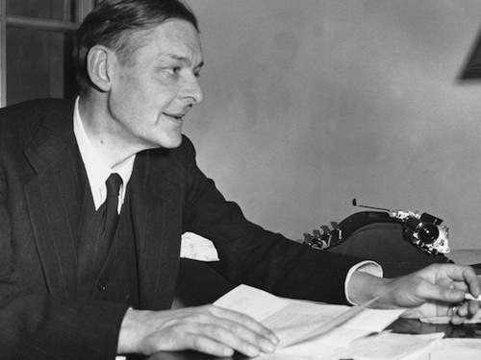
Where is the wisdom we have lost in knowledge?
Where is the knowledge we have lost in information?
T. S. Eliot
Notes:
This framework stems from a line from TS Eliot – Where is the wisdom we have lost in knowledge?
Where is the knowledge we have lost in information?
He didn’t say ‘where is the information we have lost in data’, but he should have done.

Slide 10
Knowledge
Decisions
Information
Data
Notes:
So what?
Well this is all significant because the value to be gained from any tier in the pyramid is only available if correctly supported by the tier below it.
And conversely, if a tier doesn’t DIRECTLY influence the tier above it, it is very unlikely to provide any value
increases as you go up the pyramid – but ONLY if correctly

Slide 11
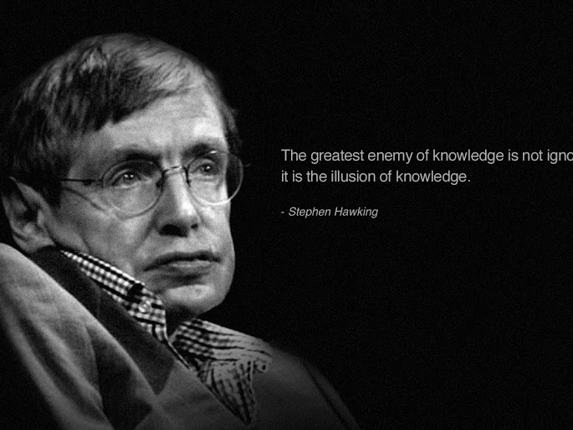
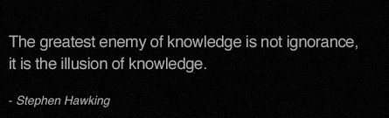
Notes:
The greatest enemy of knowledge is not ignorance. It is the illusion of knowledge.
I think this is exactly the problem faced by civil engineering. And exactly what we at CSIC are all about.

Slide 12
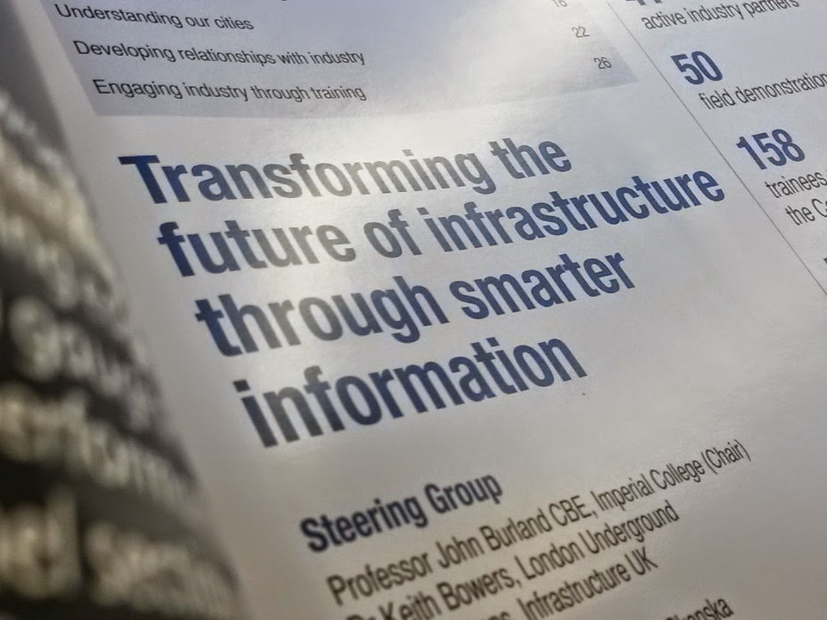
Notes:
Our mission is to transform the future of infrastructure through smarter information, and this is exactly what we mean. Over the next 30 minutes you’ll see some snippets of the great work my colleagues are doing. And with your continued support, we’ll be able to carry on turning the right data into useful information, to make well founded decisions which feed nicely into the industry’s wider base of knowledge

Slide 13
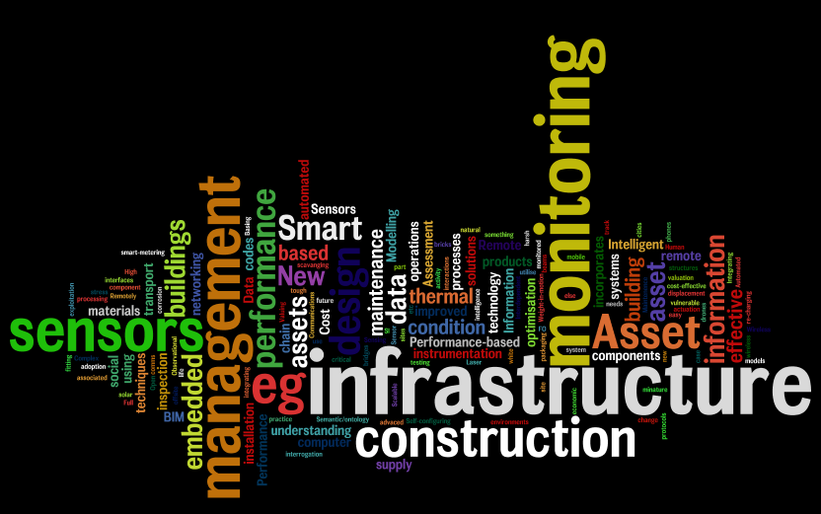
www.centreforsmartinfrastructure.com
ppc29@cam.ac.uk
Notes:
With that, I thank you for listening and I hope you enjoy the rest of the session

