Slide 1

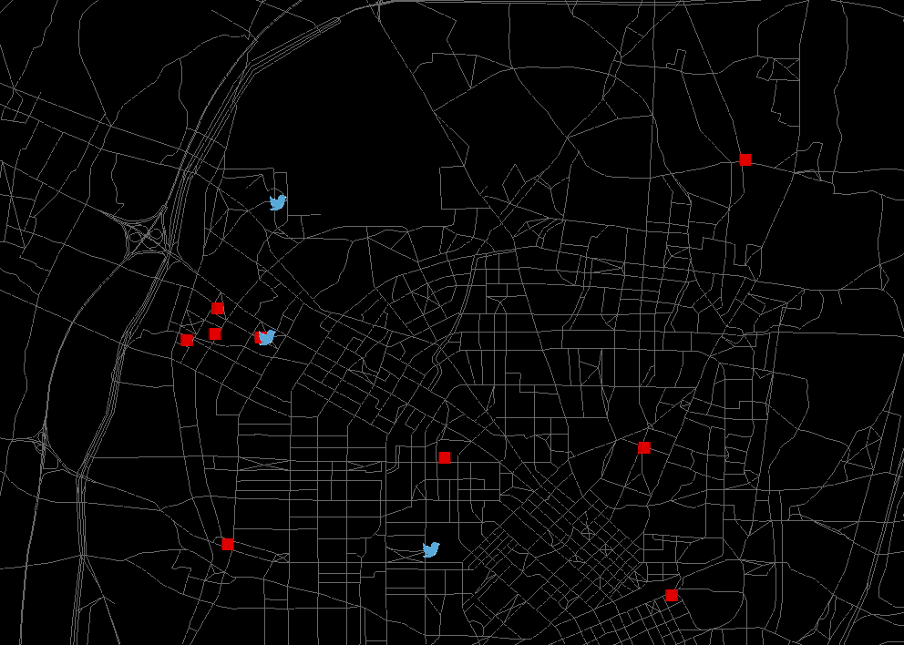
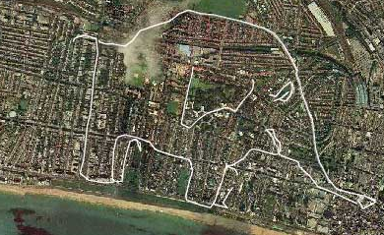
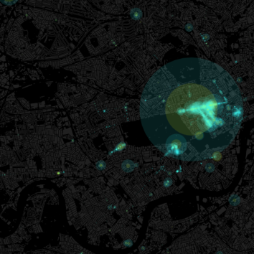
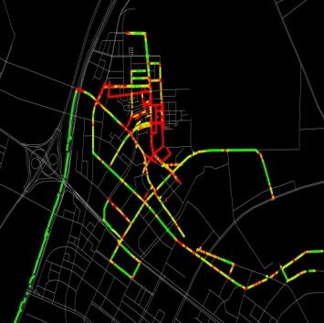
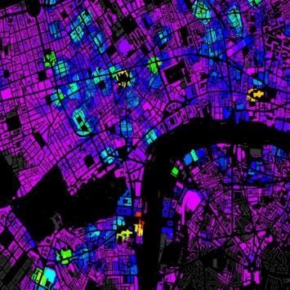
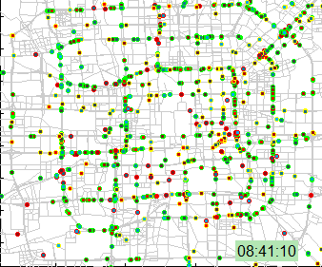
City dynamics: Following the crowd
Steve Denman – Research Associate

Slide 2

Crowd sourcing – Social media, GPS & Smart phones.
Crowd sourcing: Obtaining volunteered
data from large groups of people
The wisdom of the crowd? But is the
crowd representative? Inherent bias.
Fit with CSIC objectives:
  Innovative & low cost methods
  Predictive/Data management tools
  Improved urban/infrastructure planning

Slide 3
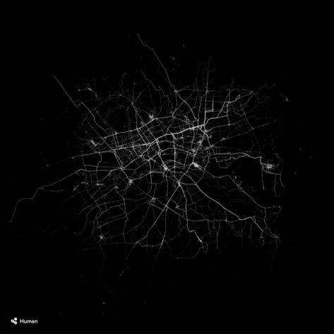
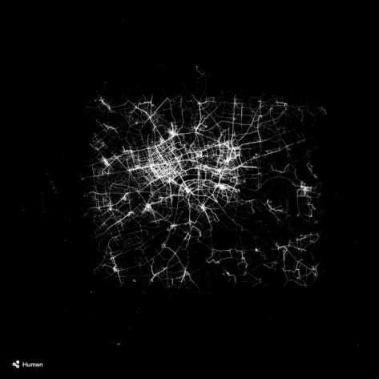
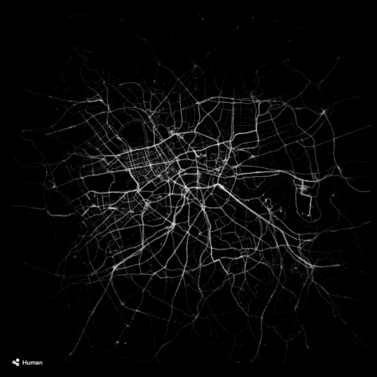



Why crowd sourcing?
Activity tracker (courtesy of Human.co)
Why use this approach?
  Real time, micro & macro temporal scales
  Inexpensive
  Informative
  New insights in to city dynamics
Why is this innovative?
  Combining passively generated data
    (e.g. twitter) with formal data (e.g. census)
  Addressing bias
  An input to modelling work

Slide 4
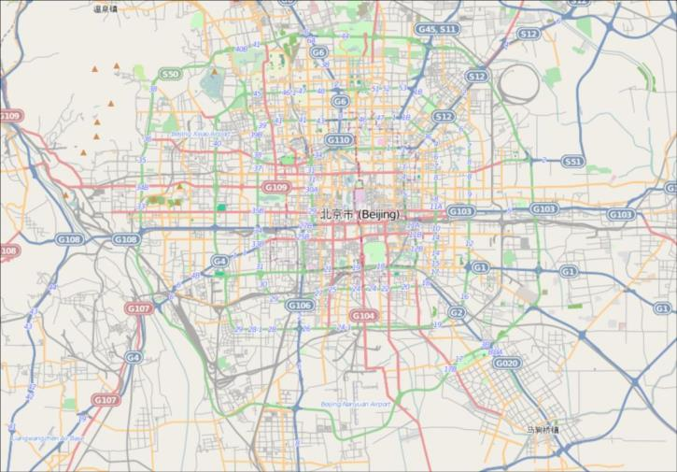

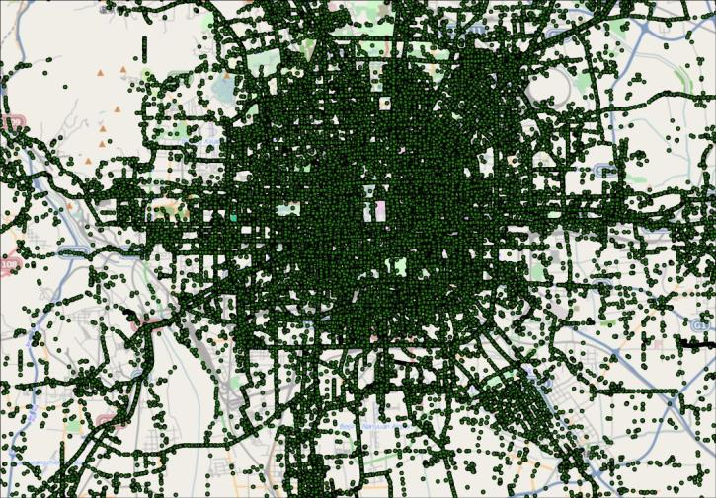
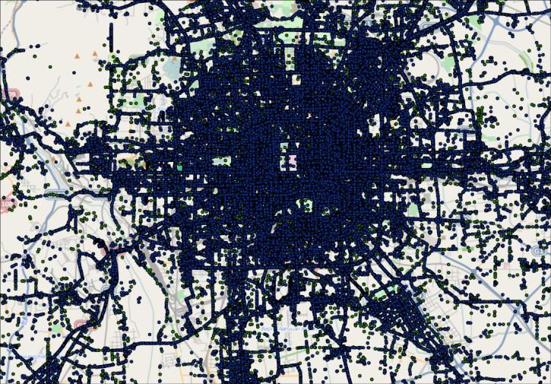
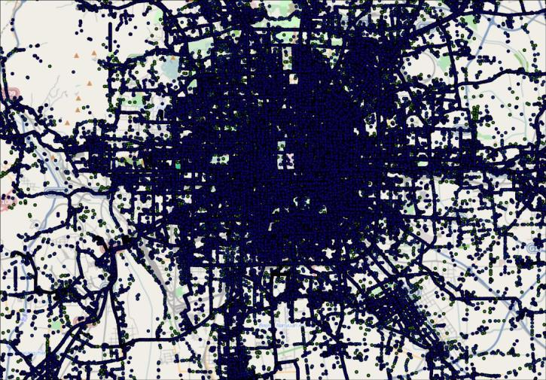


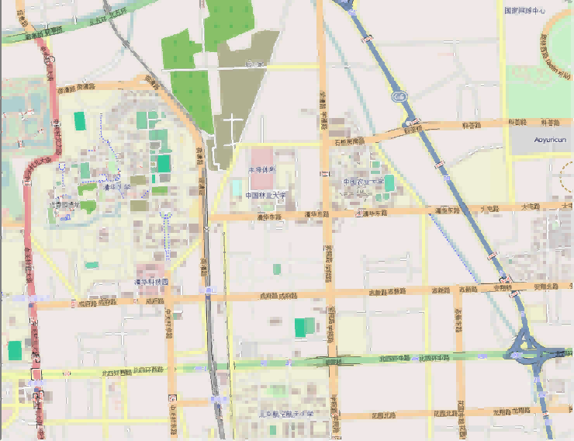
GPS tracking. What can this tell us?
The raw data: points and lines
Processing: estimating routes from points
GPS points from 10,357 taxis providing location & time
Provides 1.5 million observations over 3 days
Low sampling rate – between 1 second and 10 minutes
Unstructured data – where is the taxi between observations?

Slide 5
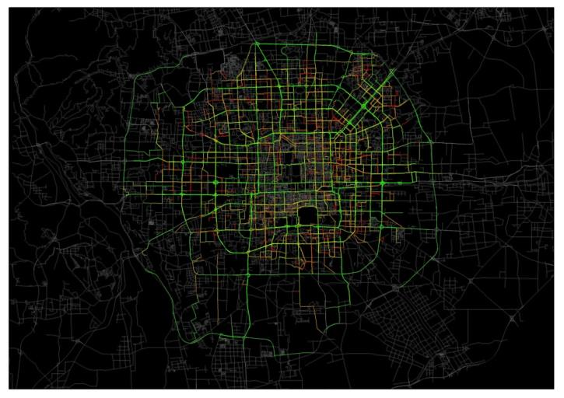
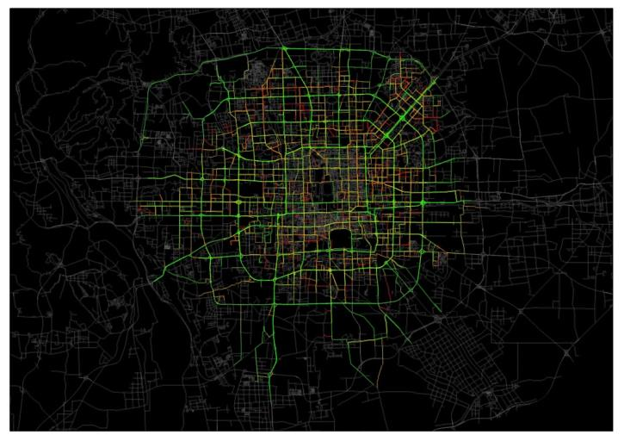
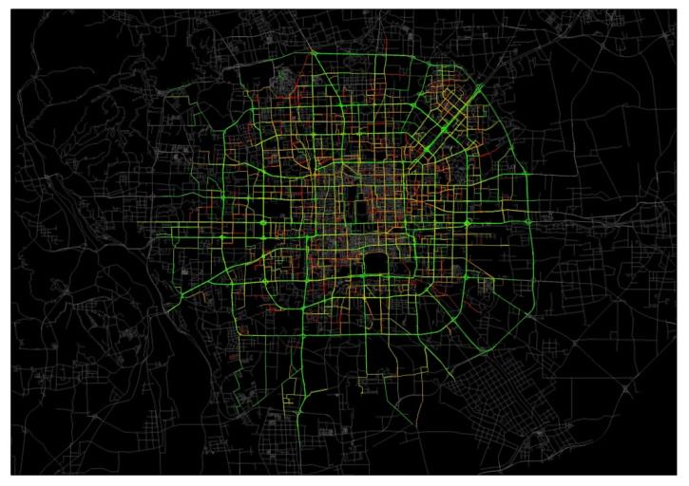
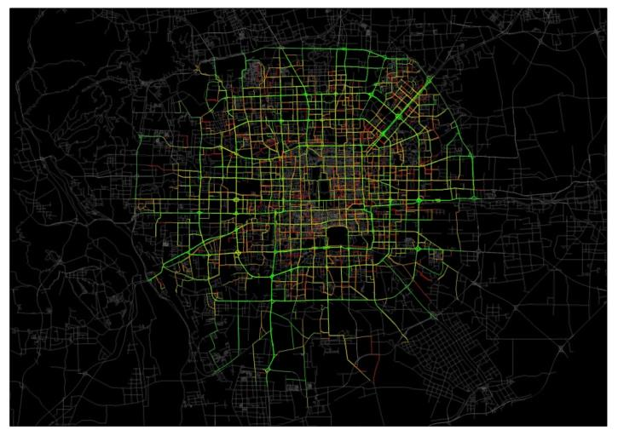
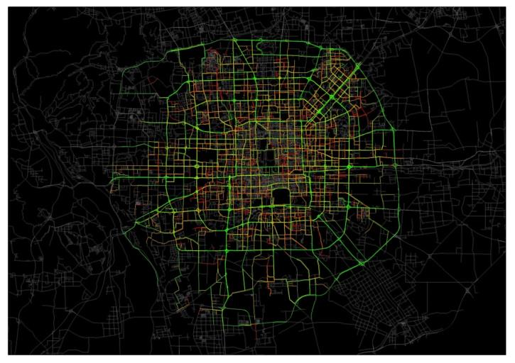
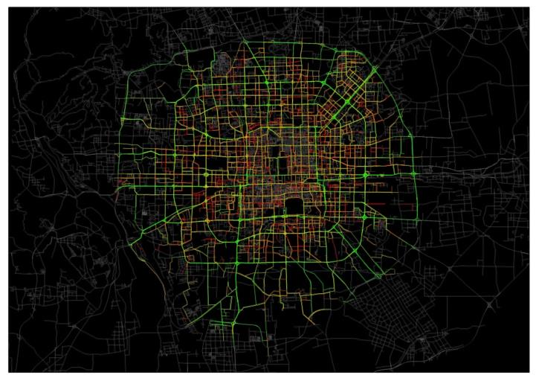
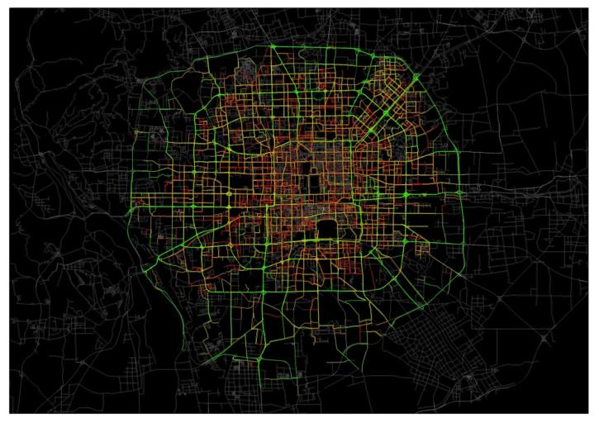
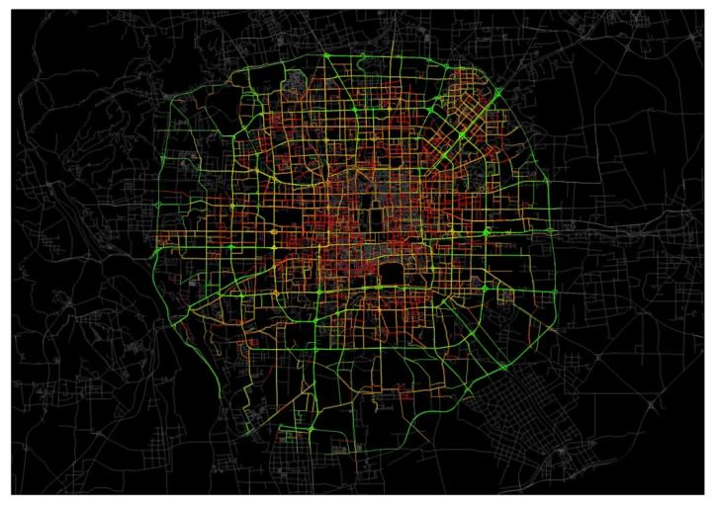
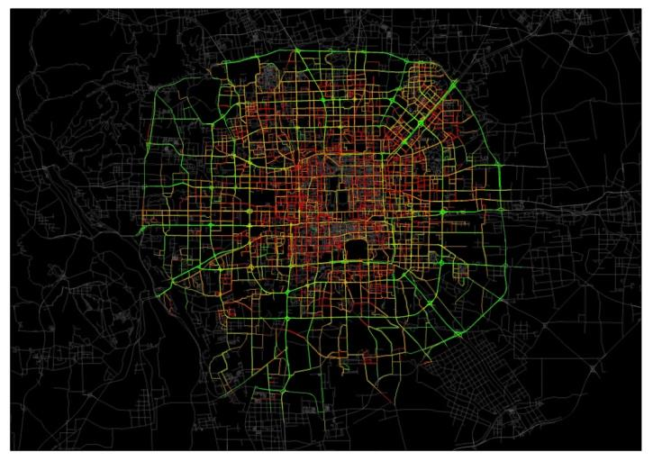
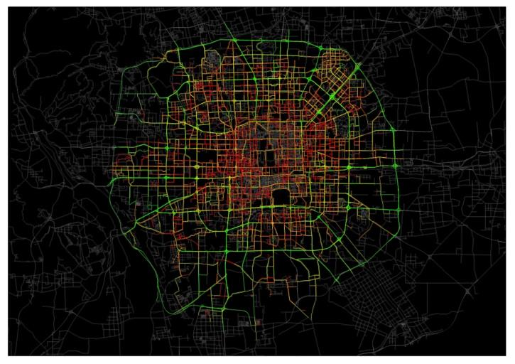
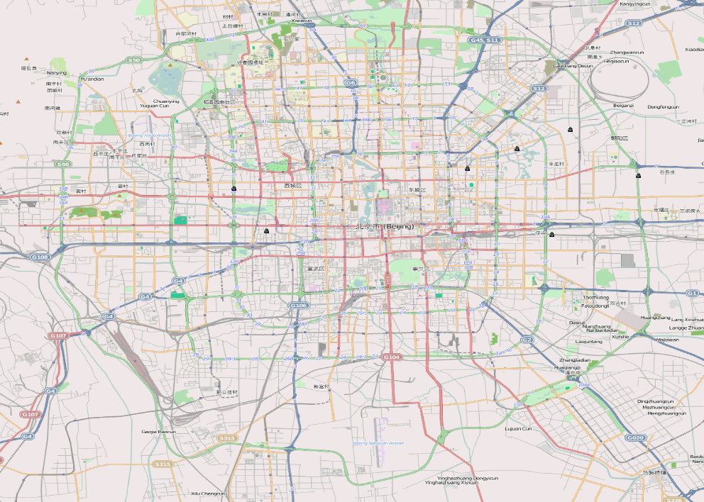
GPS tracking – deriving network speed
Traffic speed during the morning peak
Visualisation of traffic flow
10:00am
10:30am
6:00am
6:30am
7:00am
7:30am
8:00am
8:30am
9:00am
9:30am
Notes:
Can I sink timings of both videos?

Slide 6
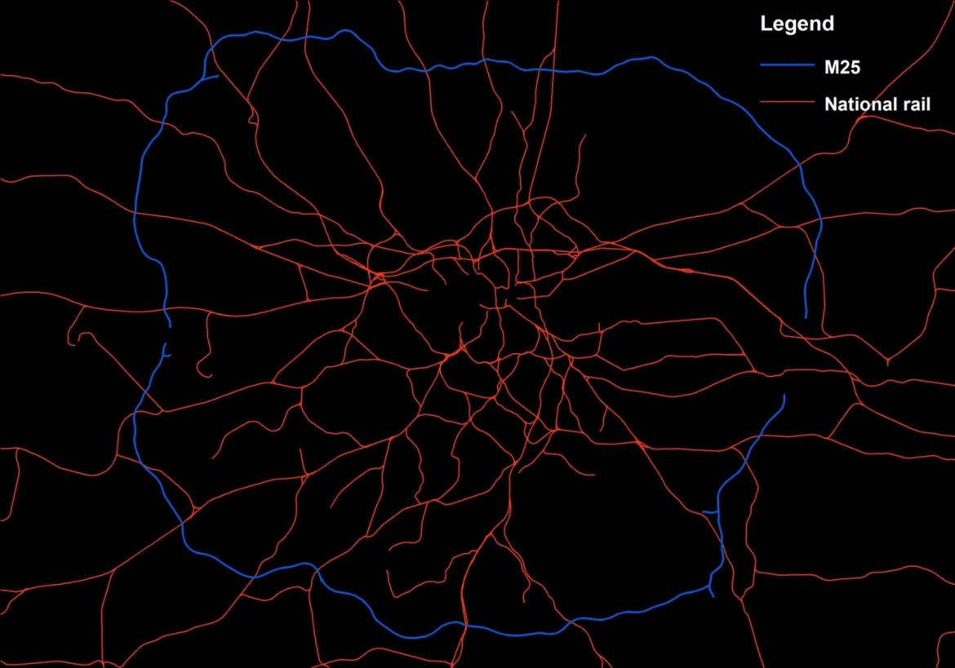
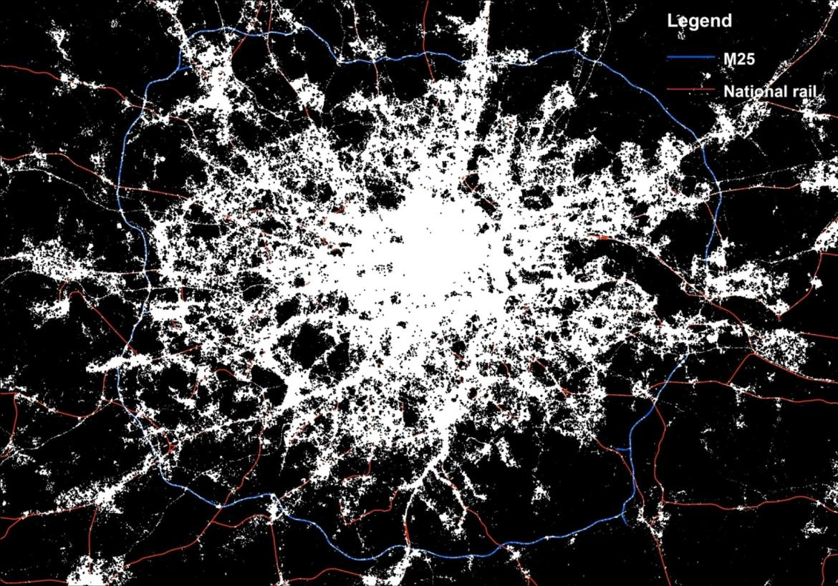
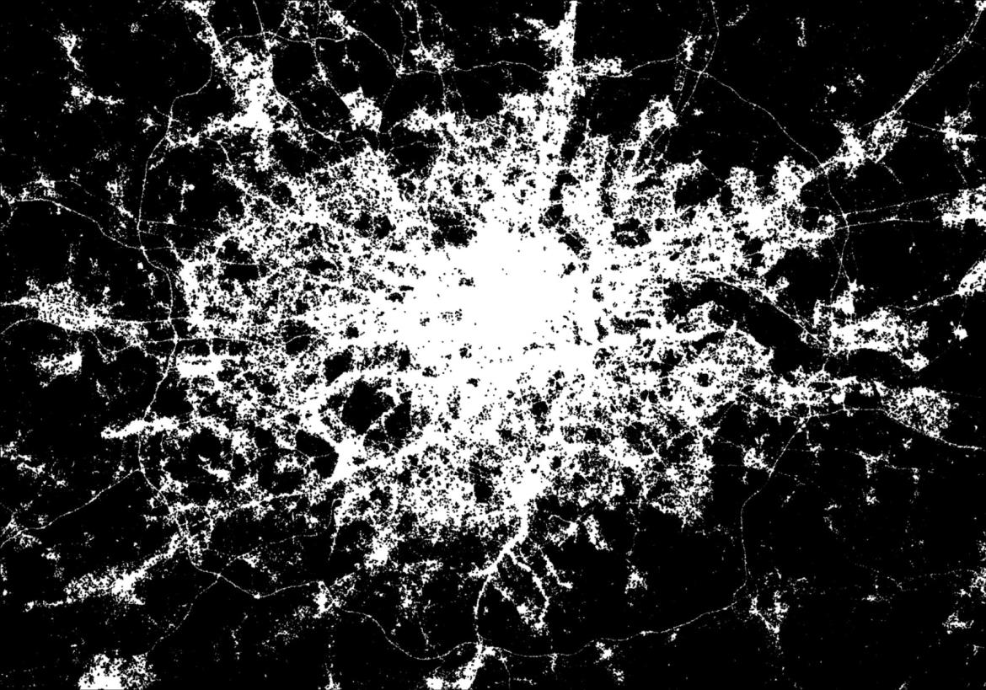
All Weekday tweets in Greater London
whitespace shows a tweet within 100m of another tweet
Road and rail networks are visible in the data!

Slide 7
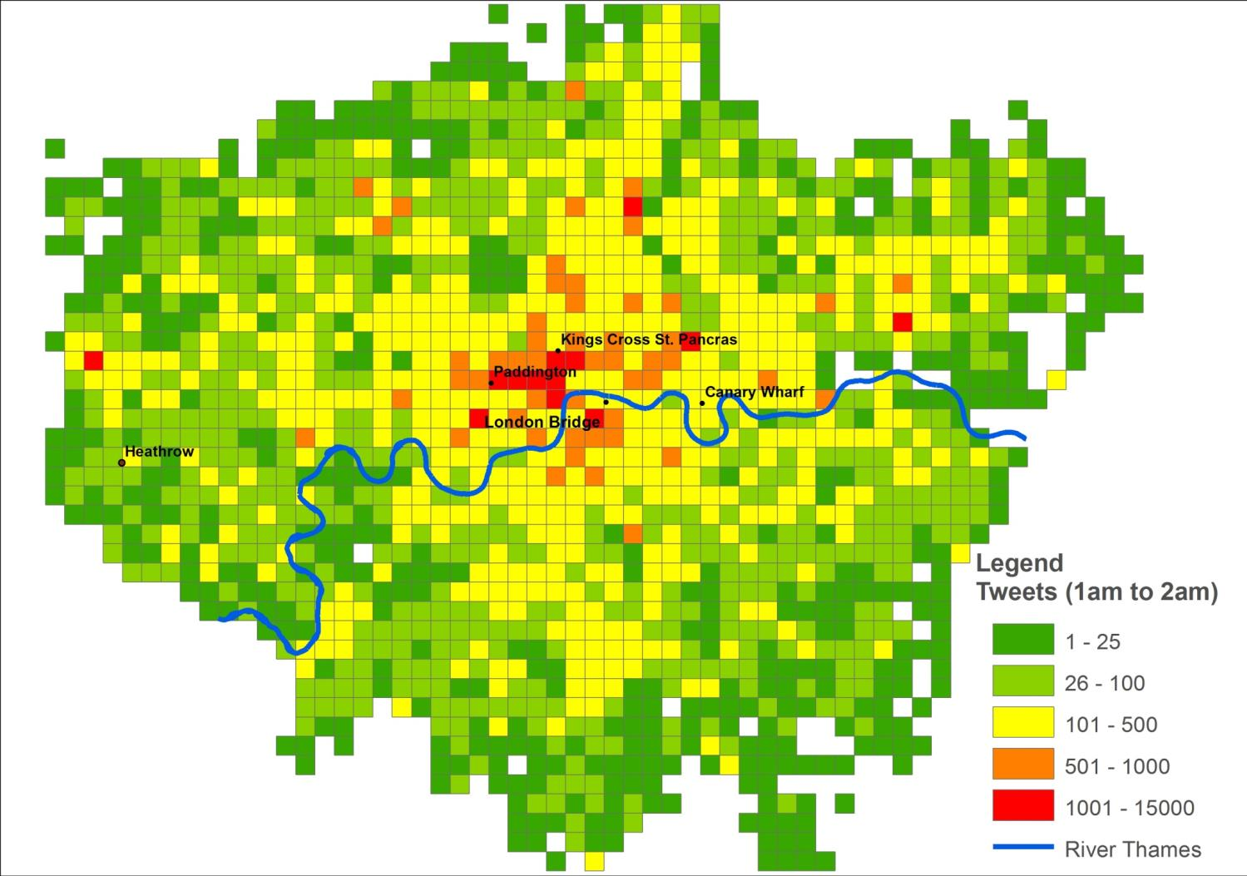
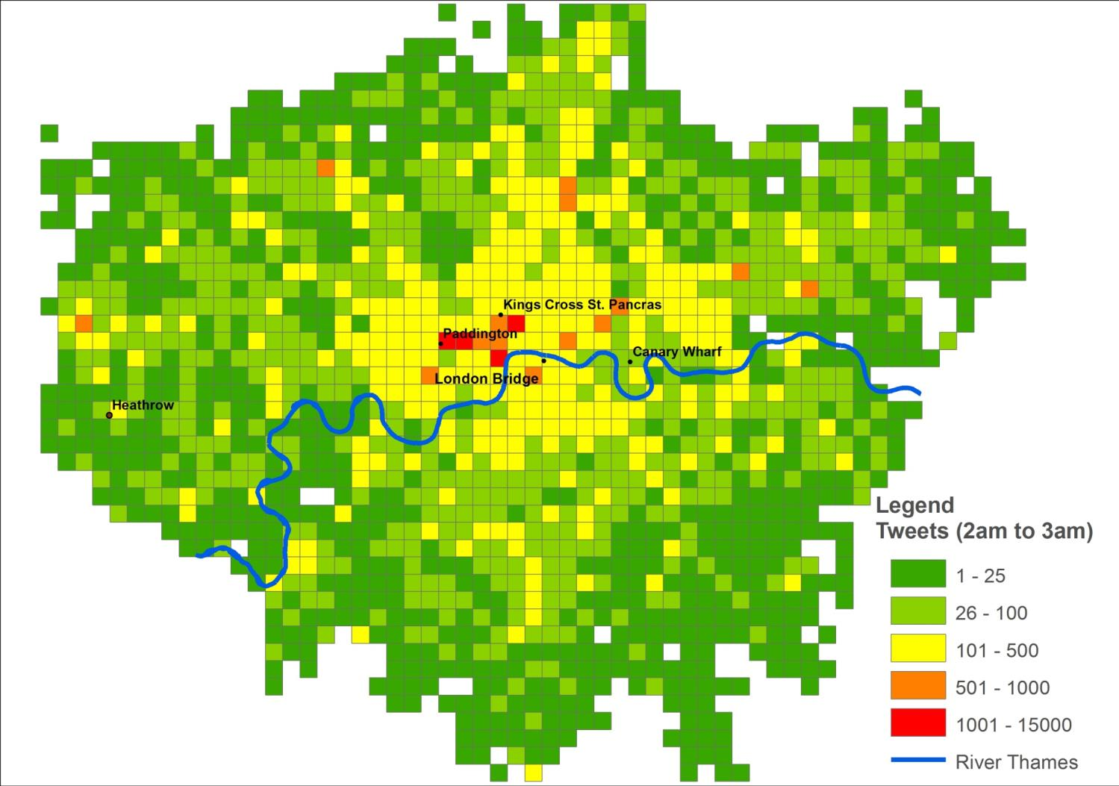
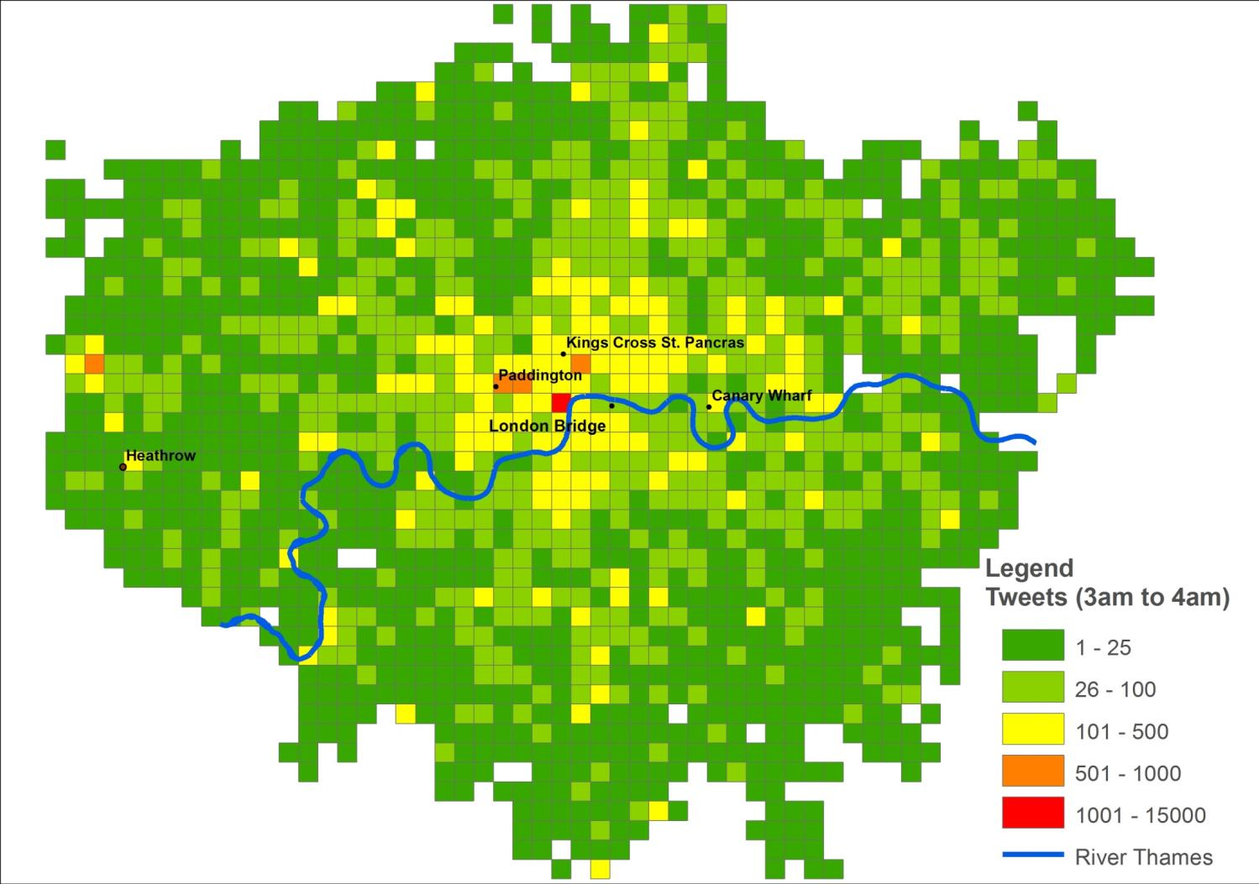
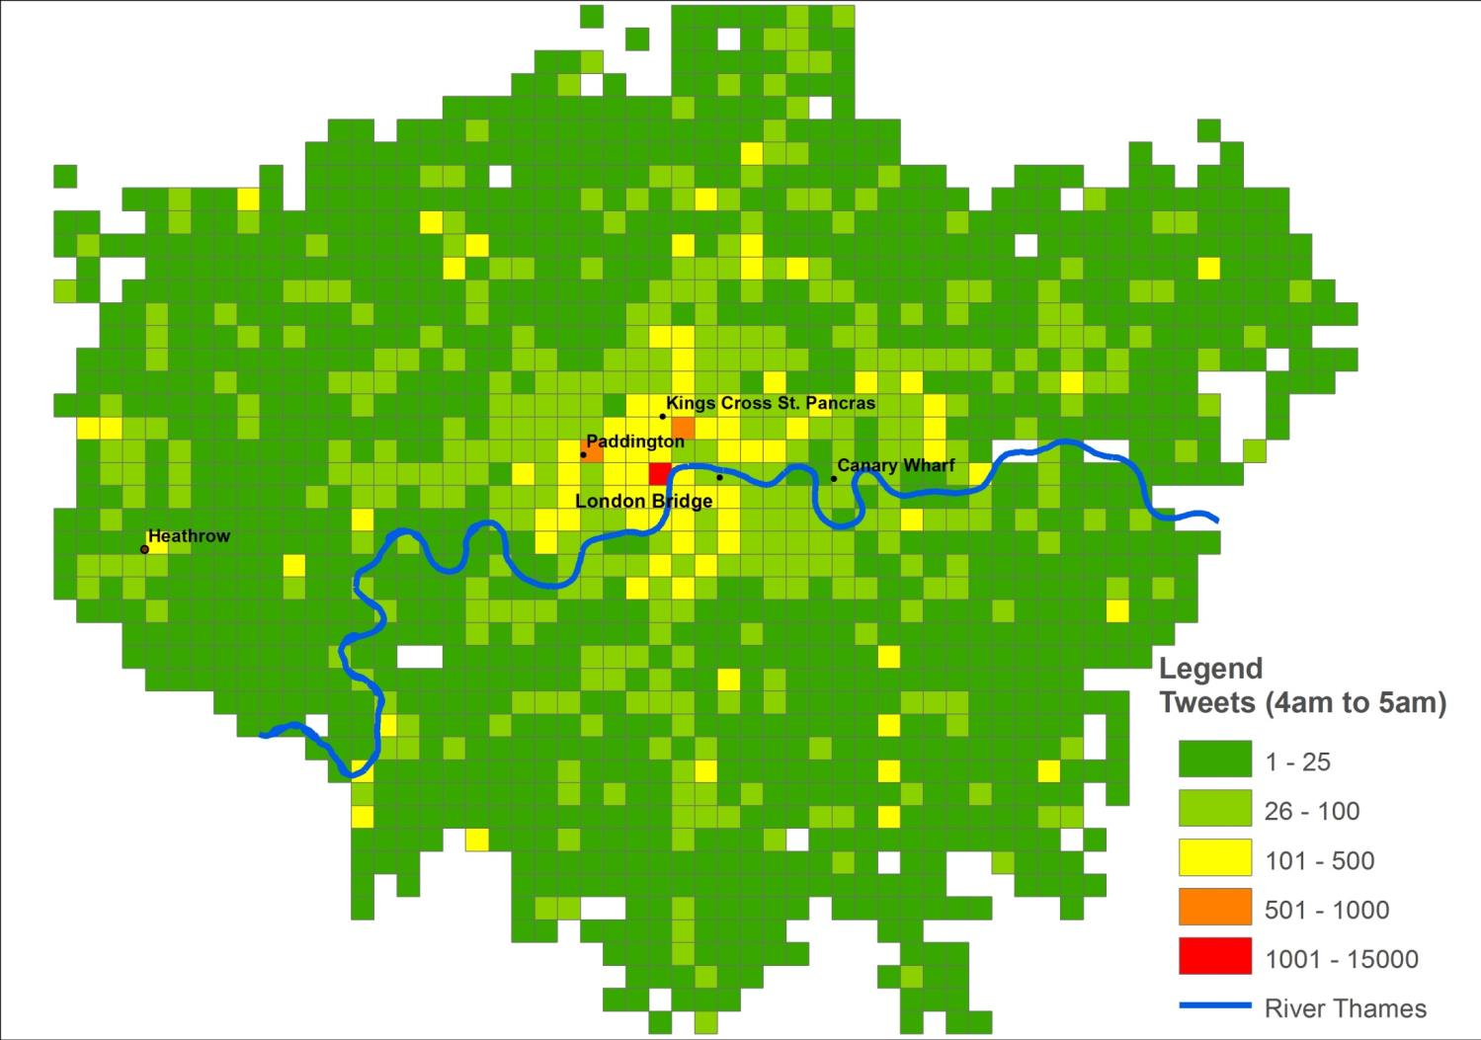

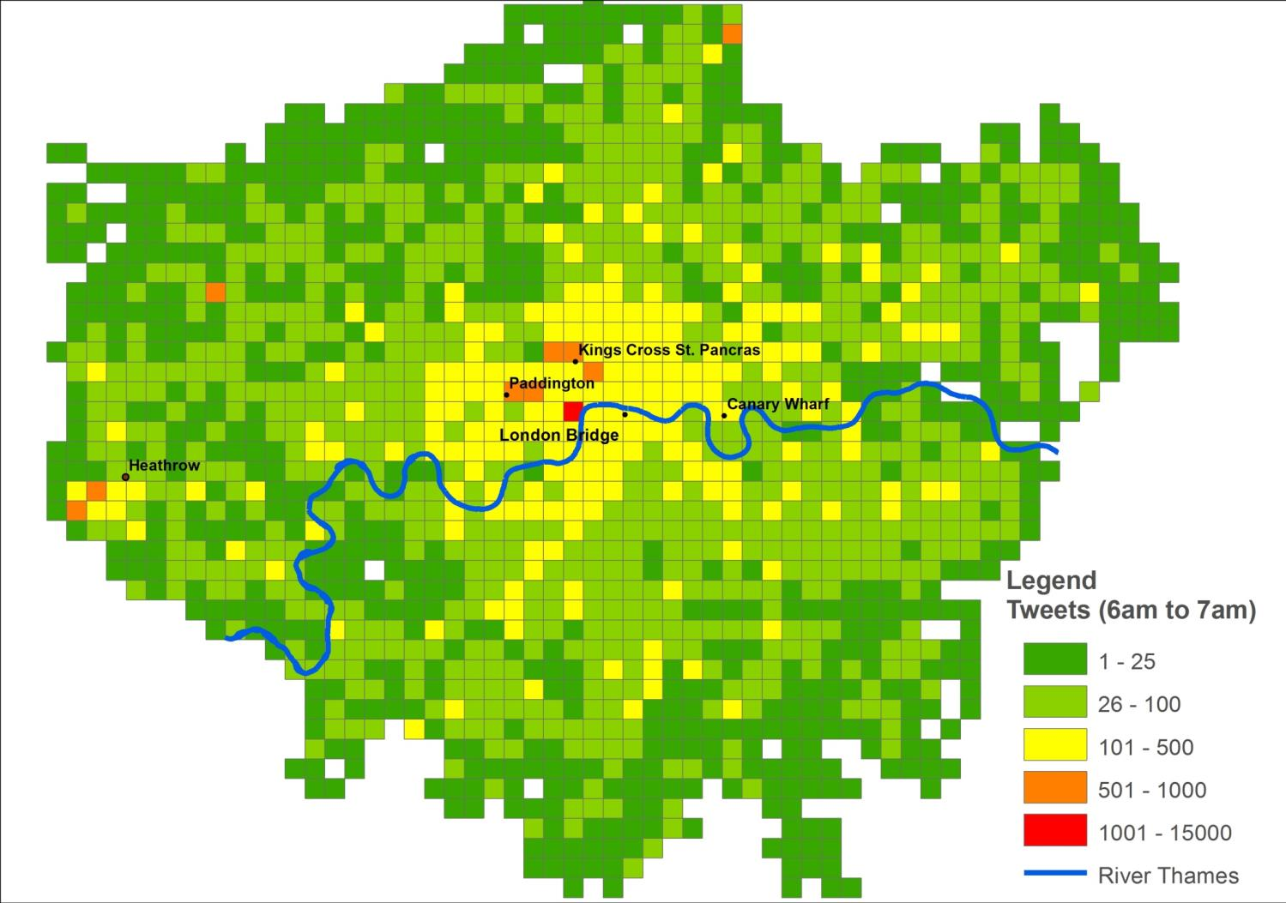
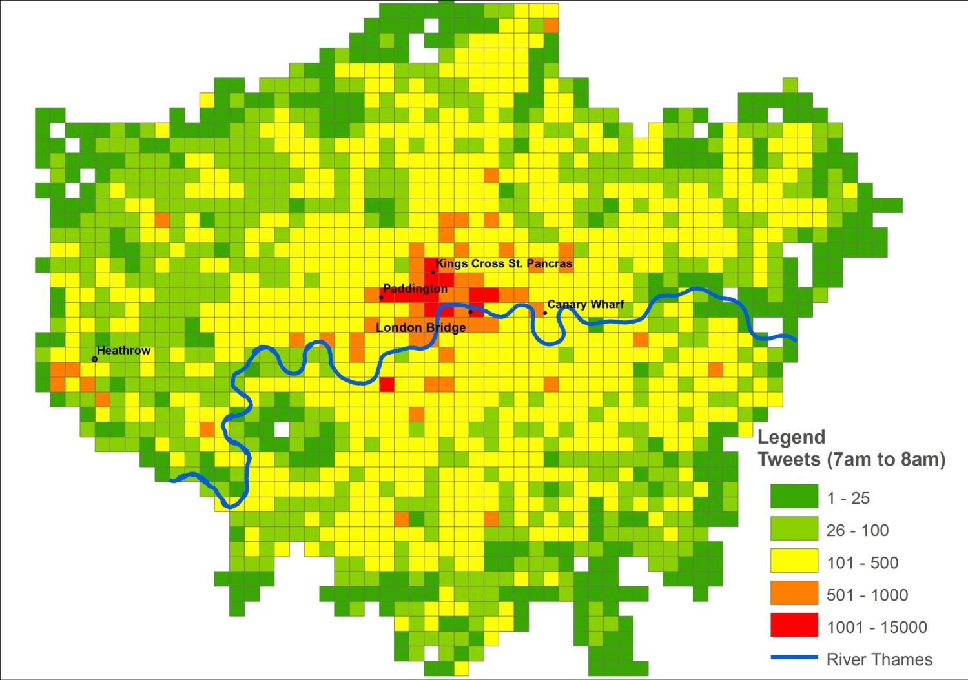
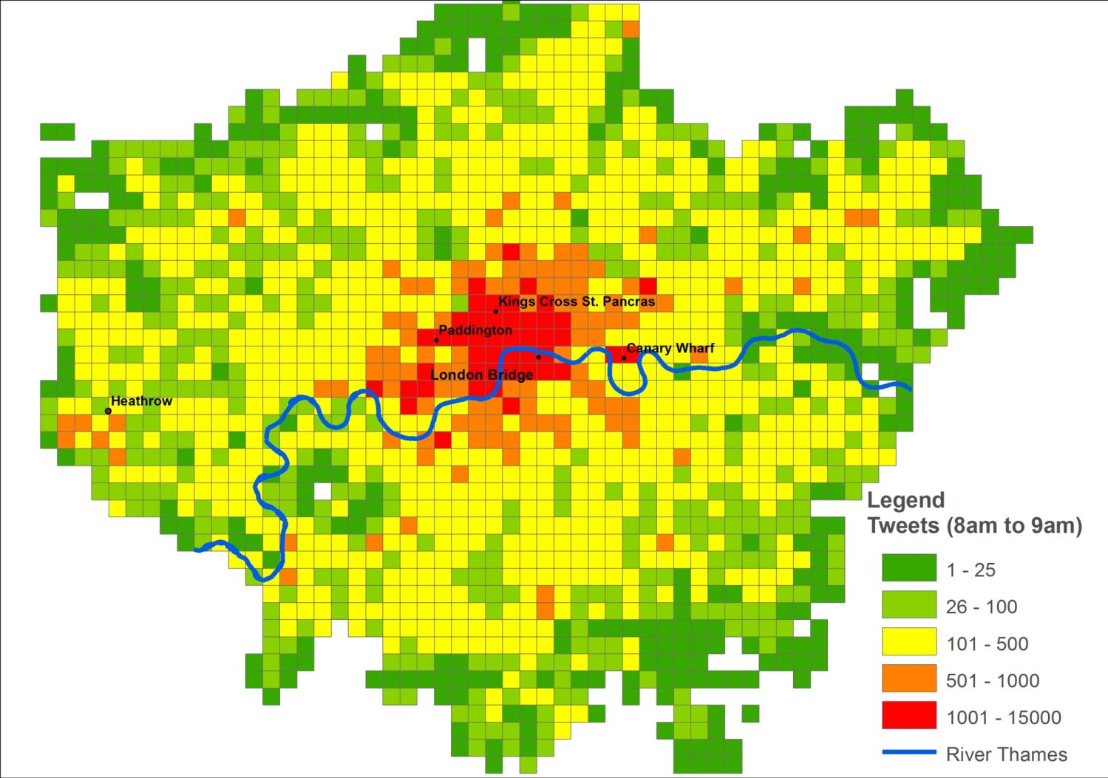
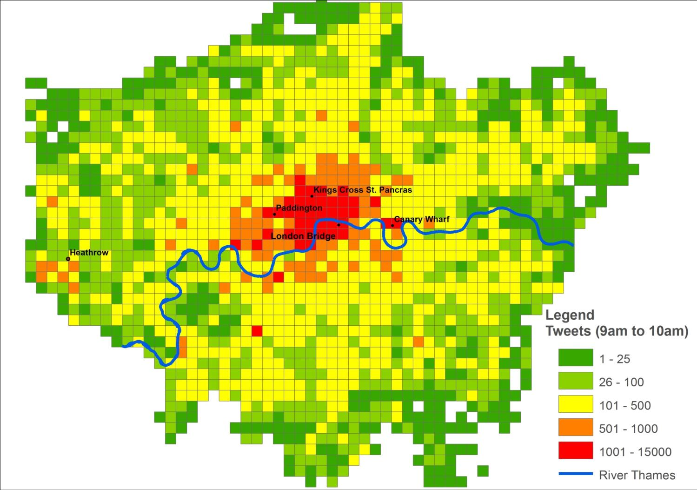



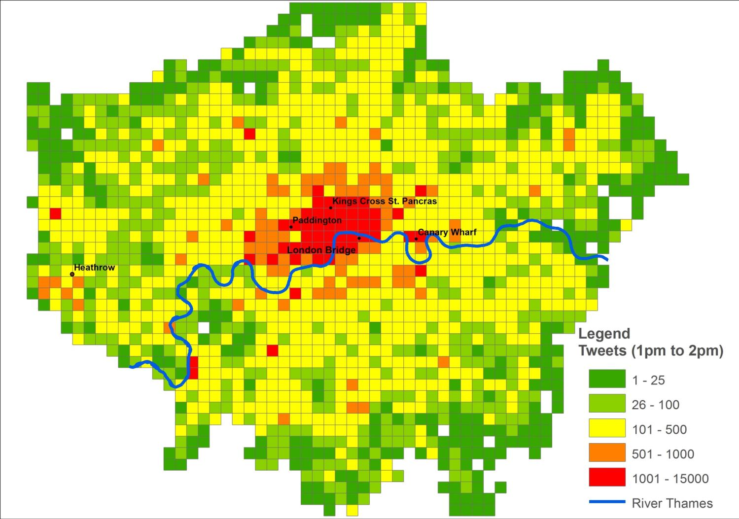


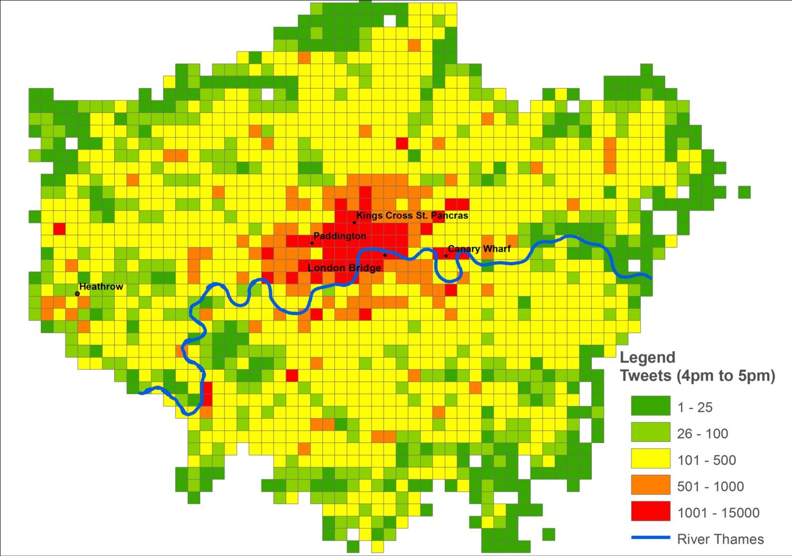
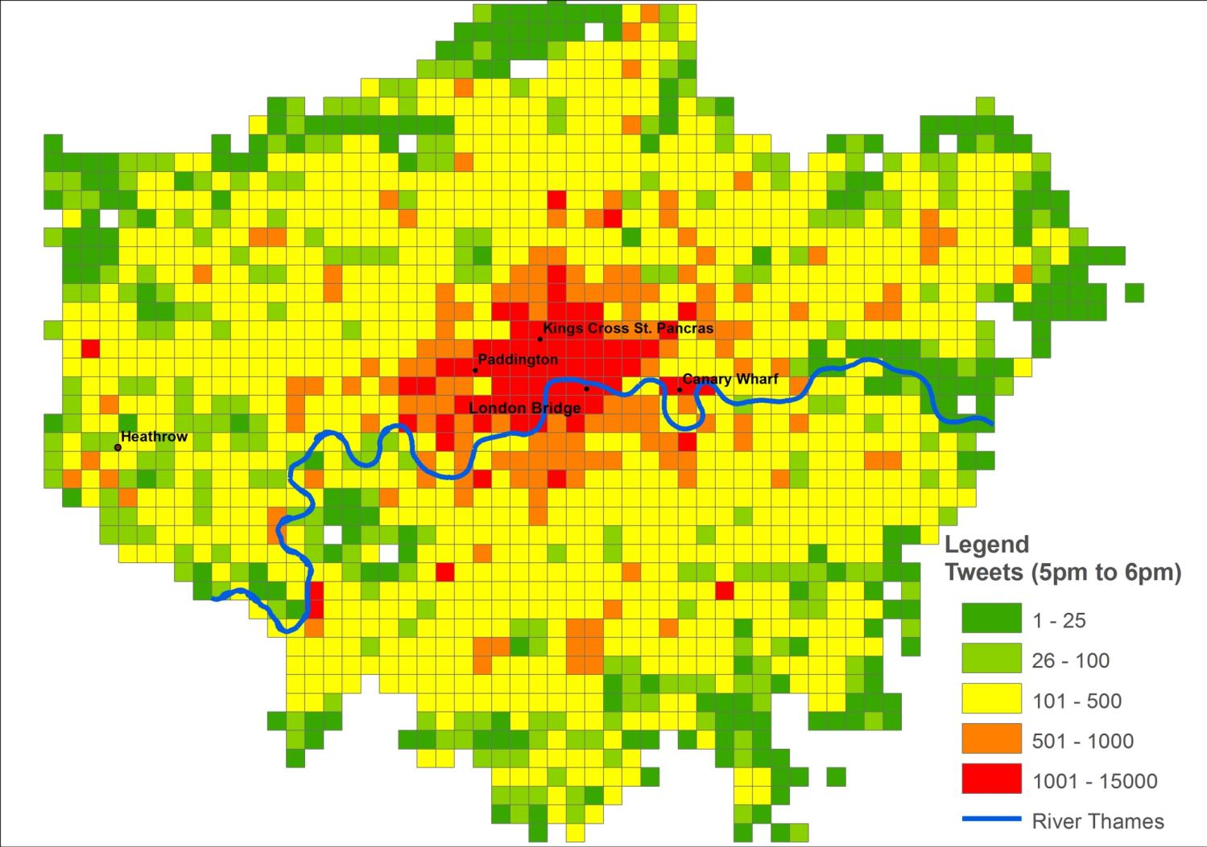
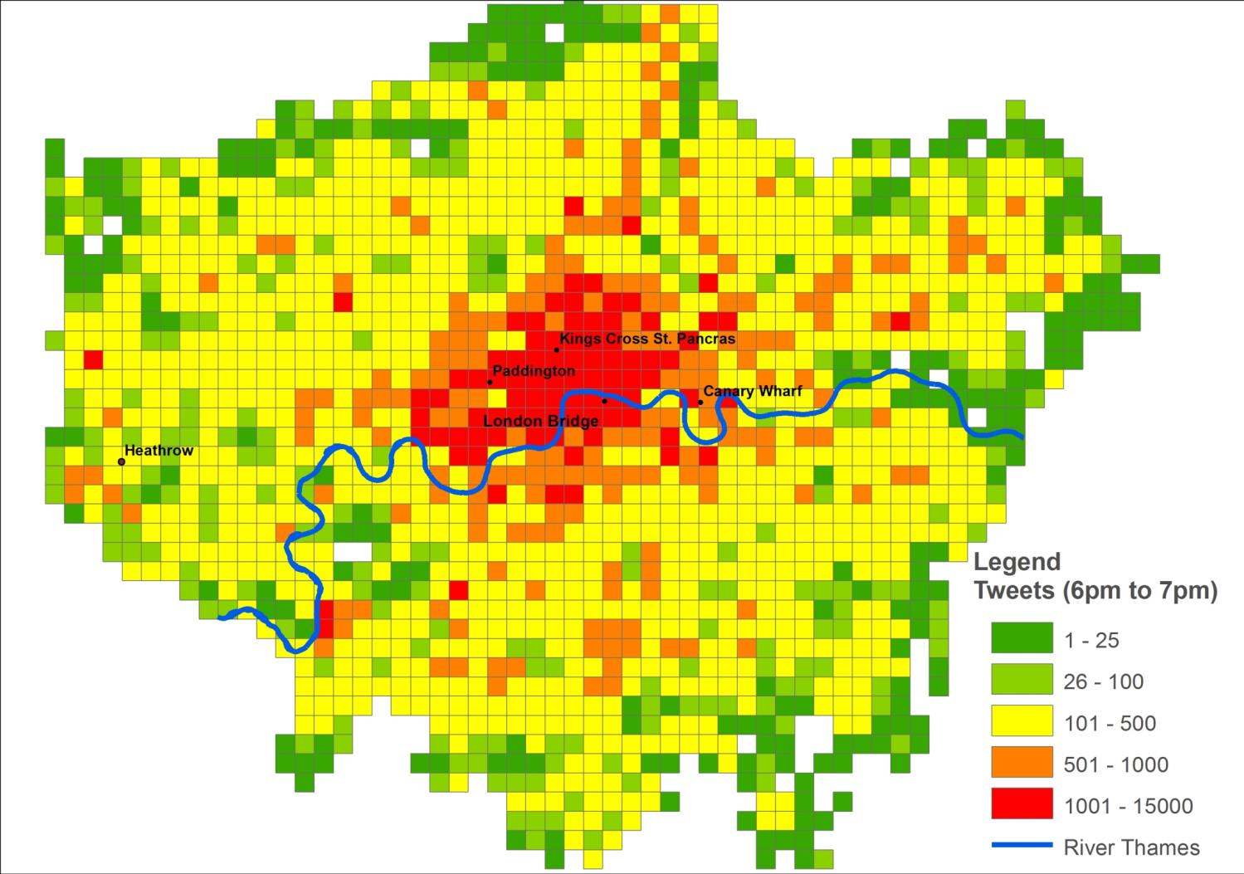
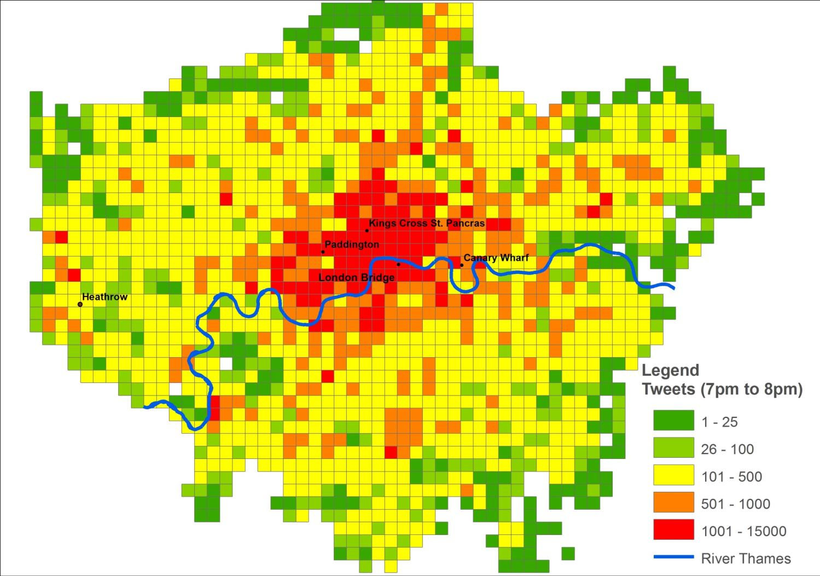
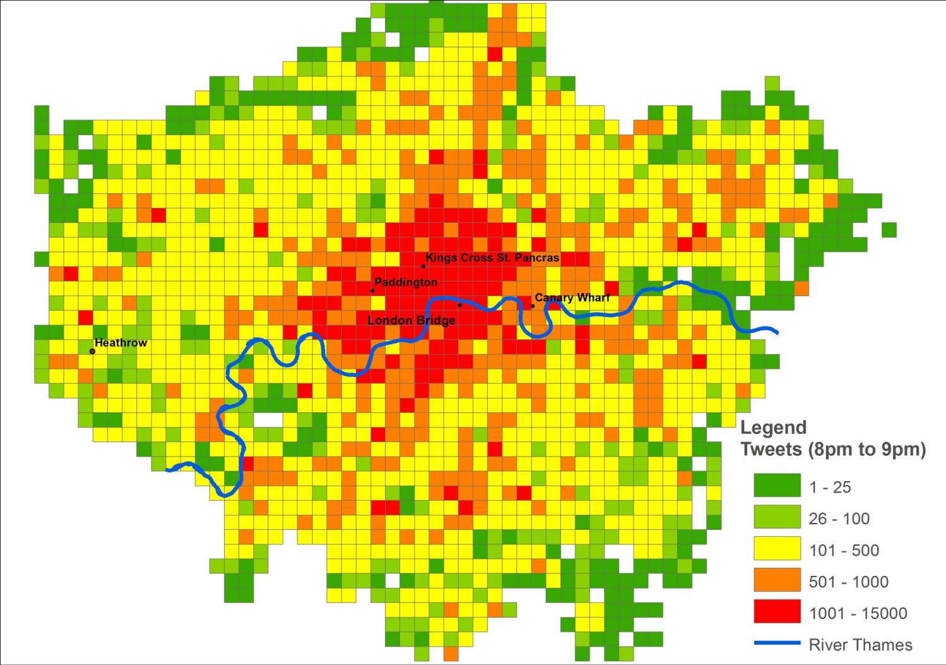
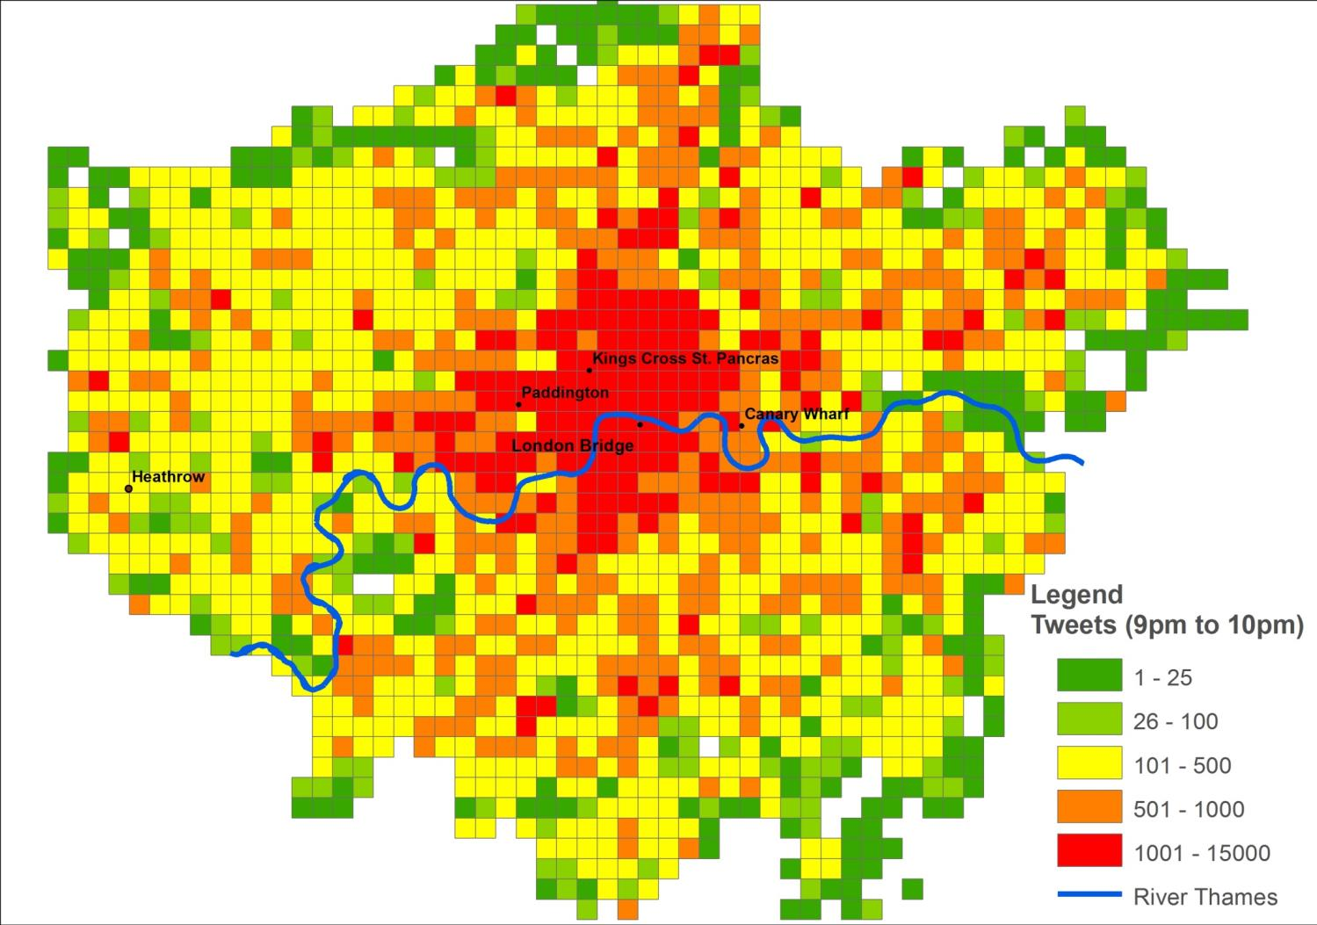
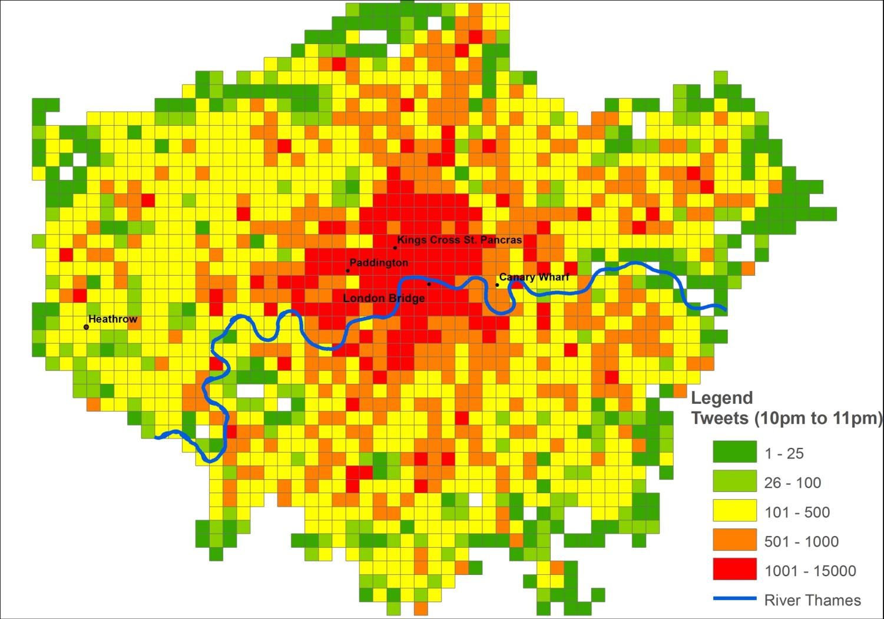
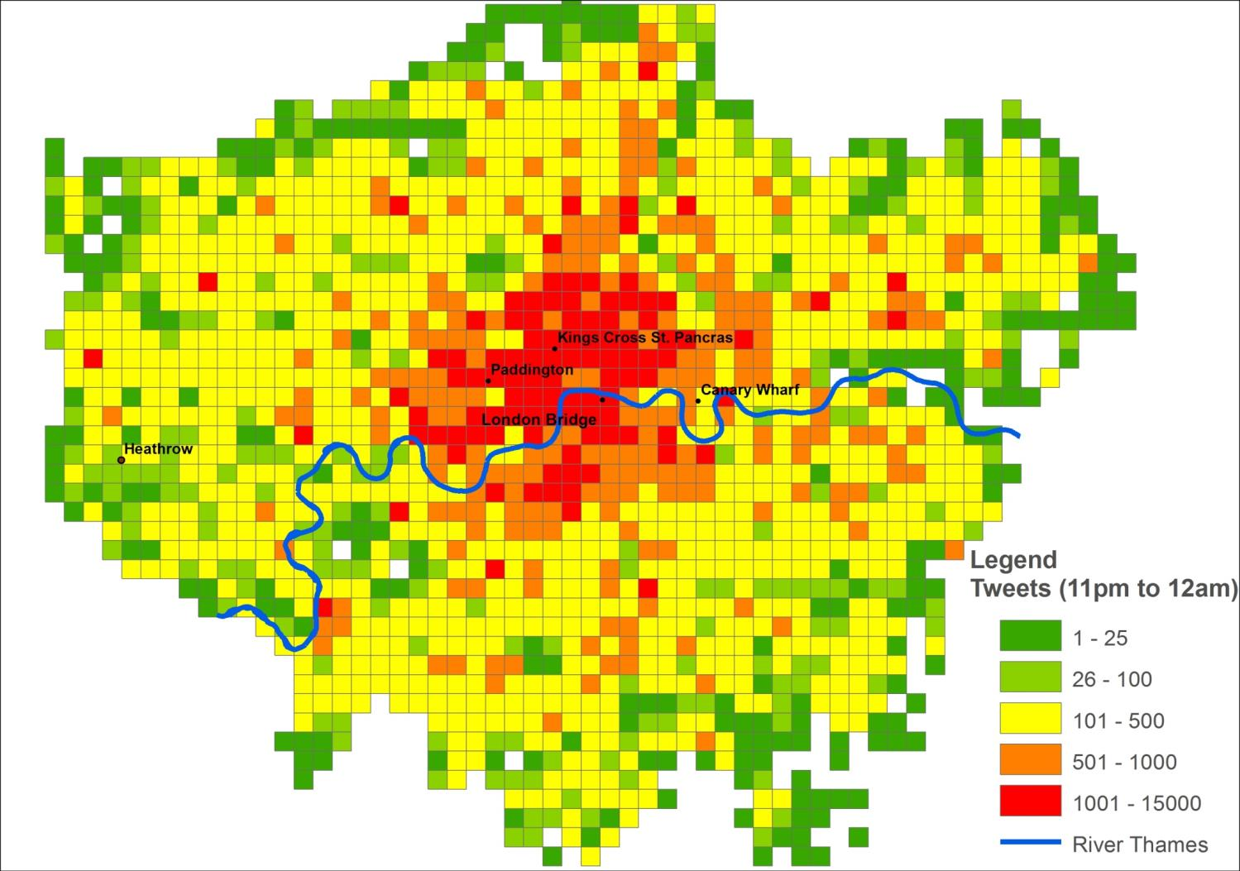
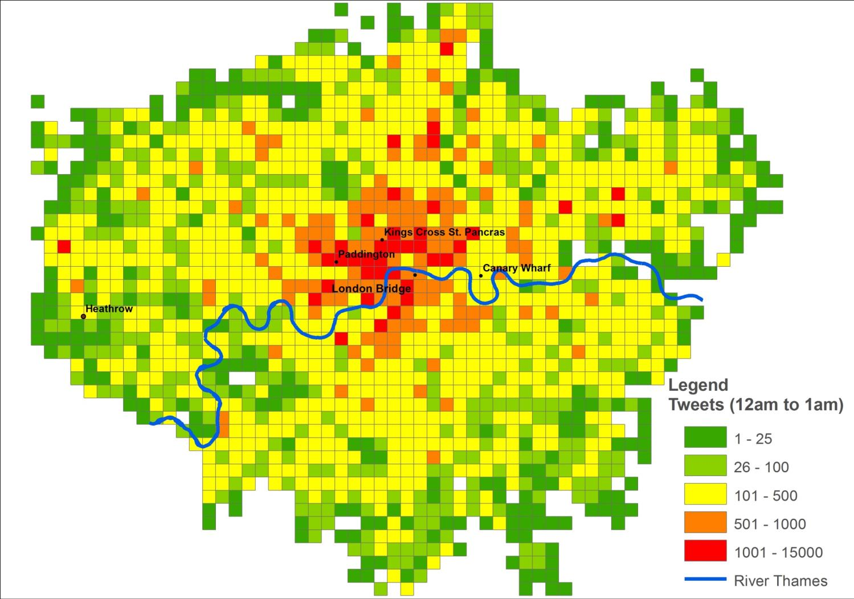
All Weekday tweets – density by 1km grid

Slide 8
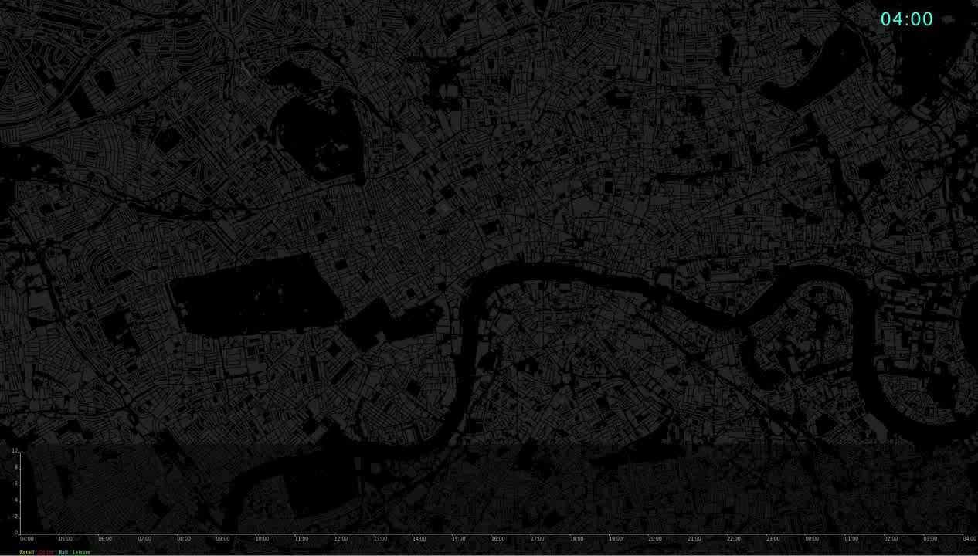
Social Media – Geo-located tweets by land use, Weekday.
Geolocated Tweets - Weekday, London (Red: Offices, Yellow: Retail, Green: Leisure, Cyan: Rail)

Slide 9
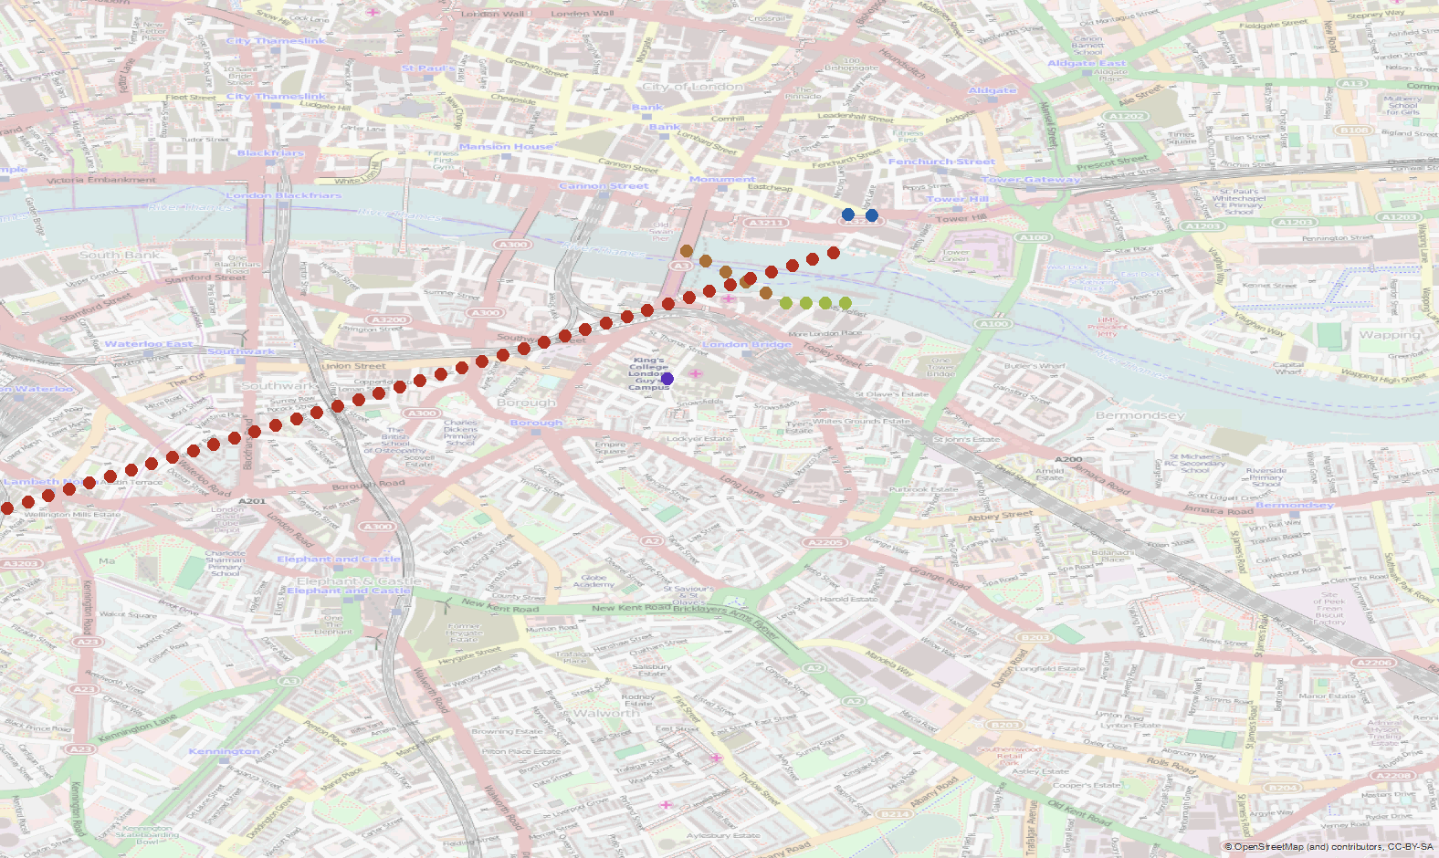
Twitter user trajectories
Tweets by users who tweet > 3 times per day more than 1km apart, within proximity to London Bridge, between 6am and 10am on a weekday. Colour denotes unique user.

Slide 10
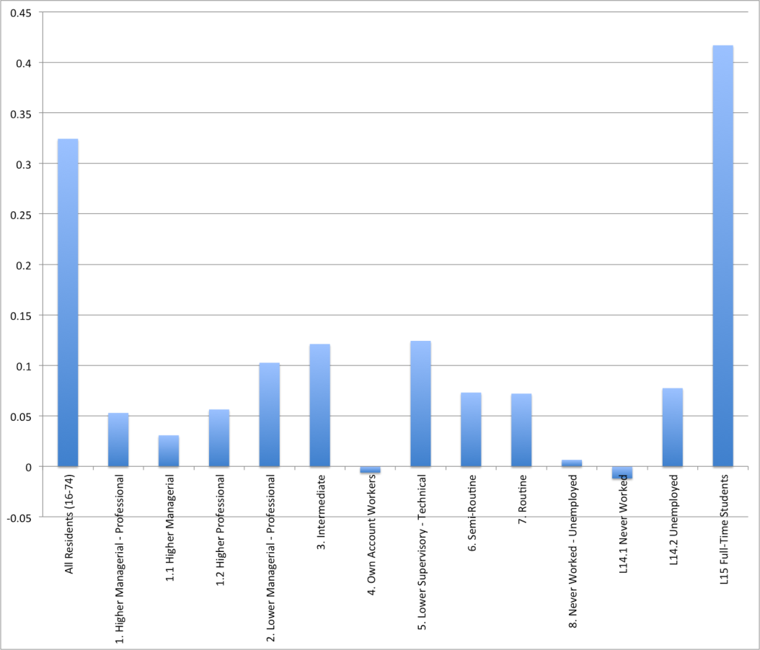
Associating twitter use with population profiles
Correlation between number of tweets and persons by Socioeconomic Class in an area (Lower Super-output Level, 2011 Census)

Slide 11
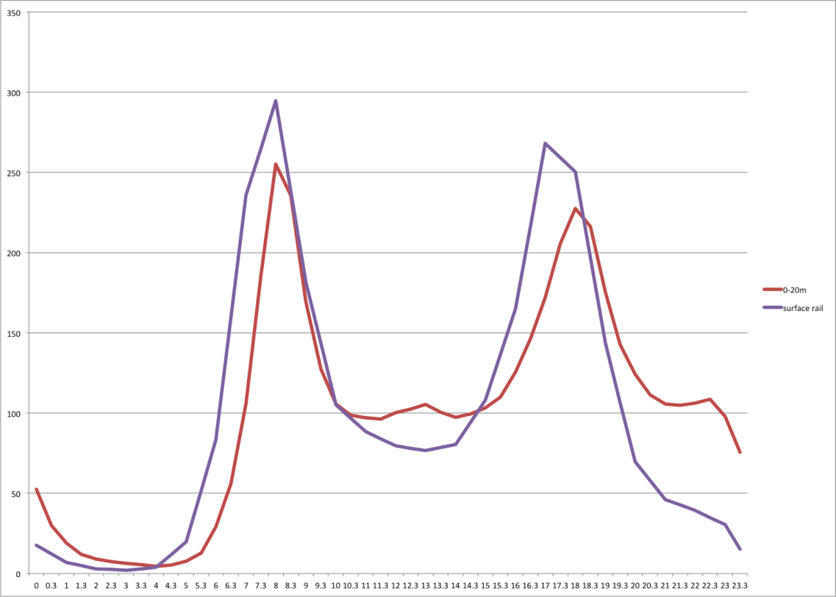
Addressing the bias: Peaks in social media activity associated with rail correlate with peaks in travel demand
Comparison between the temporal distribution of tweets associated with surface rail and respective data from the National Travel Survey (x-axis: time of day, y-axis: proportional concentration, 100 = day average)

Slide 12
To conclude
Crowd sourcing provides a new view of the city
Bias exists, but we can overcome this.
There are many more possibilities!
Who could benefit?
  Those interested in infrastructure
  Those interested in people flow
  Those interested in the interaction with people and land use – i.e. for retail planning

Slide 13

www.centreforsmartinfrastructure.com
Steve Denman
sd560@cam.ac.uk

