Slide 1




Harvesting Ambient Vibration
The Smarter Infrastructure
Yu Jia
Zeus
Thor
“May the Power be with your WSN”
Notes:
CSIC Template 2013

Slide 2
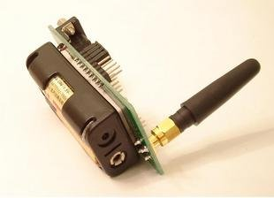
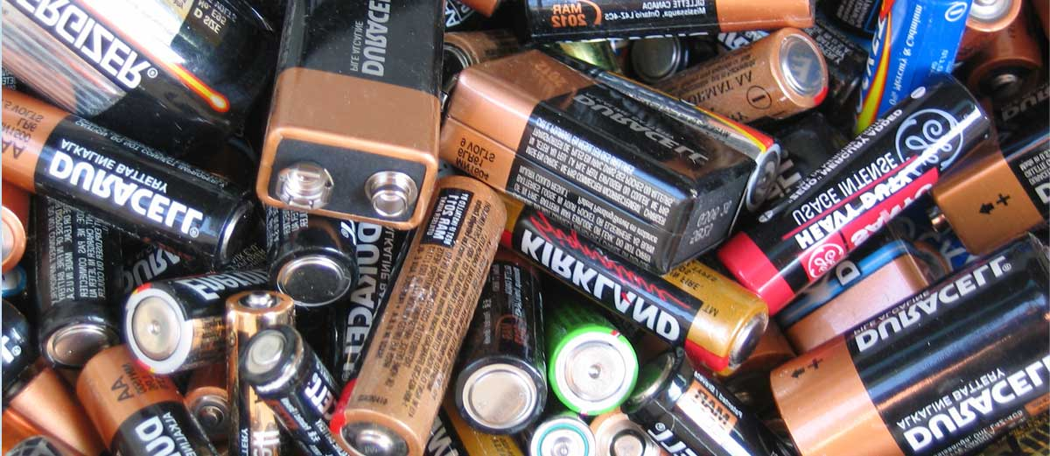
Wireless sensors – “tethered” power source
Battery power
Periodic replacement is a problem
Notes:
Wireless sensors are an important component in monitoring our infrastructure, however, battery power is a major problem. Replacement of batteries are costly and sometimes impractical for remote or embedded applications.

Slide 3
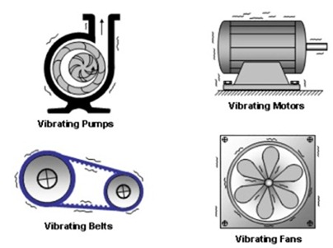



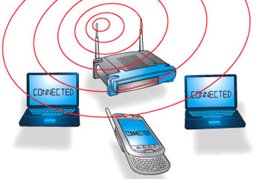




We are surrounded by an ocean of ambient energy
Human motion
Mechanical vibration
Acoustic
Radio frequency (e.g. 3G, WiFi)
Thermal
Light
Airflow

Slide 4
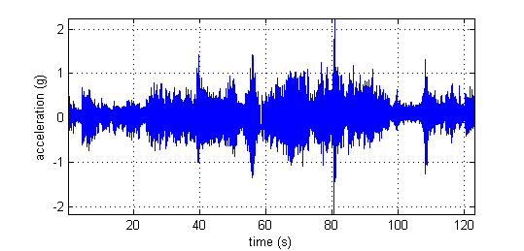


Harvesting ambient energy
Ambient energy (e.g. vibration)
Energy harvester
Electrical power

Slide 5
Harvesting ambient energy… but…
Ambient energy (e.g. vibration)
Energy harvester
Electrical power
Variable
Not efficient enough
Too high power requirement

Slide 6
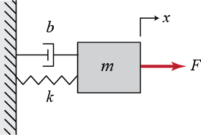
Existing vibration energy harvesting
Ambient energy (e.g. vibration)
Energy harvester
Electrical power
Directly
excited
Resonance
Mass-spring-damper

Slide 7
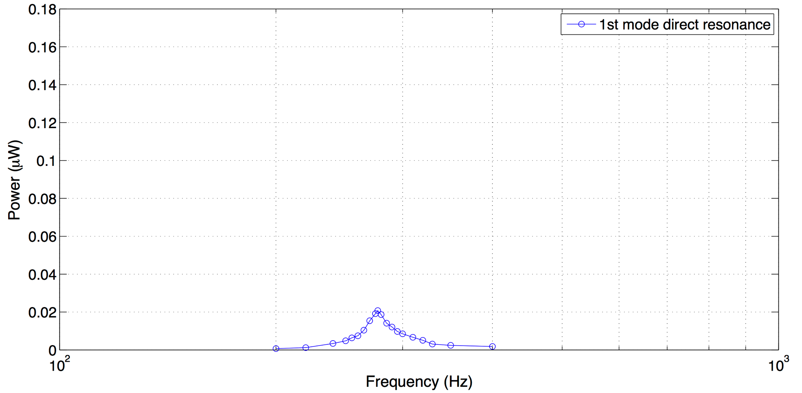
Resonance: the conventional approach
Direct resonance at room pressure
Peak power – barely enough
Frequency bandwidth – narrow

Slide 8
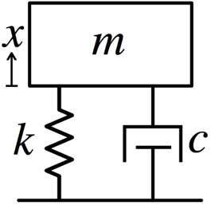
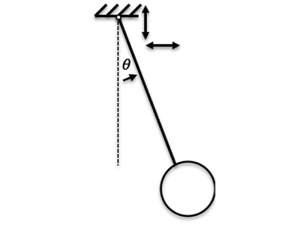
Parametric resonance: our approach
Direct forcing
Parametric
Parametric
Direct forcing
A fundamentally different approach in the physics

Slide 9

Able to accumulate significantly more mechanical energy
Parametric
at 2fn
Direct
at fn

Slide 10
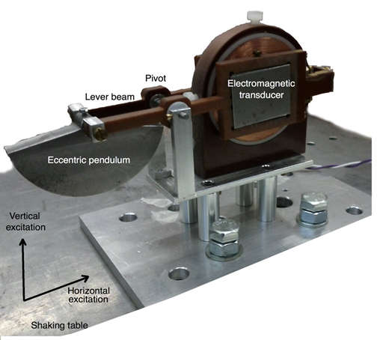
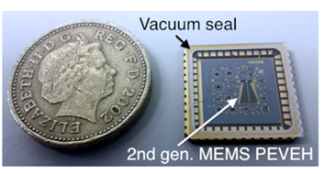
Prototypes: macro and MEMS
Macro
MEMS chip
Electromagnetic
Piezoelectric
Electrostatic
~ size of
laptop power adapter

Slide 11
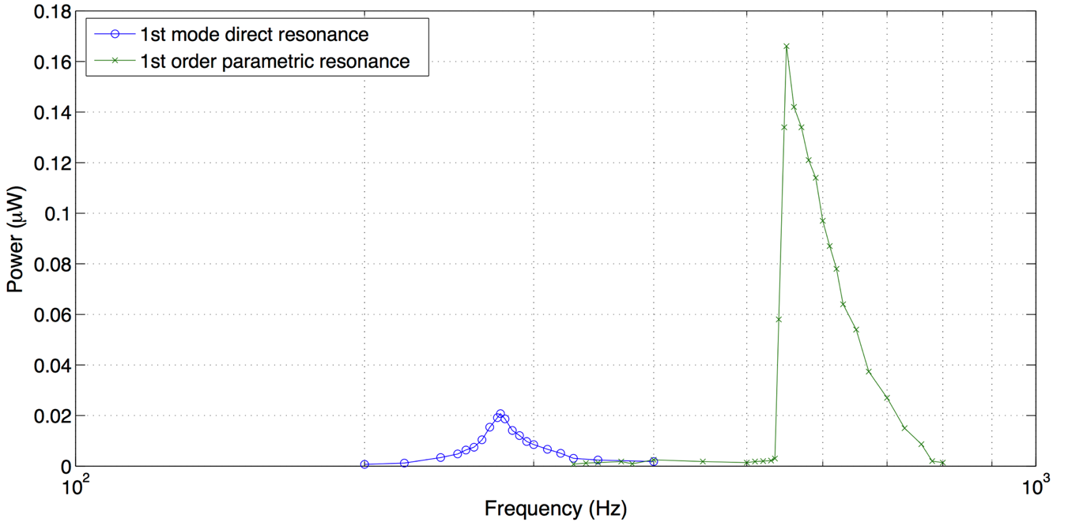
An order of magnitude better in power
166 nW
1st order parametric resonance
Direct resonance at room pressure
20.8 nW

Slide 12


In a nut shell…
Conventional harvester
Ambient energy (e.g. vibration)
Electrical power
Our invention
Giving your WSN,
more power.

Slide 13

www.centreforsmartinfrastructure.com
MEMS and Energy harvesting:
Dr Yu Jia yj252@cam.ac.uk
Dr Ashwin Seshia aas41@cam.ac.uk

